Slide 1
Psychology: Memory

Slide 2
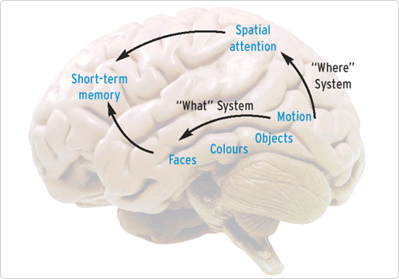
Memory
Memory: A system that encodes, stores and retrieves information.
While we are learning more about memory every day, psychologists still are unsure exactly what parts of the brain are involved and where it is all stored.

Slide 3
Memory’s Three Basic Tasks
According to the information-processing model, the human brain takes essentially meaningless information and turns it into meaningful patterns.
It does this through three steps:
Encoding
Storage
Retrieval

Slide 4
3 Basic parts: encoding
Encoding: the modification of information to fit the preferred format for the memory system.
In most cases, encoding is automatic and happens without our awareness. Other encoding, however, like these notes, require extra encoding effort called elaboration to make the memory useful.

Slide 5
Encoding-3 types
When we are exposed to stimuli and encode information, we do it in three ways:
Semantic Encoding
encoding of meaning
including meaning of words
Acoustic Encoding
encoding of sound
especially sound of words
Visual Encoding
encoding of picture images

Slide 6
Let’s Try Ebbinghaus’s Experiment
Directions: Quickly read aloud, 8 times over, the following lists…
JIH
BAZ
FUB
YOX
SUJ
XIR
DAX
LEQ
VUM
PID
KEL
WAV
TUV
ZOF
GEK
HIW

Slide 7
Encoding
The more time we spend learning novel information, the more we remember.
Time in minutes
taken to relearn
list on day 2
20
15
10
5
Using 16 unrelated 3 letter sequences
0
8
16
24
32
42
53
64
Number of repetitions of list on day 1

Slide 8
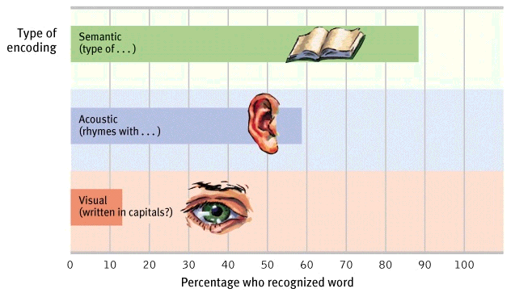
Encoding-Levels of Processing
Processing a word by its meaning (semantic encoding) produces better recognition of it lat a later time.

Slide 9
3 basic parts: storage
Storage: the retention of encoding material over time.
In terms of storing material, we have three stages of memory
Sensory Memory
Working Memory (short-term memory)
Long-term Memory

Slide 10
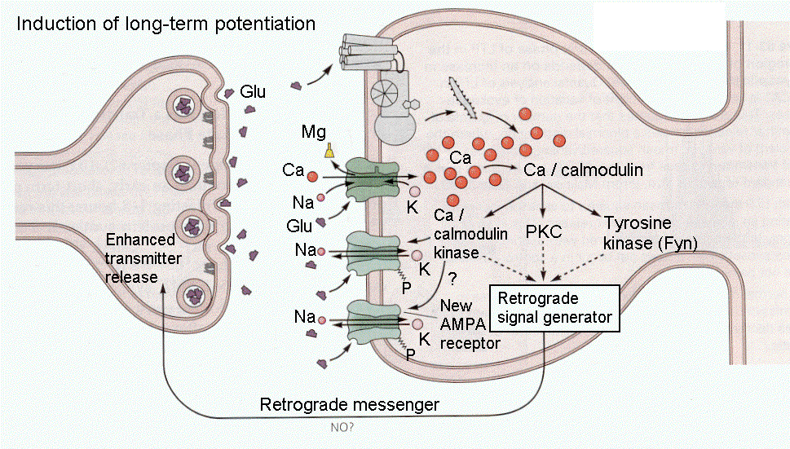
Synaptic Changes and storage
One physical change in the brain during memory storage is in the synapses.
Memories begin as impulses whizzing through the brain circuits, leaving a semi-permanent trace.
The more a memory is utilized, the more potential strength that neuron has, called long-term potentiation.
Neural basis for learning and remembering associations
This stuff gets super complicated…keep it simple for now

Slide 11
Strengthening Ltp
Research suggests that the best way to remember things is to study them and then sleep!
Once LTP has occurred, even passing an electrical current through the brain will not erase well stored memories.
More recent memories will be be wiped out
People who have a concussion and cannot remember what happened just before or after the injury have not had a chance to “consolidate” their memories to the long-term

Slide 12
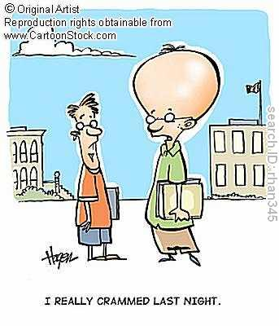
CrDoes cramming work?
People who cram do remember information for a test they study for
*if the test is immediate
Cramming does not work as well as distributed studying- hence the spacing effect
12

Slide 13
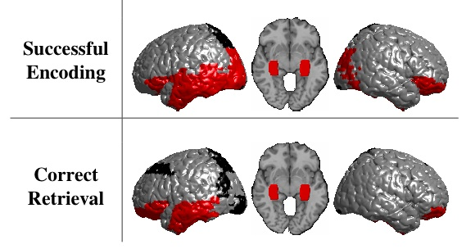
3 basic parts: retrieval
Retrieval: The locating and recovering of information from memory.
While some memories return to us in a split second, other seemed to be hidden deeper, and still others are never “recovered” correctly.

Slide 14
3 stages of memory
We encode information and store it in one of three types of memory, depending on what we need the information for.
Our memory works like an assembly line, and before information can make it to our long-term memory, it must first pass through sensory memory and working memory.
Attention to important
or novel information
Sensory input
External
events
Sensory
memory
Short-term
memory
Encoding
Long-term
memory
Encoding
Retrieving

Slide 15
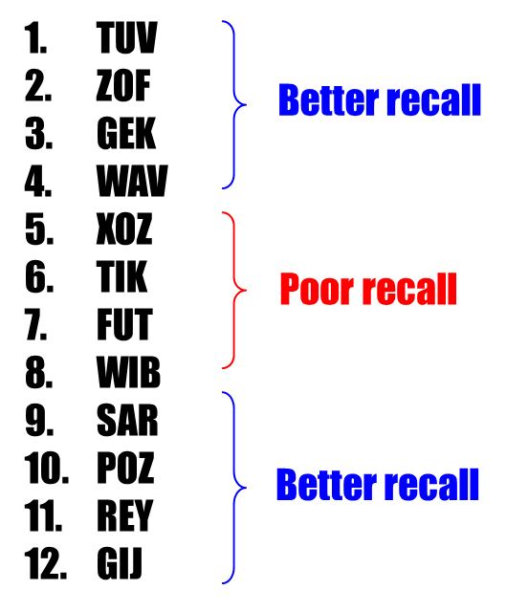
Serial Position Effect: When your recall is better for first and last items on a list, but poor for middle items.
15

Slide 16
Name as many of the U.S. Presidents as you can on your paper

Slide 17
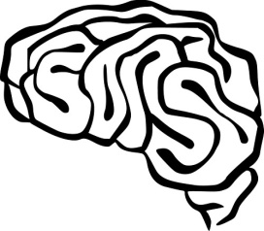
Retrieval problems
Anterograde amnesia
Retrograde amnesia
Decay theory
Proactive and retroactive interference
Memory construction errors
misinformation effect
eyewitness testimonies
source amnesia
Information Processing Model
1. Encoding
gone
2. Storage
Long Term
Memory
3. Retrieval
All the rest
Sensory Registers
Retrieval
External Stimuli
Attention
Short Term Memory

Slide 18
Amnesia
Anterograde Amnesia – you can recall the past but cannot form new memories
However H.M. and Jimmie could recall things they’ve learned through automatic processing.
Most common for a short period with concussions
Retrograde Amnesia is when you can’t recall past memories stored in LTM

Slide 19
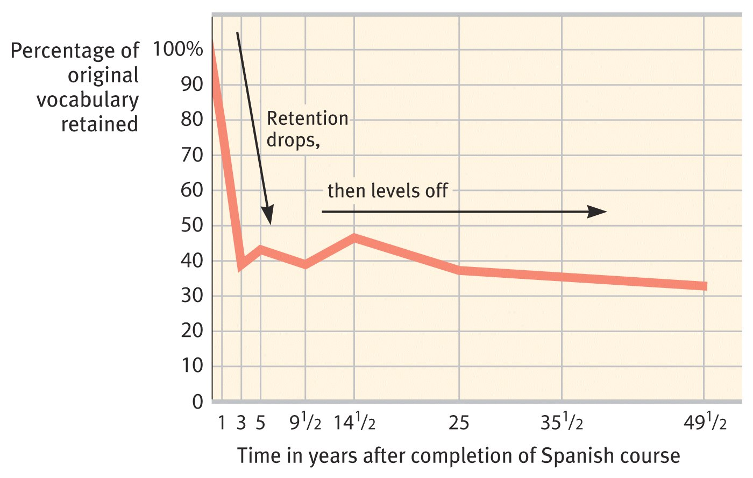
Decay Theory
The decay theory argues that the passage of time causes forgetting.
The longer information is not accessed, increases the chances of forgetting it.

Slide 20
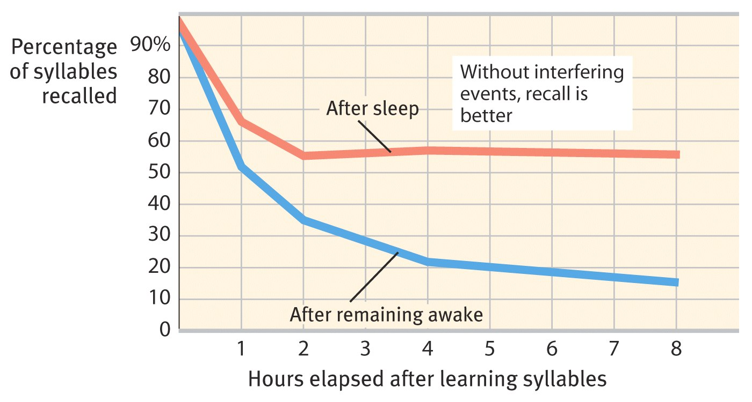
Interference
Retroactive interference
Occurs when you are being tested on old information (hint: retro means old) and new information interferes with proper retrieval.
If the answer is old information the term you use is RETROactive Interference
Sleep helps prevent retroactive interference. Therefore, it leads to better recall.

Slide 21
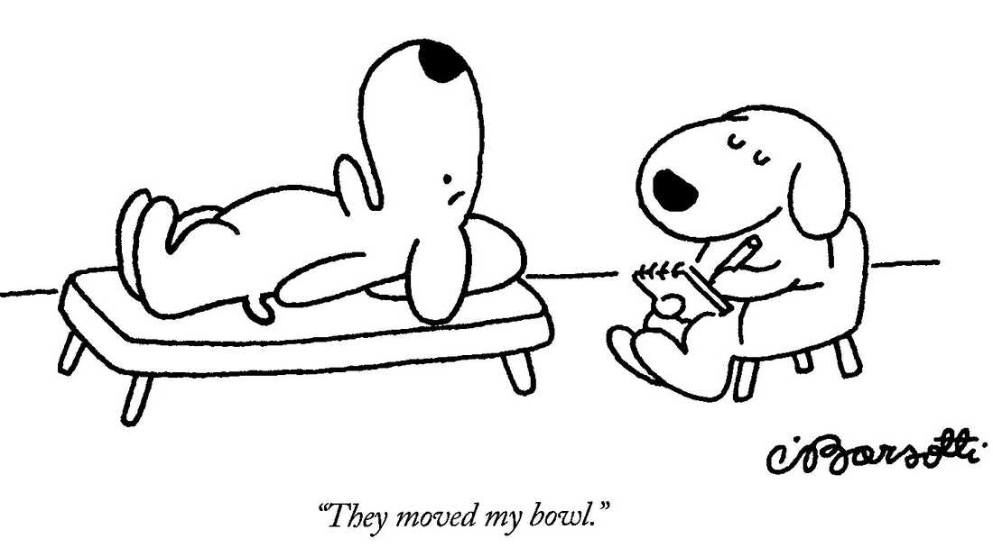
Proactive interference
Occurs when you are being tested on NEW information (Latin route for pro meaning in front of as in proceed ) and old information interferes proper retrieval.
Example: You feel like you've just gotten used to writing the right year and then it's time to write the new year. This is a classic example of proactive interference. Old memories or habits of writing 2021 get in the way of writing 2022.

Slide 22
Don’t read the words, just say the colors they’re printed in and as fast as you can
This is called the stroop effect
Red
Yellow
Green
Blue
Red
Blue
Yellow
Green
Blue
Red
When you look at the words you see both its color and meaning.
When they are in conflict you must make a choice
Experience has taught you that word meaning is more important than color so you retrieve that information.
You are not always in complete control of what you pay attention to.

Slide 23
Memory is a construct!
When we remember something, we're taking bits and pieces of experience - sometimes from different times and places - and bringing it all together to construct what might feel like a recollection but is actually a construction.
The process of calling it into conscious awareness can change it, and now you're storing something that's different.
Example- Inadvertently adopting a story “we've heard.”

Slide 24
Eyewitness testimony
Shown to be unreliable
People’s recall for events may be influenced by what they heard or constructed after the incident
Memory is reconstructed
Memories are not stored like snapshots, but are instead like sketches that are altered and added to every time they are called up.
Elizabeth Loftus has shown subjects who are given false information about an event or scene tend to incorporate it into their memories, and "recall" the false information as a part of their original memory even two weeks later.
Loftus gives the example of the sniper attacks in the fall of 2002. "Everybody was looking for a white van even though the bad guys ended up having a dark Chevy Caprice." That's because some people reported seeing a white van at the scene of the crime. "Witnesses overhear each other," says Loftus, and police may also unintentionally influence people's memories when they talk about a crime.
Study after study has shown that there is no correlation between the subjective feeling of certainty one has about a memory, and the memory’s accuracy

Slide 25
Memory Accuracy:
Critics protested that Loftus still hadn't proved the memories were fake. So she raised the ante. She persuaded 16 percent of a study population that they had met Bugs Bunny at Disneyland. In a follow-up experiment, researchers sold the same memory to 36 percent of subjects. This was impossible, since Bugs belonged to Warner Bros., not Disney.
When critics debated the Bugs Bunny research methods, Loftus obliged them again. Her team convinced 30 percent of another group of subjects that on a visit to Disneyland, a drug-addled Pluto character had licked their ears.

Slide 26
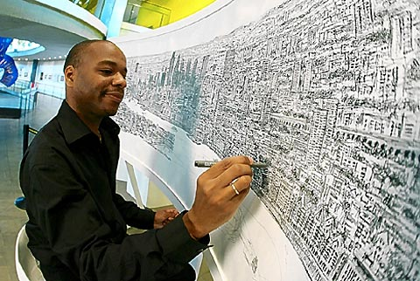
Autobiographical memory
Eidetic Memory
Recollection of events in our life
More recent events are easier to recall
Hyperthymesia is the condition of possessing an extremely detailed autobiographical memory. Hyperthymesiacs remember an abnormally vast number of their life experiences.
Pop culture calls this a photographic memory
Usually due to well developed memory techniques

Slide 27
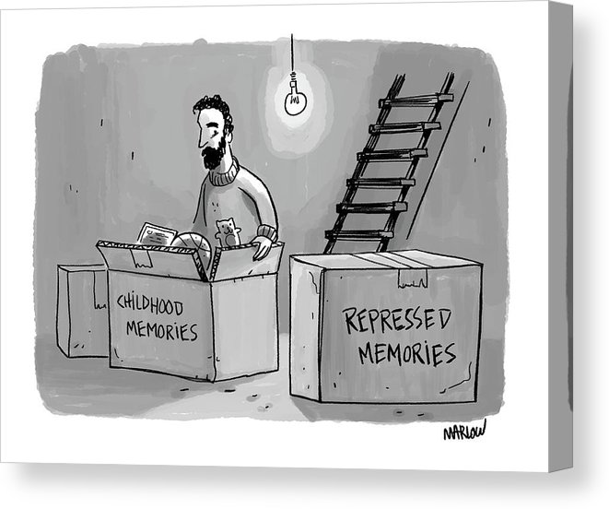
Recovered memories
Involved the recall of a long-forgotten dramatic event
May be the result of suggestion
Some evidence that memories can be repressed and recalled later

