Slide 1
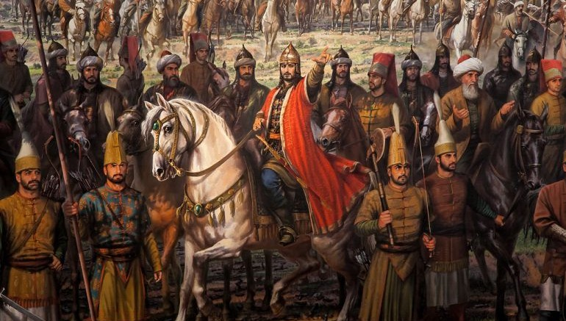
The Ottoman and Safavid Empires
Lesson Four
Topic
VIII

Slide 2
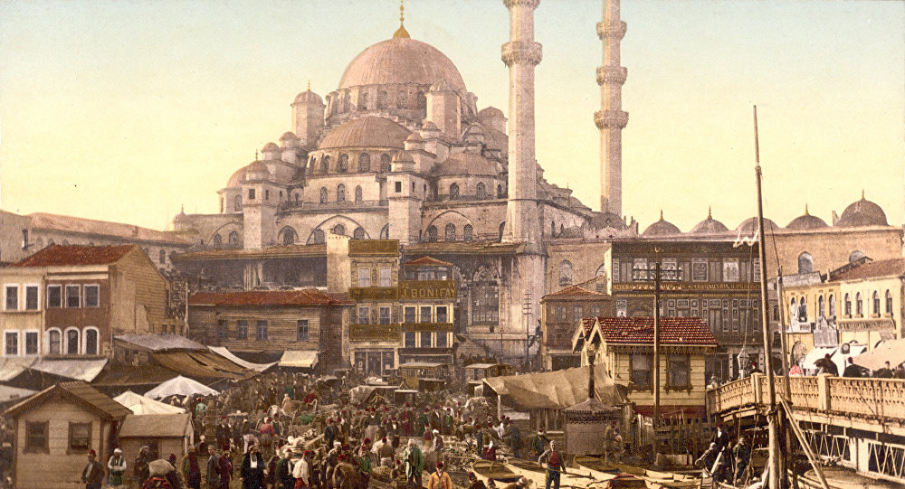
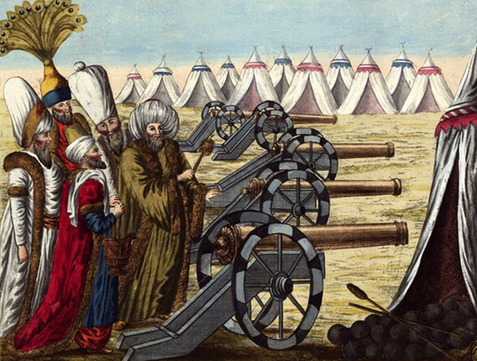
Growth of the Ottoman Empire
By the 1400s, two powerful new empires had emerged in the Middle East: the Ottoman and the Safavid empires
Both were Muslim empires and owed their success in part to a new military technology, gunpowder
For this reason, the Ottoman and Safavid empires are often called “gunpowder empires”
Like the Seljuks, the Ottomans were a Turkish-speaking nomadic people who had migrated from Central Asia into northwestern Asia Minor

Slide 3
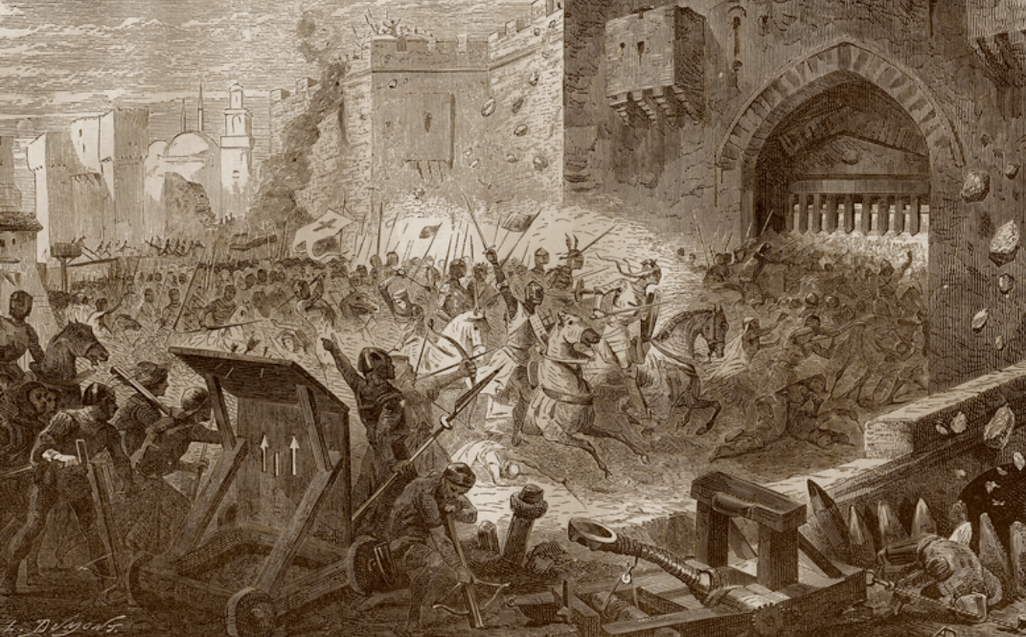
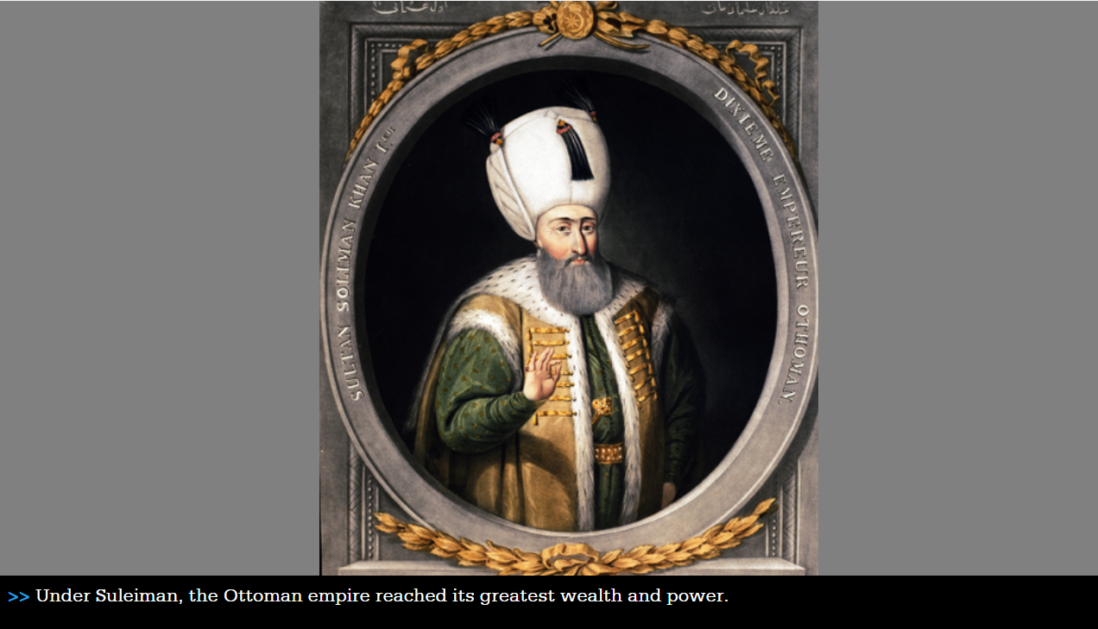
Growth of the Ottoman Empire
The Ottomans ruled the largest, most powerful empire in Europe and the Middle East for centuries
The Ottoman sultan Mehmet II captured Constantinople (which gradually became known as Istanbul) in 1453
The Ottoman empire enjoyed a golden age under the sultan Suleiman, who ruled from 1520 to 1566
Suleiman modernized the army and conquered many new lands
In 1533, Suleiman created an enormous navy that dominated all trade in the eastern Mediterranean

Slide 4
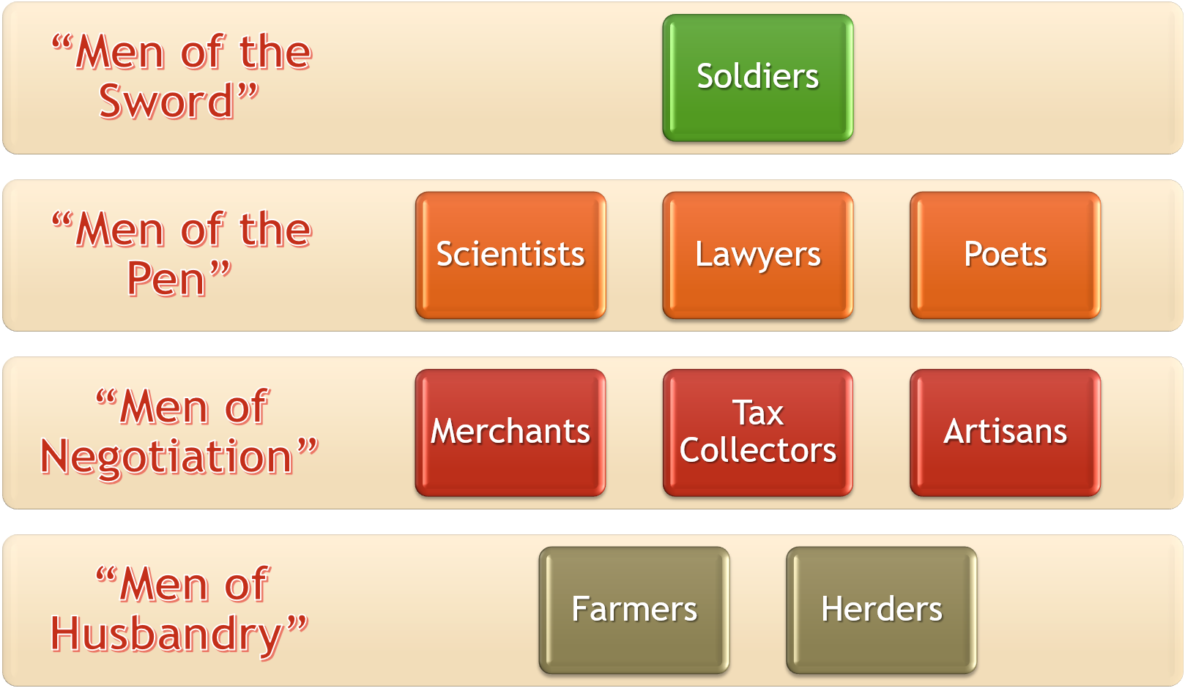
Ottoman Society

Slide 5
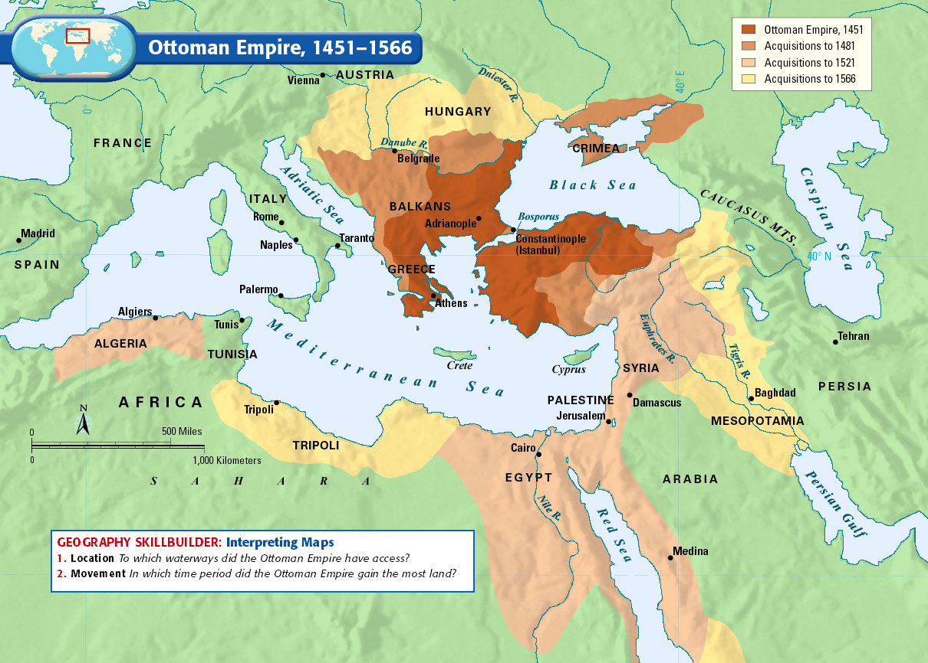
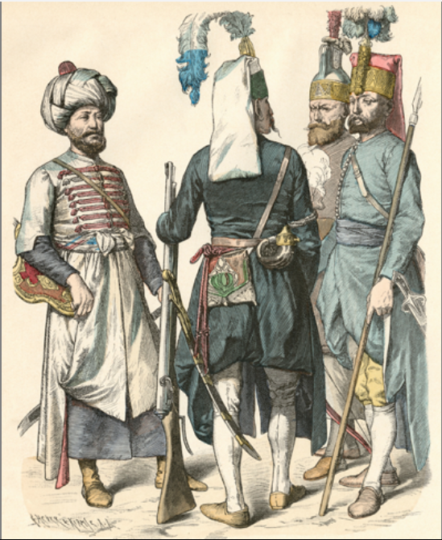
Ottoman Society
Suleiman extended Ottoman rule eastward into the Middle East, and also into Kurdistan and Georgia in the Caucasus Mountain region. In the west, Suleiman advanced deeper into Europe through a combination of diplomacy and warfare. In 1529, his armies besieged the Austrian city of Vienna, sending fear through the kingdoms of Western Europe.
The Ottomans levied a “tax” on Christian families in the Balkans, requiring them to turn over their young sons for government service
The boys were converted to Islam and received military training
The best soldiers won a prized place in the janizaries, the elite force of the Ottoman army
Non-Muslim girls from eastern Europe served as slaves in wealthy Muslim households
Notes:
Explanation of map: Although they failed to take Vienna, the Ottoman armies threatened the divided kingdoms of Europe, which feared invasion from the east. While European powers formed alliances to keep Suleiman from expanding further into Europe, France tried to weaken its rivals by signing a treaty with the Ottomans.

Slide 6
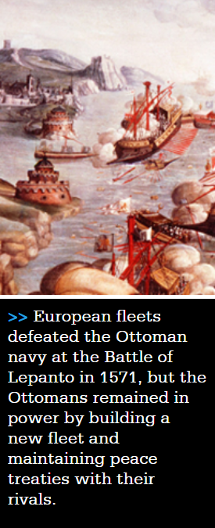
Ottoman Society
After Suleiman’s death in 1566, Ottoman government and society began to decline slowly
His son and successor Selim II left most of the governing to his ministers, and the government became corrupt
By the 1700s, European advances in both commerce and military technology were leaving the Ottomans behind

Slide 7
The Rise of the Safavids
By the early 1500s, the Safavid dynasty had united an empire in Persia (present-day Iran)
The most outstanding Safavid ruler, or shah, was Shah Abbas the Great who revived the glory of ancient Persia
He centralized the government and created a powerful military force
Abbas reduced taxes on farmers and herders and encouraged the growth of industry
Notes:
Discuss The Decline of the Safavid Empire after the map: Safavid glory slowly faded after the death of Shah Abbas and under continuing pressure from Ottoman armies. Shiite scholars also challenged the authority of the shah by stressing their own authority to interpret law and determine government policy. They encouraged persecution of religious minorities, pushing Sunni Afghans to rebel. The rebels defeated imperial armies, captured Isfahan, and forced the last Safavid ruler to abdicate in 1722.

Slide 8
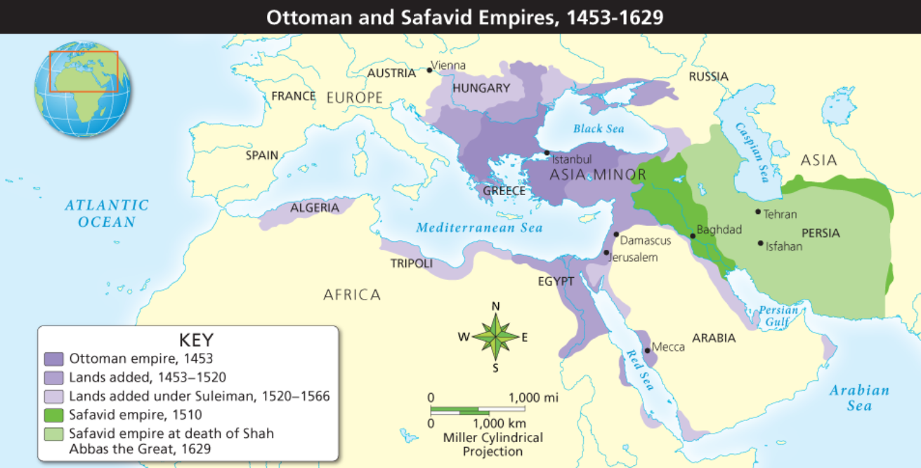
Map Work
One person from each pair of desks take a Chromebook and turn it on.
Open the Chrome web browser. Type www.pearsonrealize.com and then sign in to your Pearson account.
Username: lastname+nbhs
Password: student number+NBHS

