Slide 1
509 B.C. - 476 A.D.

Slide 2
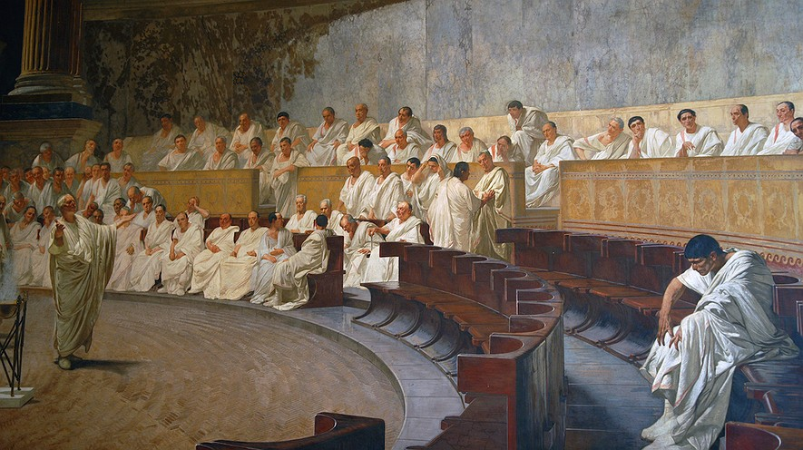

Slide 6
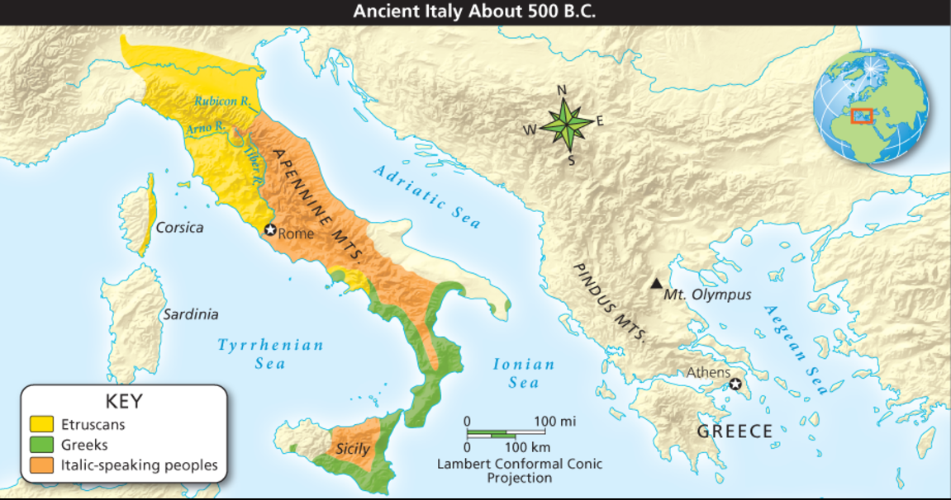

Slide 7
Italy is a peninsula bordering the Mediterranean Sea and the Adriatic Sea
By 800 B.C., the ancestors of the Romans, called the Latins, had migrated into Italy, settling along the Tiber River
Their villages would in time grow together into the city-state of Rome
The Etruscans lived mostly north of Rome

Slide 9
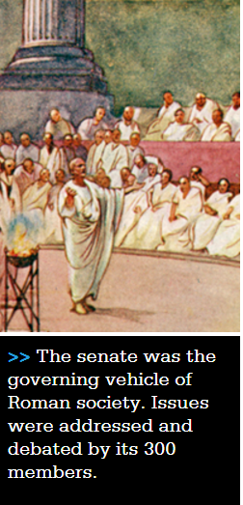
509 B.C. - the Romans set up a new government called a republic, in which officials were chosen by male citizens
The Senate made laws and controlled the govt.
At first, its members were all patricians, or members of the landholding upper class

Slide 10
Plebeians - the farmers, merchants, and artisans who made up most of the population, had little influence
In time, the plebeians gained the right to elect their own officials, called tribunes, to protect their interests
The tribunes could veto, or block, laws that they felt were harmful to plebeians
Notes:
Little by little, plebeians forced the senate to choose plebeians as consuls, appoint them to high offices, and finally to admit them to the senate. These changes made Rome’s government more representative.
A Lasting Legacy Although the senate still dominated the government, the common people had gained access to power and won safeguards for their rights without having to resort to war or revolution.
More than 2,000 years later, the framers of the United States Constitution would adapt such Roman ideas as the senate, the veto, and a system of checks and balances on political power.

Slide 11
BELL WORK
Take out your Topic 6 Lesson 1 Notes - The Roman Republic.
Choose from the following terms to fill in the chart in pencil. They are not in order!
Republic
Democracy
Oligarchy
Totalitarian
Aristocracy
Theocracy

Slide 12
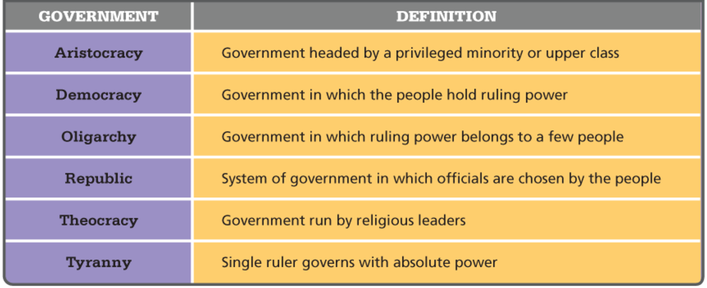
In the event of war, the consuls might choose a dictator or ruler who has complete control over a government, ruling by force
Totalitarian
Notes:
Each Roman dictator was granted power to rule for six months. After that time, he had to give up power. Dictators were nominated by a consul on the recommendation of the Senate and confirmed by the Assembly.
Create a SMART activity with this chart to review types of government
Little by little, plebeians forced the senate to choose plebeians as consuls, appointed them to high offices, and finally to admit them to the senate. These changes made Rome’s government more representative.
A Lasting Legacy Although the senate still dominated the government, the common people had gained access to power and won safeguards for their rights without having to resort to war or revolution.
More than 2,000 years later, the framers of the United States Constitution would adapt such Roman ideas as the senate, the veto, and a system of checks and balances on political power.

Slide 13
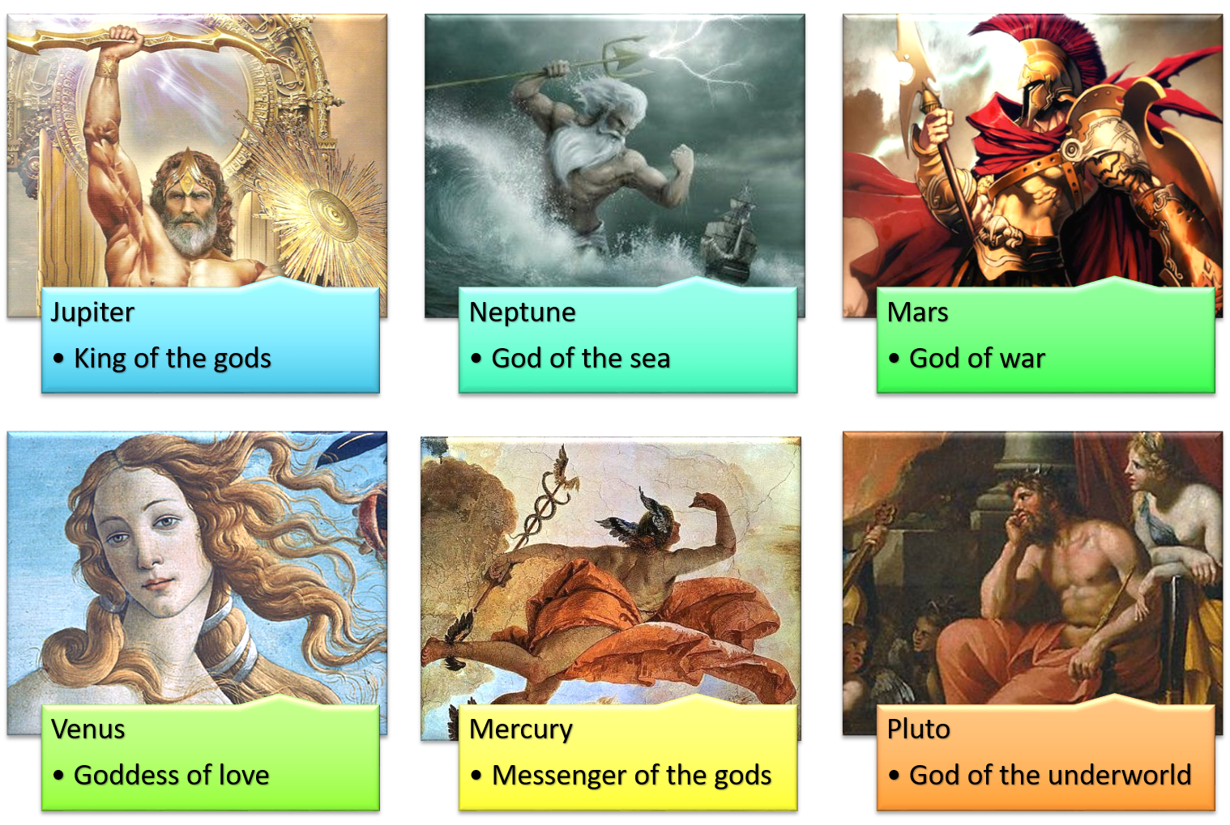
Roman life centered on the family and religious practice
The father had absolute power in the household
The Romans were polytheistic
Science connection: what are named after the Roman gods/goddesses?
Notes:
The Roman calendar was full of feasts and other celebrations to honor the gods and goddesses and to ensure divine favor for the city. As loyal citizens, most Romans joined in these festivals, which inspired a sense of community. Throughout Rome, dozens of temples housed statues of the gods. In front of these temples, Romans took part in ritual activities such as worshipping the gods and asking for divine assistance.

Slide 14
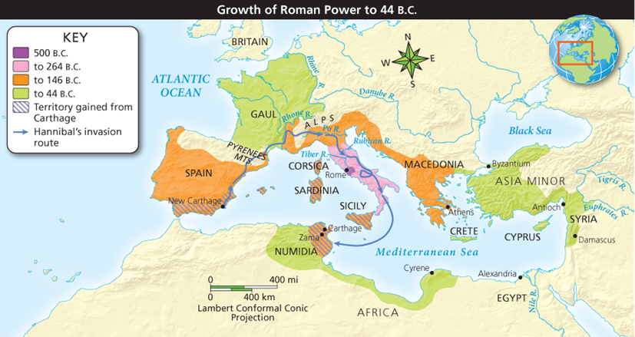
Rome controlled most of what four areas by 146 B.C.?
Spain, Italy, Macedonia, and Greece
Notes:
Do the “Interactive Map: Growth of the Roman Republic, 500 B.C. to 44 B.C.” activity. Either assign as homework or do in class together.

Slide 15
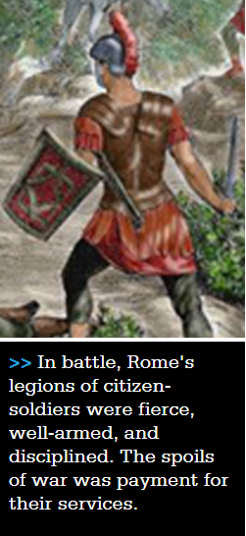
Rome’s success was due to skillful diplomacy and to its army.
The basic military unit was the legion,each of which included about 5,000 men
Roman armies consisted of citizen-soldiers who supplied their own weapons and fought without pay

Slide 16
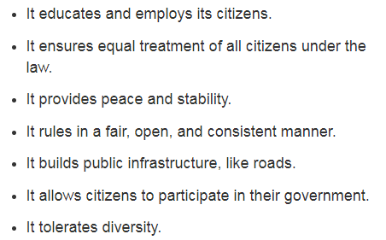
WRAP UP
What do you think makes a successful government? On the paper provided, put the following descriptions in order from most important to least important.
Be able to give a reason for your ranking!

