Slide 1
Language
Ch. 5 APHG

Slide 2
Origin & Diffusion of English
½ Billion fluent speakers
42 nations = Eng. “official” lang. (not US)
Mainly former colonies
Origins in England
Celts pushed out by Germanic tribes
Anglos, Saxons, Jutes
Viking invasion added to mix
Norman invasion = 300 years of French influence

Slide 3
Dialects of English
Regional variations
Vocab, spelling, pronunciation
More dialects due to greater geographic extent
Map page 140 = variations in England
Upper class, London, Cambridge, Oxford
Advance as “standard” after printing press used for grammar books
After colonization of America & revolution
Am. Pronunciation from earlier upper class

Slide 4
Dialects of English
American English variations
Inventions AFTER colonization differ
Noah Webster
Comprehensive American dictionary & grammar
Not aware of new standardized rules in England
Part of movement for increased nationalism

Slide 5
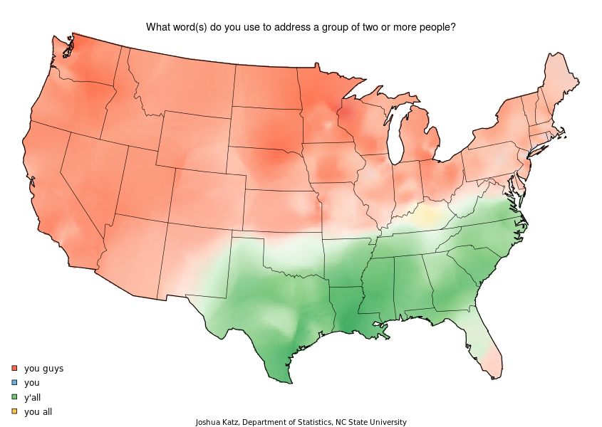
Dialects of English
Within U.S. dialects
Variations from settlers origins
S. vs. N. England or other parts of Europe
Different Words
Pronunciation
Boston & coastal ports = more contact with English
MidAtlantic = supply most settlers to West
Became most recognized variation nationally

Slide 6
Families & Branches
English language
English: part of Indo-European language family
Collection of languages related through common ancestor
Use literary tradition: written form of a language
Used by many languages
Language branch: what is the difference?

Slide 7
Language
Family: group of languages that share a common ancestor
Branch: collection of languages within a family
Group: collection of languages within a branch
Group of languages w. common origin that have evolved into individual languages
EX: Family-Branch-Group (FBG)

Slide 8
Indo-European Language Family
8 total branches-4 large, 4 small
Germanic branch
West Germanic group
High = modern German
Low = English, Dutch, Flemish, Afrikaans
North Germanic group = Scandinavian
Swedish, Danish, Norwegian, Icelandic – all from Norse
Indo-Iranian branch
Largest branch, > 100 languages, > 1 billion people
Eastern group = Indic
Western group = Iranian

Slide 9
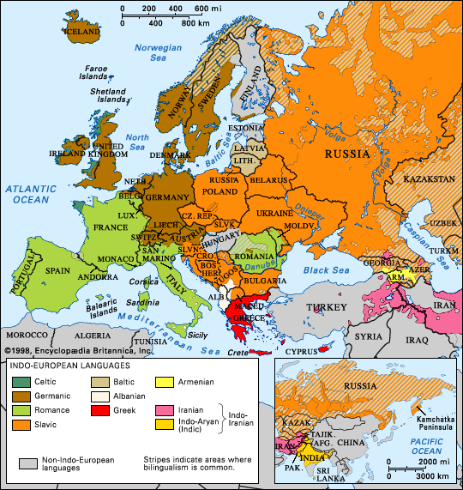
Map, p. 144

Slide 10
Indo-European Language Family
Balto-Slavic branch
East group = largest, includes Russian
West group = Polish, Czech, Slavic
South group = Serbo-Croatian & Bulgarian
Baltic group = Lithuanian & Latvian
Romance branch
Major ones = Spanish, Portuguese, French, Italian
Origins in Roman Empire

Slide 11
Dialect Issues in Romance Branch
Northern v. Southern French
Provençal
Occeitan dialect, southern France
Castilian Spanish
Old Castille, 9th Century, Northern Spain
Portugal, Brazil etc. standardized in 1994
Portuguese upset – most accent marks eliminated and many Brazilian words added
Issue of identity – Dialect vs. distinct language

Slide 12
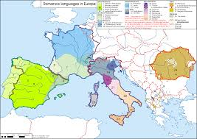
Map, p. 148, Romance branch
Romance includes 3 of the world’s 12 most widely spoken languages- Spanish, Portuguese, and French

Slide 13
Origin & Diffusion of Indo-European
Words from daily life of original speakers are similar in many branches
Ex. Bears, snow, deer, bee
Words added later (after diffusion) vary
Ex. Elephants, rice, ocean
Conclusion = area of origin was colder, continental climate etc.

Slide 14
Two Theories of Diffusion (maps p. 151)
Kurgan Hearth Theory
Central Asia, approx. 4300 BC
May have been 1st speakers of Indo-European
Warriors looking for herding space
Domesticated horses, cavalry, conquer areas of Europe & South Asia
Anatolia Hearth Theory
Eastern Anatolian peninsula 6000 BC
Followed successful agriculture (diffusion)
Better food supply = population pressure = migration

Slide 15
Classification of Languages
50% speak Indo-European family
20% speak Sino-Tibetan family
Most Chinese
5% each
Afro-Asiatic (Middle East)
Arabic most common indiv. Language
Austronesia (Southeast Asia)
Niger-Congo (Africa)
Dravidian (India)

Slide 16
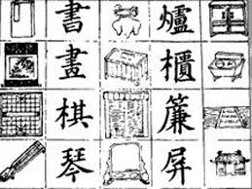
Ideograms
Method of writing for Chinese
Thousands of characters
Some represent sounds
Most represent ideas or concepts , not pronunciations
Ideograms

Slide 17
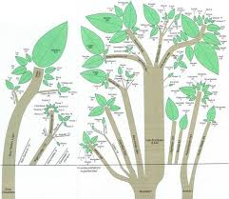
Figure 5-12
Super family roots before recorded history? Diagram p. 155 & handout

Slide 18
African & Afro-Asiatic
African language family:
Nearly 1,000 distinct languages
Few spoken by more than 1 million ppl
Why?
Afro-Asiatic language family:
Includes Hebrew & Arabic
Quran written in Arabic: helped Muslims gain knowledge of it

Slide 19
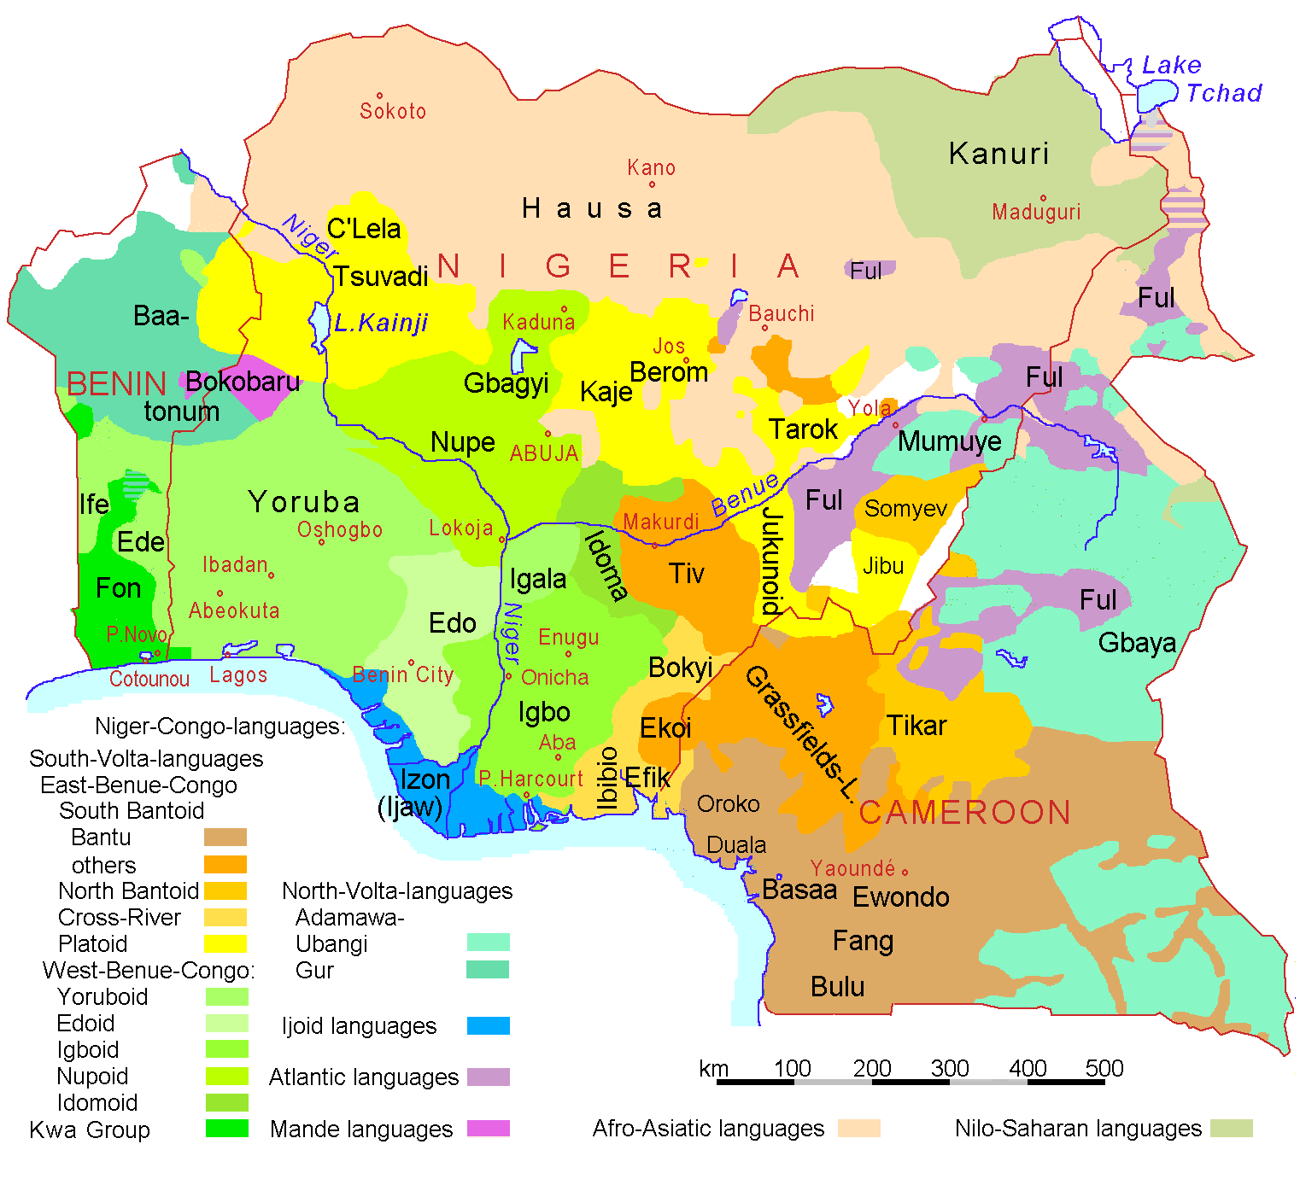
Major languages in Niger-Congo Family
Problems arise when cultural & language diversity packed into small area = conflict

Slide 20
Preserving Local Languages
To survive-a language needs:
A sufficient # of speakers
Government support
Devolution: Transfer of power from high to low in govt
Allows minority language to exist
Or nationalist promote local language to resist central govt
Ex: Basque
Nationalism: Govt. policies to increase pride in country
Ex: Ireland/Gaelic, Israel/Hebrew
Centripetal forces: forces that unite (language)
Ex: 2 or more languages to reduce threats, secession

Slide 21
Preserving language diversity
European Union: European Bureau of Lesser Used Languages
http://eblul.eurolang.net/
Groups resist English
Native Americans
Minority languages, passed on by elders to kids
Many already extinct
Several Native American languages
Gothic & entire Eastern Germanic branch
Political &/or religious domination forced conversion to other languages

Slide 22
Reviving an extinct language
Hebrew = official language in Israel
Unifies diverse Jewish immigrants
Required inventing new words
all things invented since extinction

Slide 23
Preserving Endangered Languages
Celtic
Gaelic group = Irish & Scottish
Few speakers left but extensive literature
Brythonic group
Conquests by English & French led to decline
Governments & pop culture try to revive
Welsh training required in Wales & history & Lit added to curriculum
Irish Gaelic music groups, TV & radio try to establish separate identity

Slide 24
Multi-lingual States Belgium & Switzerland
Split by Germanic/Romance language border
Belgium
South = Walloons = speak French
North = Flemings = speak Flemish (Dutch dialect)
Wallonia & Flanders with separate governments
Capital officially bilingual
Boundary issues for some towns

Slide 25
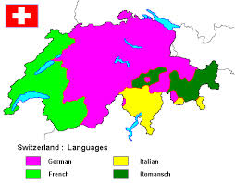
Official Languages of Switzerland, p. 162
4 official languages – German, French, Italian, Romanish
Government very decentralized = mostly local control

Slide 26
Isolated Languages
Unrelated to neighbors
Icelandic
Related to other North Germanic
Isolation means less change from origins
Unattached to a language family
Basque = Pyrenees Mt. Area
Likely the only Pre-Indo-European survivor

Slide 27
Global Dominance of English
Common language between varied speakers
Lingua Franca – particularly for economics
Simplified forms = pidgin language
Enough to communicate basics
No native speakers of a pidgin language
ESL common abroad (83% in EU, 6yrs. In Japan)

Slide 28
Expansion Diffusion
Migration & conquest = normal spread of lingua franca
Today English spread without either!
new vocab, spelling & pronunciations
Ethnic dialects & common usage gain validity
English words fusing with other languages

