Slide 1
Article 1
The Legislative Branch

Slide 2
Congressional Origins
The U.S. Congress was greatly influenced by the American colonial experience and by the Articles of Confederation
Under the British, colonial assemblies were chosen as advisory bodies to the royal governors.
These assemblies gradually assumed more power and authority in each colony, eventually gaining responsibility over taxation and spending.
The weaknesses of the Articles of Confederation (Unicameral) led to the Philadelphia Convention in 1787.

Slide 3
House of Representatives and Senate
Article I creates a bicameral legislative branch of government.
The upper house is called the Senate in which each state receives 2 representatives.
The lower house is called the House of Representatives which is apportioned by population
The Senate has a 6 year term with 1/3 of the seats up for reelection every two years.
House members serve 2 year terms.

Slide 4
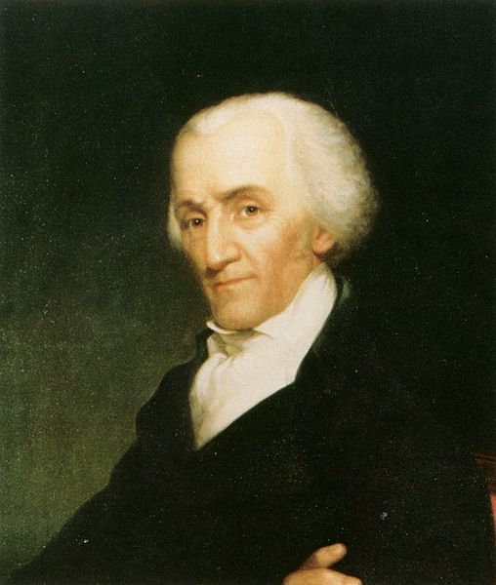
The Constitution requires that all Americans be counted every 10 years by a census This determines the representation breakdown in the House.
Redistricting is done by state legislatures (drawing new district boundaries for reps)
Gerrymandering occurs when the process is exploited purely for political gains.
Elbridge Gerry
https://www.youtube.com/watch?v=YcUDBgYodIE

Slide 5
Powers of Congress
The most important constitutional power of Congress is the power to make laws.
This power is shared by the House and the Senate.
In order to become a law, a bill must be passed by both the House and the Senate.

Slide 8
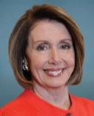
Democrats currently have the majority in the House of Representatives. Therefore, they set the agenda for the legislature.
Nancy Pelosi is the Speaker of the House. She is the presiding officer of the House and sets the agenda for legislation.
Steny Hoyer is the Majority Leader. He works to advance the policies of the Democratic Party.
Jim Clyburn is the Majority Whip. He counts votes and monitors attendance on party votes. He uses his influence to support the party leadership.

Slide 9
The Republicans are currently the minority in the House of Representatives. They must follow the agenda set forth by Democrats, and rely upon negotiation to introduce and pass party legislation.
Kevin McCarthy is the Republican Minority Leader of the House of Representatives. His role is to compromise with the leadership and find ways to pass legislation that supports the party platform.
Steve Scalise is the Republican Whip. He counts votes and monitors party participation. He takes directives from the Minority Leader.

Slide 10
Senate Leadership= Republicans currently have a majority in the Senate, but still need Democrats to meet the 60 vote threshold to pass a bill.
President of the Senate= Mike Pence (R)
Senate Majority Leader= Mitch McConnell (R)
Senate Majority Whip= John Thune (R)
Senate Pro Tempore= Charles Grassley (R)
Senate Minority Leader= Chuck Schumer (D)
Senate Minority Whip= Dick Durbin (D)

Slide 12
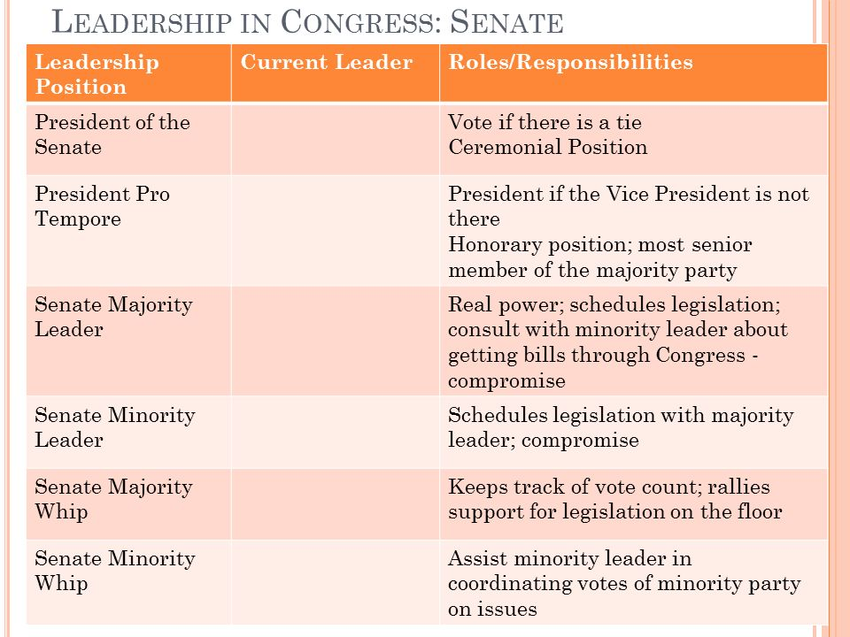

Slide 13
Bicameral Differences House Senate
Initiate revenue bills
2-year terms
435 members
Formal procedures
Specialists on policy
Majority have more influence on rules, procedures, and votes
Advise and consent executive choices
6-year terms
100 members
Relaxed leadership
Generalist in policy
Foreign policy leaders

Slide 14
Spend
Money
Regulate
Commerce
Taxation
Create
Courts
Powers of
Congress
Lawmaking
Declare
War
Make all laws
"necessary and proper" to carrying out
the enumerated powers

Slide 15
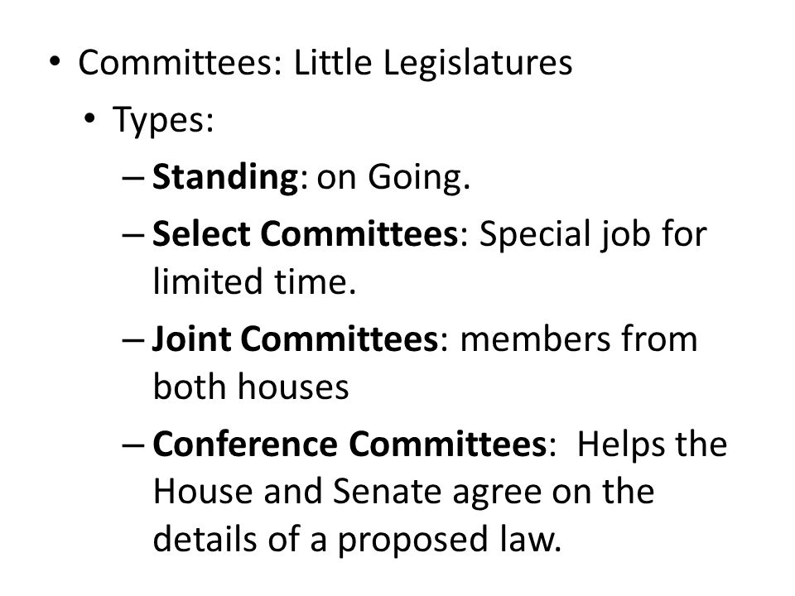

Slide 17
How Members Make Decisions
Interest Groups
Colleagues
Caucuses
Party
Representative
Constituents
Staff
Political Action Committees

Slide 18
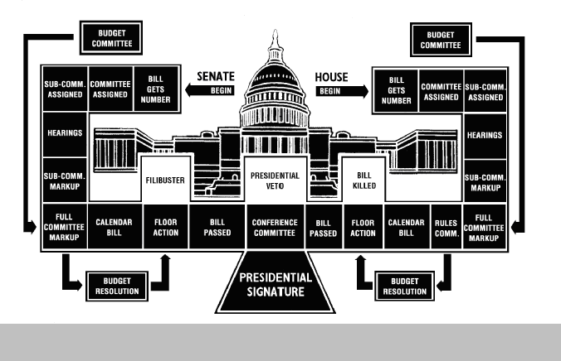

Slide 19
Continuity and Change
The framers of the U.S Constitution placed Congress at the center if the government.
In the early years of the republic, Congress held the bulk of power.
The face of Congress is changing as women and minorities have achieved seats.
Today, the presidency has become quite powerful particularly since FDR.
Congress now generally responds to executive branch legislative proposals.

