Slide 1
AP Human Geography Unit 3: Ch. 4 Folk & Popular Culture

Slide 2
Geography & Culture
Spatial distribution
Diffusion patterns
Integrates with other characteristics
Relationship between material culture & physical environment
What do people take from the environment?
How do people modify the environment?

Slide 3
Hierarchy
Habit = individual
Custom = habit adopted by a group
Culture = collection of customs of a group
Folk Culture
Small, homogeneous groups, isolated, rural areas
Very little variation over time
Varies from place to place
Popular Culture
Large, heterogeneous societies
Share customs despite personal differences
More widespread from interaction
Changes frequently = varies from time to time

Slide 4
What is culture?
Formal definition:
Culture is a shared set of meanings that are lived through material and symbolic practices of everyday life
Geography is concerned with how culture shapes space and place. How place and space can influence cultures
Habit
Repetitive act that a particular individual performs
wearing jeans to class every day
Custom
Repetitive act of a group, performed to the extent that it becomes characteristic of the group
College students wear jeans to class every day
Adopted by most of the society's population

Slide 5
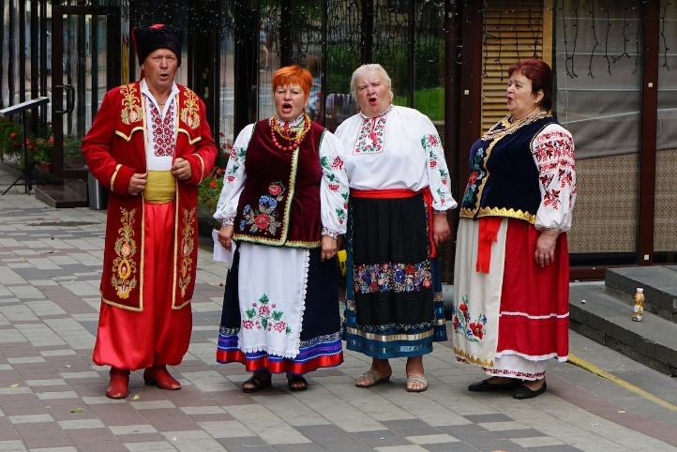
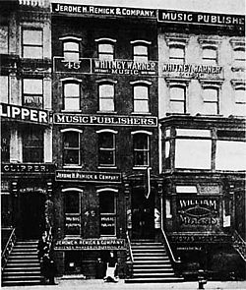
Origins
Folk Music
Composed anonymously, transmitted orally
May originate independently at multiple hearths
Tell a story or convey information about:
daily activities
life-cycle events
mysterious events (nature events)
Popular Music
Music written by specific individuals for the purpose of being sold to a large number of people
Takes technological skill
Performed in studio with equipment
Originated in 1900
Music industry developed out of Vaudeville
Tin Pan Alley developed in New York
Later moved to Broadway

Slide 6
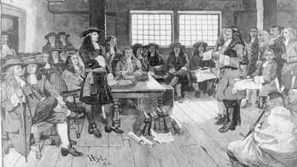
Diffusion
Folk = slower & smaller scale
Usually through migration
Ex. Relocation diffusion
Folk Culture Diffusion-Amish
Visible in 17 state in U.S.
Origin = Bern, Switzerland; Alsace region, France; southwest Germany
Not distinctive in language, clothing etc.
Blended into Mennonite church groups
2 waves of migration to N. Am. for cheap land
1st = PA in 1700s
2nd = OH, IL, IA, Ontario early 1800s
Rural & isolated = retained traditional customs vs. adapting new ones of U.S.
Spreading with migration to KY
Cheaper land & fewer tourists!

Slide 7
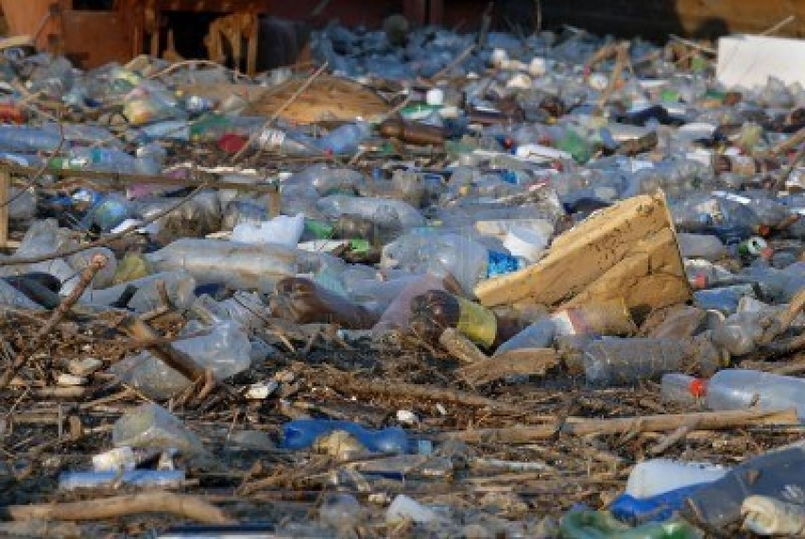
Diffusion Popular = hierarchical from nodes/hearths Rapid with use of technology
Seen by some as threat to the environment
Increased consumption
Plastic water bottles
Found in large, heterogeneous societies
Mass culture that diffuses rapidly
Spreads through expansion diffusion
hierarchical
Some believe it threatens local or regional distinctiveness
Cultural homogeneity
Effects on landscape create homogeneous “placeless landscape”

Slide 8
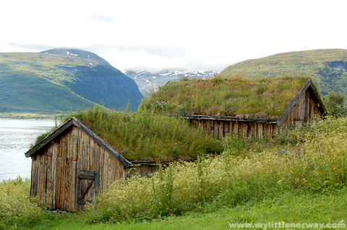
Influences of Physical Environment
Environmental conditions can limit the variety of human actions anywhere
Two necessities of daily life- food and shelter- demonstrate the influence of cultural values and environment on the development of unique folk culture.
Different societies prefer different foods and styles of house construction

Slide 9
Cultural Imperialism
Diffusion of popular culture can contribute to cultural conflict when part of a group may protest the arrival of a type of popular culture in its region
Cultural imperialism
The invasion of a culture into another with the intent of dominating the invaded cultural politically, economically, and/or socially.
Cultural nationalism
The resistance by a group of people against cultural imperialism and cultural convergence
McDonald’s attacks
Globalization is often seen as causing cultural imperialism and the controversy surrounding its cultural consequences.

Slide 10
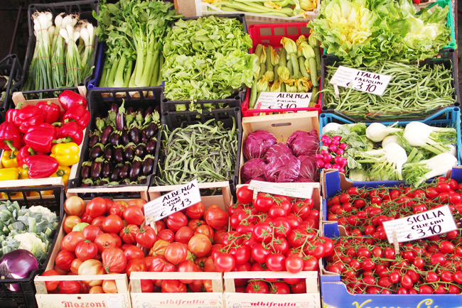
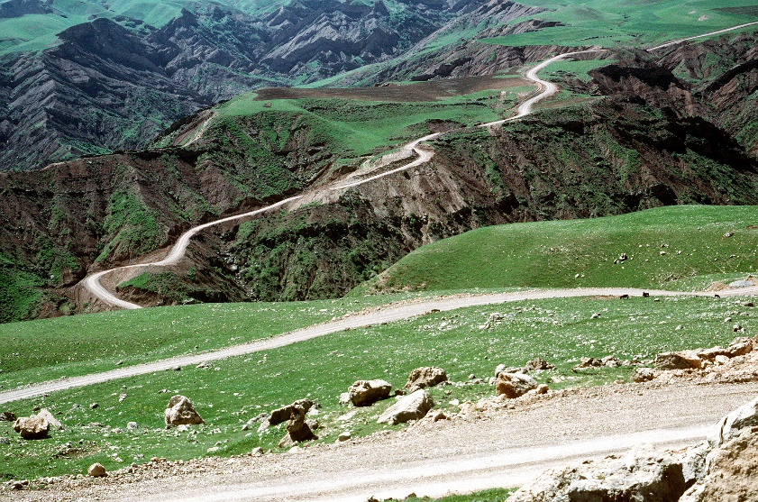
Distinctive Food Preferences
Folk food habits are embedded especially strong in the environment
Humans eat mostly plants and animals
Inhabitants of a region must consider:
Soil
Climate
Terrain
Vegetation

Slide 11
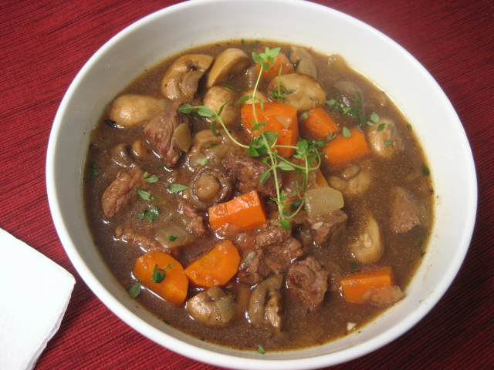
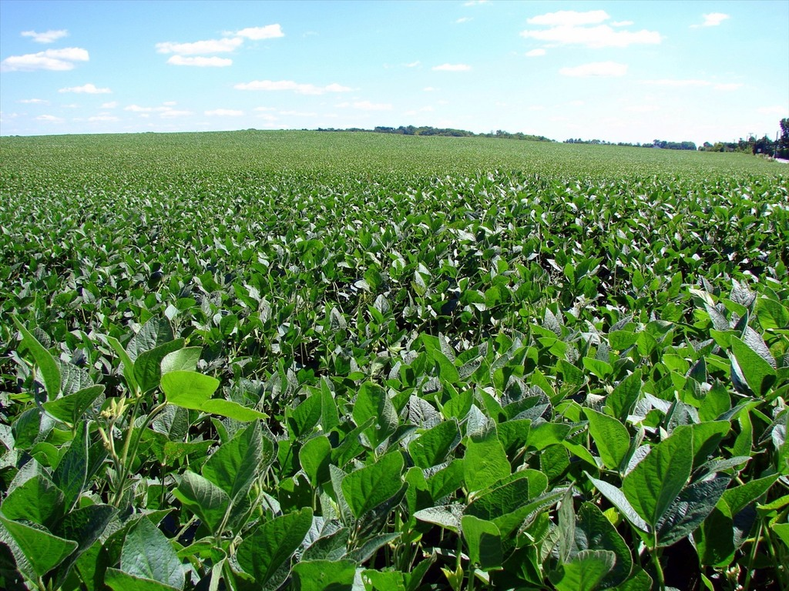
Food Preferences
People adapt their food preferences to conditions in the environment
Europe:
traditional preferences for quick-frying foods in Italy resulted in part from fuel shortages
In Northern Europe, an abundant wood supply encouraged the slow-stewing and roasting of foods
Asia
Soybeans
Fuel scarce
Asians adapted

Slide 12
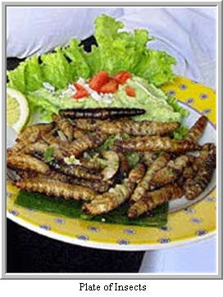
Food Taboos
People refuse to eat particular plants or animals that are thought to embody negative forces in the environment.
protect an endangered animal
Conserve natural resources
Taboo:
Restriction on behavior imposed by social custom

Slide 13
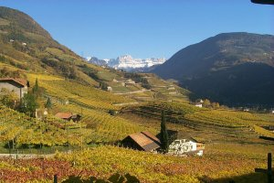
Food Taboos
Terrain
Contribution of a location’s distinctive physical features to the way food tastes
Effects of local environment on a particular food item
Often used to refer to the combination of soil, climate, and other physical features that contribute to the distinctive taste of a wine.
Taboos are often found in countries that are dominated by popular culture
Americans don’t eat insects

Slide 14
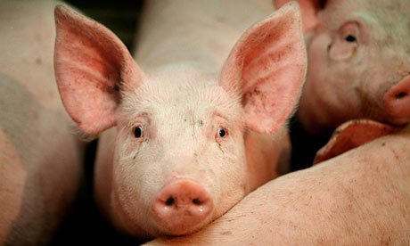
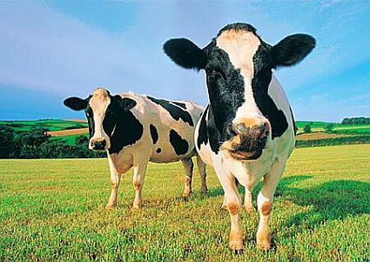
Food Taboos
Taboos can be found in several religions including:
Christianity
Not many taboos
Judaism
Taboos
Animals that do not chew own cud
Animals that have cloven feet
Fish lacking fins and scales
Why?
Concern for environment
Land near Mediterranean
Islam
Pork
Why?
Pigs unsuited for dry land of Arabian Peninsula
Compete with humans
Ecological disaster
Hinduism
Cows
Why?
Environment

Slide 15
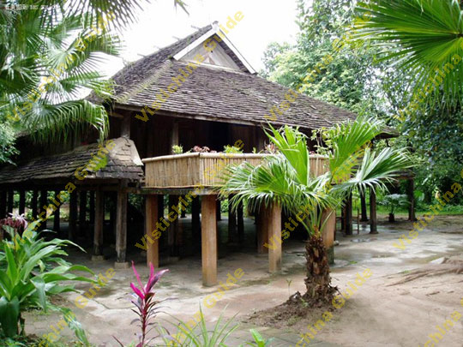
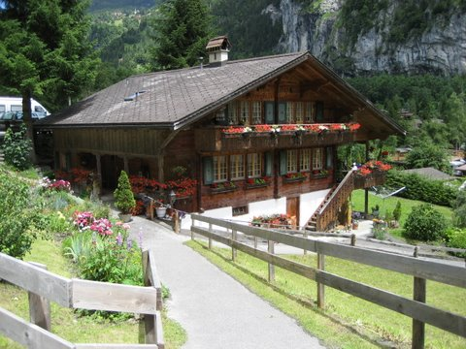
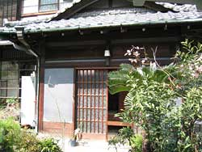
Folk Housing
The house is a product of both cultural traditions and natural conditions
Reflection of cultural heritage, current fashion, and functional needs.
Form of houses might reflect religious values, environmental, and social conditions.

Slide 16
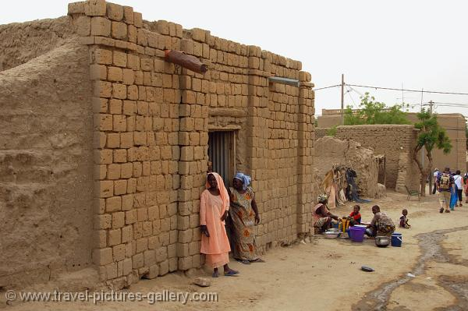
Distinctive Building Materials
Choice of building materials is influenced both by social factors and what is available in the environment
Hot, dry climates - bricks
Type of building materials used to construct folk houses is influenced partly by resources available
Two most common materials are wood and brick
Wood preferred because it is easy to build with
Log cabins in forested regions

Slide 17
Beliefs and Folk House Forms
The distinctive form of folk houses may derive primarily from religious values and other customary beliefs rather than from environmental factors
Compass directions may be more important than others
Java
Front door often faces south
Direction of the South Sea Goddess
Holds the key to earth
Fiji
East wall of house sacred
Madagascar
Main door on west
Most important direction
Thailand
Yuan and Shan
Sleep with head towards east
Staircases must not face west
Direction of death and evil spirits
Laos
Beds perpendicular to the center ridgepole in house
Head =noble, high value
Feet= low value

Slide 18
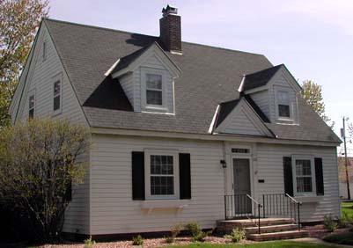
U.S. Folk House Forms
Older houses in U.S. display local folk-culture traditions
When families migrated west new homes reflected preference on East Coast
Three major hearths of folk house forms in U.S.:
New England
Middle Atlantic
Lower Chesapeake

Slide 19
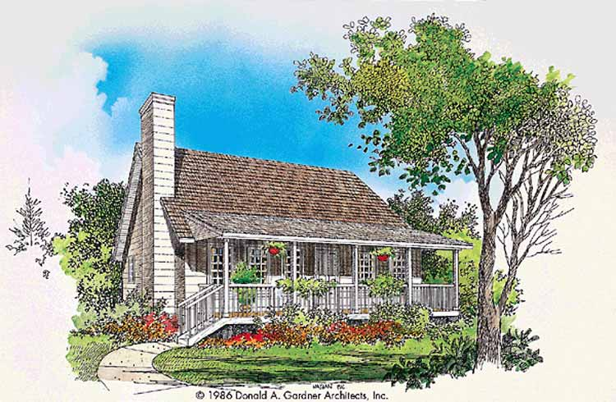
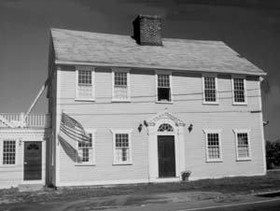
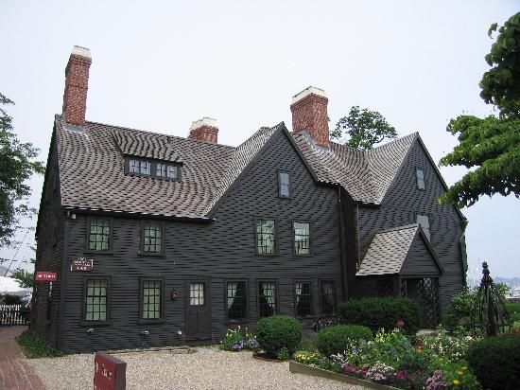
U.S. Folk Housing
Lower Chesapeake
Tidewater style
Typically one-story
Steep roof
Chimneys at either end
Migration spread these houses from Chesapeake Bay – Tidewater, Virginia area to Southeast coast
The Middle Atlantic
Principle house
“I” house
Two full stories
Gables on sides
One room deep, two rooms wide
Migrants carried house type westward across Ohio Valley and along Appalachian trail
Most prevalent
New England
Four house types popular at various times in 18th and 19th centuries
Sailbox
Two-chimney
Cape cod
Front gable and wing
Migrants carried house types northward to upper NE and across Great Lakes regions

Slide 20
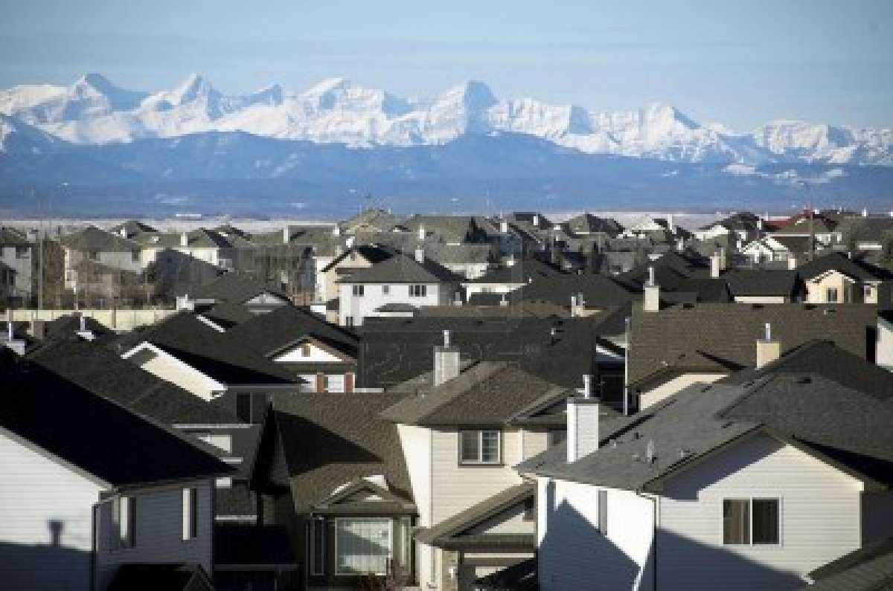
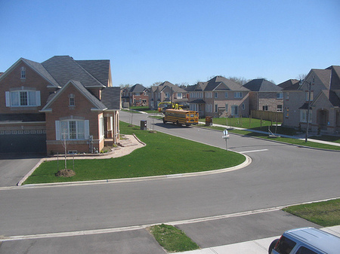
U.S. Folk Housing
Today distinctions are relatively difficult to observe in the United States
Degree of regional distinctiveness diminishing
Rapid construction
Communication/ transportation
No longer built by people, mainly companies

