Slide 1
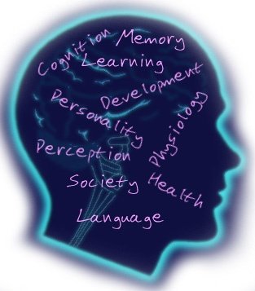
General Psychology
Review Syllabus
PATH Guidelines
Describe your interests in psychology.
Assess your goals…is this a good fit for you this semester?

Slide 2
Getting to know you
Answer the following questions independently, and then break into groups to discuss your responses. Provide an explanation for each response.
What motivates me to do good work?
Where do I want to spend most of my time?
What helps me with memorization?
What intelligence factor do I value?
What is my preferred method for communication?
How can I become self-actualized?
When am I most vulnerable to my emotions?
What is more important? Nature or Nurture?

Slide 3
Chapter 1 Introduction to Psychology and Research Methods

Slide 4
What is Psychology?
Psychology
Psyche: Mind
Logos: Knowledge or study
Definition: The scientific study of behavior and mental processes
Behavior: Overt (i.e., can be directly observed, as with crying)
Mental Processes: Covert (i.e., cannot be directly observed, as with remembering)

Slide 5
What Might a Psychologist Research?
Development: Course of human growth and development
Learning: How and why it occurs in humans and animals
Personality: Traits, motivations, and individual differences
Sensation and Perception: How we come to know the world through our five senses

Slide 6
What Might a Psychologist Research? (cont)
Comparative: Study and compare behavior of different species, especially animals
Cognitive: Primarily interested in thinking
Biopsychology: How behavior is related to biological processes, especially activities in the nervous system
Gender: Study differences between males and females and how they develop
Social: Human and social behavior

Slide 7
What Might a Psychologist Research?
Evolutionary: How our behavior is guided by patterns that evolved during our history
Cultural: How culture affects behavior
Imagine that you are a psychologist. Your client Linda, tells you that spirits live in the trees near her home. Is Linda suffering from a delusion? Is she abnormal?
Linda is Native American. Obviously, you will misjudge Linda’s mental health if you fail to take her cultural beliefs into account. Cultural relativity (the idea that behavior must be judged relative to the values of the culture in which it occurs) can greatly affect the diagnosis of mental disorders. Cases like Linda’s teach us to be wary of using inappropriate standards when judging others or comparing groups.

Slide 8
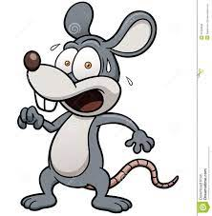
Animal Model
When an animal’s behavior is used to derive principles that may apply to human behavior
For example, rats learn better when reinforced with food instead of punished by electric shock.

Slide 9
What Are the Goals of Psychology?
Description of Behaviors: Naming and classifying various observable, measurable behaviors
Understanding: Being able to state the causes of a behavior
Prediction: Predicting behavior accurately
Control: Altering conditions that influence behaviors
Think of positive and negative uses for control.

Slide 10
Critical Thinking
Ability to analyze, evaluate, and synthesize information
What would you expect to see if the claim were true?
Gather evidence relevant to the claim
Evaluate the evidence
Draw a conclusion
Often used in research
Most important thing you will learn in this class

Slide 11
Critical Thinking: Key Principles
Few truths transcend the need for empirical testing
Evidence varies in quality
Authority or claimed expertise does not automatically make an idea true
Critical thinking requires an open mind

Slide 12
Pseudopsychologies
Pseudo means “false.” Any unfounded “system” that resembles psychology and is NOT based on scientific testing
Palmistry: Lines on your hands (palms) predict future and reveal personality
Phrenology: Personality traits revealed by shape of skull
Graphology: Personality traits are revealed by your handwriting
Astrology: The positions of the stars and planets at birth determine personality traits and affect your behavior

Slide 13
Separating Fact from Fiction (cont)
Be sure to distinguish between observation and inference (e.g., Robert is crying, but do we know why he is crying?)
Beware of oversimplifications, especially those motivated by monetary gain
For example is not proof!

Slide 14
Some Terms
Hypothesis testing: Scientifically testing the predicted outcome of an experiment or an educated guess about the relationship between variables.
Operational definition: Defines a scientific concept by stating specific actions or procedures used to measure it.
Theory: A system of ideas that interrelates facts and concepts, summarizes existing data, and predicts future observations.

Slide 15
History of Psychology: Beginnings
Wilhelm Wundt: “Father” of psychology
1879: Set up first lab to study conscious experience
Introspection: Looking inward (i.e., examining and reporting your thoughts, feelings, etc.)

Slide 16
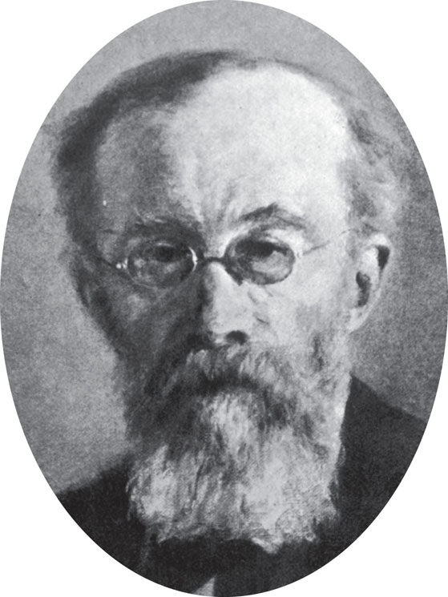
Wilhelm Wundt, 1832–1920. Wundt is credited with making psychology an independent science, separate from philosophy. Wundt’s original training was in medicine, but he became deeply interested in psychology. In his laboratory, Wundt investigated how sensations, images, and feelings combine to make up personal experience.
p. 22

Slide 17
History of Psychology: Structuralism
Wundt’s ideas brought to the US by Titchener and renamed Structuralism; dealt with structure of mental life
Attempted to discover the “building blocks” of conscious thought. This was based on a pure, immediate sensory experience

Slide 18
Structuralism Activity
Identify the most basic taste sensations
How to you explain the taste of water using these sensations?
Structuralism is based on the truthfulness of your own sensory experiences
6 volunteers
In partners, one will be the “introspectionist” and the other is the recorder

Slide 19
Structuralism
The introspectionist gets 10 seconds to look at the object and say whatever comes to mind about the qualities of the object. Not emotional responses.
Example: This object is “round, soft, sweet, juicy, etc…”
Recorder writes down everything they say.

Slide 20
Discussion
Should we rely on this methodology as a way of obtaining consistent and unbiased data?
What problems exist with interpreting data based on this methodology?
What problems exist with regard to studying certain types of psychological phenomena using the method of introspection? (altruism, aggression, psychopathology?
To what degree or how does this methodology violate the basic tenants of empiricism?

Slide 21
History of Psychology: Functionalism
William James (American) and functionalism
How the mind functions to help us adapt and survive
Functionalists admired Darwin and his theory of natural selection: based on the idea that Animals keep features through evolution that help them adapt to environments

Slide 22
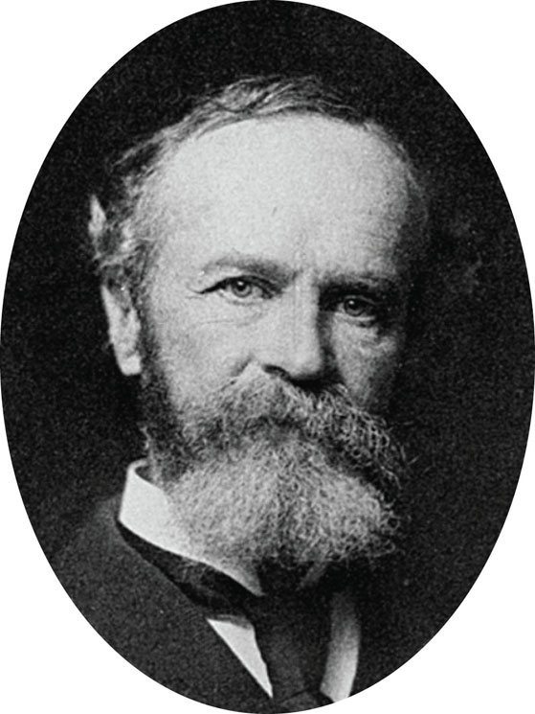
William James, 1842–1910. William James was the son of philosopher Henry James, Sr., and the brother of novelist Henry James. During his long academic career, James taught anatomy, physiology, psychology, and philosophy at Harvard University. James believed strongly that ideas should be judged in terms of their practical consequences for human conduct.
p. 23

Slide 23
Educational Psychology
Educational Psychology
Study of learning, teaching, classroom dynamics, and related topics
Promoted by functionalists
What I’ve been doing by default in the teaching role

Slide 24
History of Psychology: Behaviorism
John Watson and B.F. Skinner
Psychology must study observable behavior objectively
Studied relationship between
Stimuli: Environmental events
Responses: Any identifiable behavior(s)
Watson studied Little Albert with Rosalie Raynor; Skinner studied animals almost exclusively

Slide 25
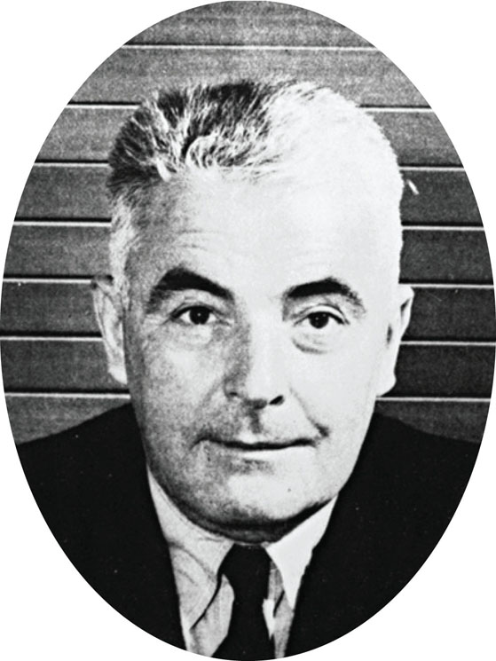
John B. Watson, 1878–1958. Watson’s intense interest in observable behavior began with his doctoral studies in biology and neurology. Watson became a psychology professor at Johns Hopkins University in 1908 and advanced his theory of behaviorism. He remained at Johns Hopkins until 1920 when he left for a career in the advertising industry!
p. 23

Slide 26
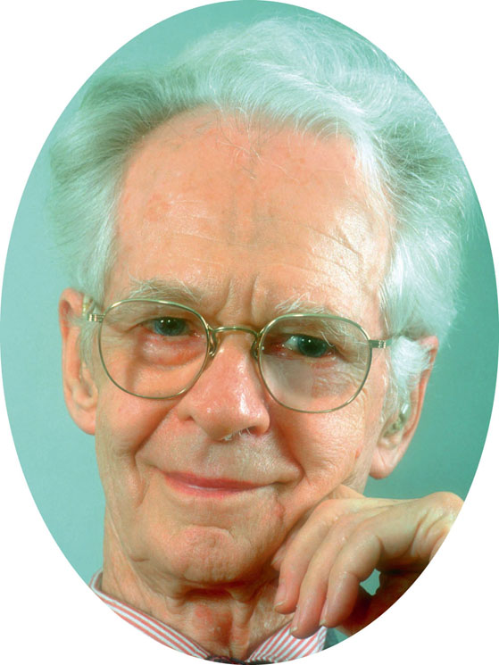
B. F. Skinner, 1904–1990. Skinner studied simple behaviors under carefully controlled conditions. The “Skinner box” has been widely used to study learning in simplified animal experiments. In addition to advancing psychology, Skinner hoped that his radical brand of behaviorism would improve human life.
p. 24

Slide 27
History of Psychology: Cognitive Behaviorism
Albert Ellis and Albert Bandura
Our thoughts influence our behaviors; used often in treatment of depression
Cognition (thinking) and conditioning are combined to explain behavior
Gestalt psychology: “The whole is greater than the sum of its parts”
Studied thinking, learning, and perception in whole units, not by analyzing experiences into parts
Key names: Max Wertheimer, Fritz Perls

Slide 28
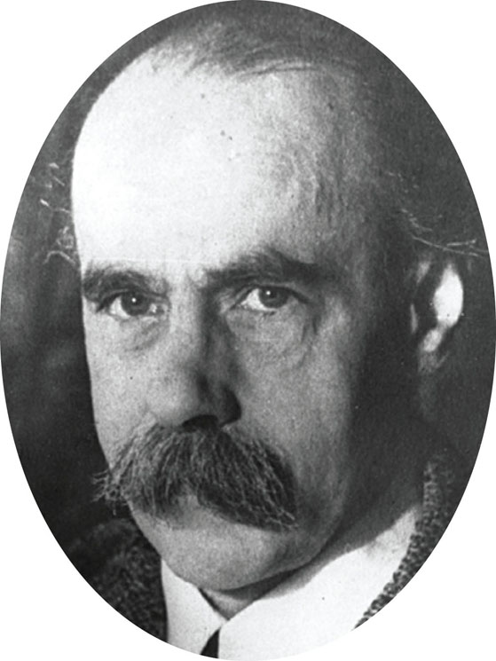
Max Wertheimer, 1880–1941. Wertheimer first proposed the Gestalt viewpoint to help explain perceptual illusions. He later promoted Gestalt psychology as a way to understand not only perception, problem solving, thinking, and social behavior, but also art, logic, philosophy, and politics.
p. 24

Slide 29
The design you see here is entirely made up of broken circles. However, as the Gestalt psychologists discovered, our perceptions have a powerful tendency to form meaningful patterns. Because of this tendency, you will probably see a triangle in this design, even though it is only an illusion. Your whole perceptual experience exceeds the sum of its parts.
Fig. 1-4, p. 24

Slide 30
History of Psychology: Freud
Psychoanalytic Perspective
Battle of the Id, Ego, & Super Ego
Our behavior is largely influenced by our unconscious wishes, thoughts, and desires, especially sex and aggression
All thoughts, actions, and emotions are determined
Freud performed dream analysis and was an interactionist (combination of our biology and environment makes us who we are)

Slide 31
Repression
Repression: When threatening thoughts are unconsciously held out of awareness
Recent research has hypothesized that our unconscious mind is partially responsible for our behaviors

Slide 32
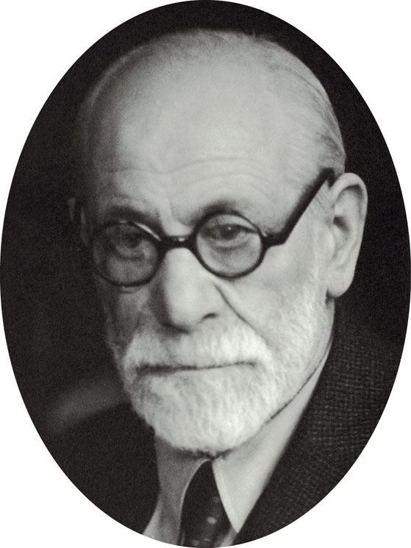
Sigmund Freud, 1856–1939. For more than 50 years, Freud probed the unconscious mind. In doing so, he altered modern views of human nature. His early experimentation with a “talking cure” for hysteria is regarded as the beginning of psychoanalysis. Through psychoanalysis, Freud added psychological treatment methods to psychiatry.
p. 25

Slide 33
Psychoanalysis
Free Association: Saying whatever comes to mind, regardless of how embarrassing or unimportant it may seem
By doing so without censorship and censure, unconscious material can emerge
In partners, have a recorder and a subject. The recorder says one of the following words to the subject:
Mother, father, death, birth, gun, love, failure, touch, rival
The subject then says whatever word comes to mind first.
The recorder writes that word down, then repeats it back to the subject, the subject then says what word first comes to mind from that word
Do this 10 times so you each have a word list
Switch partners

Slide 34
Where did you end up?
Share where you started and where you ended up with a partner.
Explain, as much as you can, HOW you ended up with the word you did.
Does it relate to what’s going on in your life currently?
Analyze the lists for themes: violence, family, love, sex, money, aggression, etcetera

Slide 35
History of Psychology: Humanism
Goal of psychology is to study unique aspects of the person
Focuses on human experience, problems, potentials, and ideals
Each person has innate goodness and is able to make free choices (contrast with Skinner and Freud)
Key Names: Carl Rogers and Abraham Maslow

Slide 36
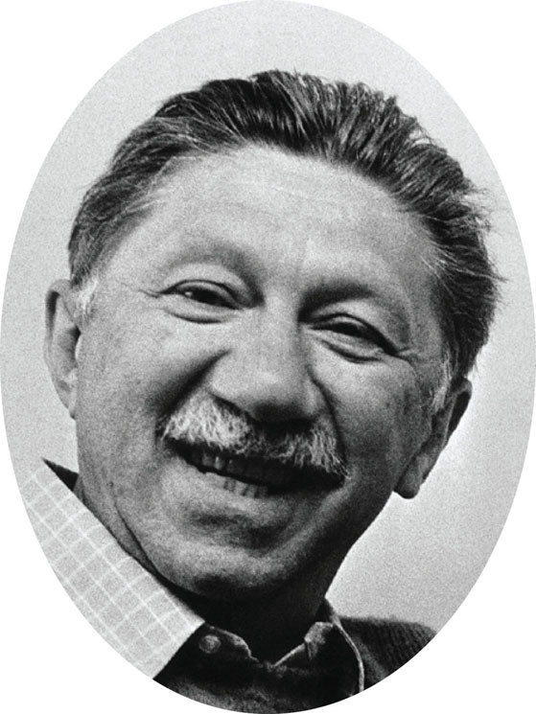
Abraham Maslow, 1908–1970. As a founder of humanistic psychology, Maslow was interested in studying people of exceptional mental health. Such self-actualized people, he believed, make full use of their talents and abilities. Maslow offered his positive view of human potential as an alternative to the schools of behaviorism and psychoanalysis.
p. 25

Slide 37
Humanism: Some Key Terms
Self-image: Your perception of your own body, personality, and capabilities
Self-evaluation: Positive and negative feelings you have about yourself
Frame of reference: Mental perspective used for interpreting events
Self-actualization (Maslow): Fully developing one’s potential and becoming the best person possible

Slide 38
Scientific Fact
Modern sciences are built on observations that can be verified by two or more independent observers regarding the same event. This is what gives them validity and reliability.

Slide 39
Psychology Today
Biopsychology: All of our behavior can be explained through physiological processes
Uses brain scans to gather data (CT, MRI, PET)
Positive Psychology: Study of human strengths, virtues, and optimal behavior
Looks at positive side of human behavior
Sociocultural: Focus on importance of social and cultural contexts influencing our behavior
Cognitive: Study thoughts, memory, expectations, perceptions, and other mental processes

Slide 40
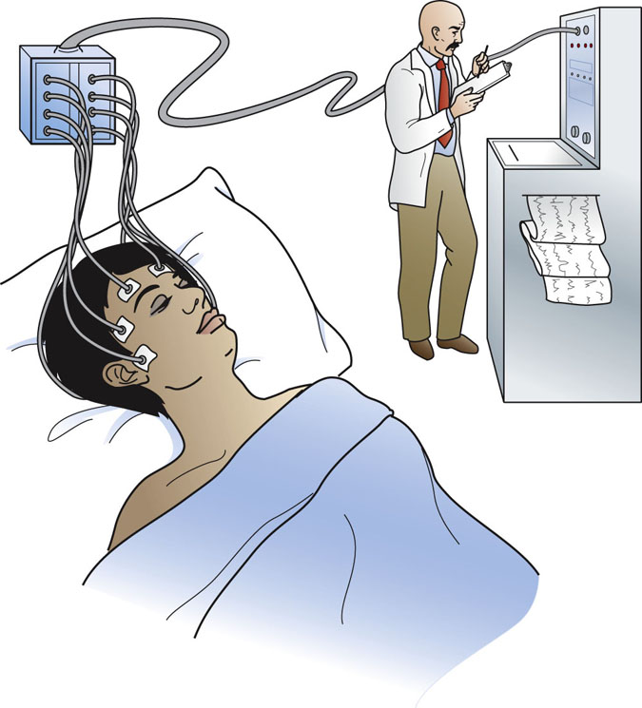
The scientific study of dreaming was made possible by use of the EEG, a device that records the tiny electrical signals generated by the brain as a person sleeps. The EEG converts these electrical signals into a written record of brain activity. Certain shifts in brain activity, coupled with the presence of rapid eye movements, are strongly related to dreaming. (See Chapter 6, pages 186–188, for more information.)
p. 14

Slide 41
Many Flavors of Psychologists
Psychologists: Usually have master’s or doctorate degree; trained in methods, knowledge, and theories of psychology
Clinical psychologists: Treat more severe psychological problems or do research on mental disorders
Counseling psychologists: Treat common issues and problems, such as school or work concerns.

Slide 42
More Helping Professionals
Psychiatrists: MD; usually use medications to treat problems; generally do not have extensive training in providing “talk” therapy
Psychoanalysts: Receive additional training post-PhD or MD at an institute for psychoanalysis

Slide 43
Some More Helping Professionals
Psychiatric social worker: Mental health professional who applies social science principles to help people in clinics and hospitals
Presently a very popular profession
Counselor: Advisor who helps solve problems with marriage, school, and so on
Not all psychologists perform therapy!

Slide 44
Experiments
To identify cause-and-effect relationships, we conduct experiments
Directly vary a condition you might think affects behavior
Create two or more groups of subjects, alike in all ways except the condition you are varying
Record whether varying the condition has any effect on behavior

Slide 45
Types of Variables
Any conditions that can change, and might affect an experiment's outcome
Independent variable: Condition(s) altered by the experimenter; experimenter sets their size, amount, or value; these are suspected causes for behavioral differences
Dependent variable: Demonstrates effects that independent variables have on behavior
Extraneous Variables: Conditions that a researcher wants to prevent from affecting the outcomes of an experiment (i.e. # of hours slept before a sleep study)

Slide 46
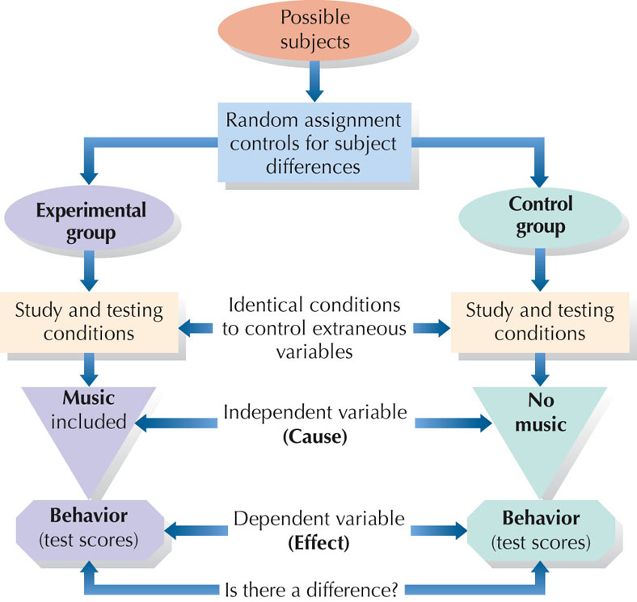
Fig. 1-6, p. 34

Slide 47
Evaluating Experiments’ Results
Statistically significant: Results gained would occur very rarely by chance alone. The difference must be large enough so that it would occur by chance in less than 5 experiments out of 100
Meta-analysis: Study of results of other studies
Random Assignment:
Subject has an equal chance of being in either the experimental or control group

Slide 48
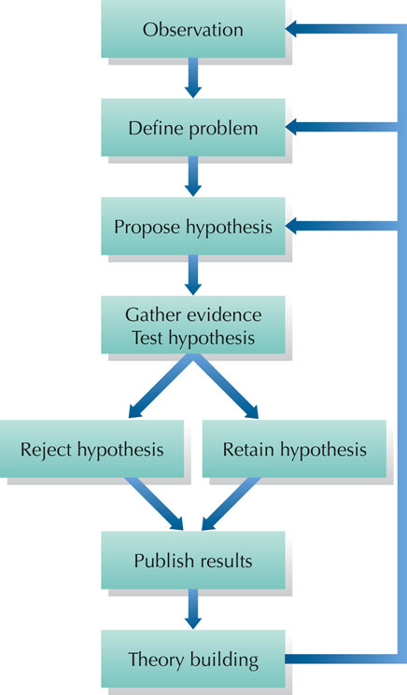
Fig. 1-3, p. 21

Slide 49
In our daily lives, we often conduct little experiments to detect cause-and-effect connections. If you are interested in gardening, for example, you might try adding plant food to one bed of flowers but not another. The question then becomes: Does the use of plant food (the independent variable) affect the size of the flowers (the dependent variable)? By comparing unfed plants (the control group) to those receiving plant food (the experimental group) you could find out if plant food is worth using.
In groups, think of at least one informal experiment you’ve done in the last month. What were the variables? What was the outcome? Did they adequately control for the variables?

Slide 50
Experiment Types
Single-blind experiment: Only the subjects have no idea whether they get real treatment or placebo
Double-blind experiment: The subjects AND the experimenters have no idea whether the subjects get real treatment or placebo
Best type of experiment, if properly set up

Slide 51
Experimenter Effects
Experimenter effects: Changes in behavior caused by the unintended influence of the experimenter
Self-fulfilling prophecy: A prediction that leads people to act in ways to make the prediction come true…a common problem for people.
Observer effect: Changes in subject’s behavior caused by an awareness of being observed
Observer bias: Occurs when observers see what they expect to see or record only selected details

Slide 52
Correlational Studies
Studies designed to measure the degree of a relationship (if any) between two or more events, measures, or variables
How is this measured?
Coefficient of Correlation
Statistic ranging from –1.00 to +1.00; the sign indicates the direction of the relationship
The closer the statistic is to –1.00 or to +1.00, the stronger the relationship
Correlation of 0.00 demonstrates no relationship between the variables

Slide 53
Correlations (cont)
Positive correlation: Increases in one variable are matched by increases in the other variable
Negative correlation: Increases in one variable are matched by decreases in the other variable
Correlation does not demonstrate causation: Just because two variables are related does NOT mean that one variable causes the other to occur

Slide 54
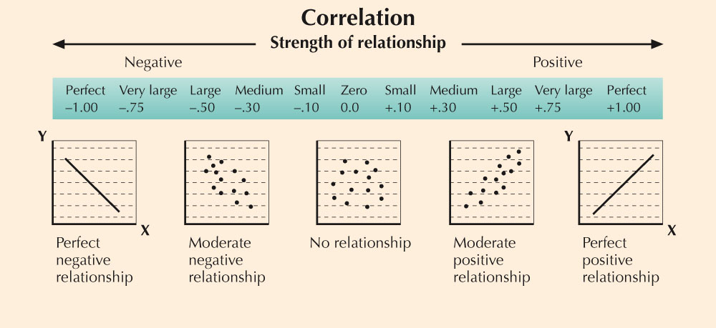
Fig. 1-9, p. 39

Slide 55
The Clinical Method
Case study: In-depth focus on all aspects of a single person
Natural clinical tests: Natural events, such as accidents, that provide psychological data
Survey method: Using public polling techniques to answer psychological questions

Slide 56
Sampling
Representative sample: Small group that accurately reflects a larger population
Population: Entire group of animals or people belonging to a particular category (e.g., all married women)
Internet surveys: Web-based research; low cost and can reach many people

