Slide 1
Population & Migration
APHG Ch. 2 & 3

Slide 2
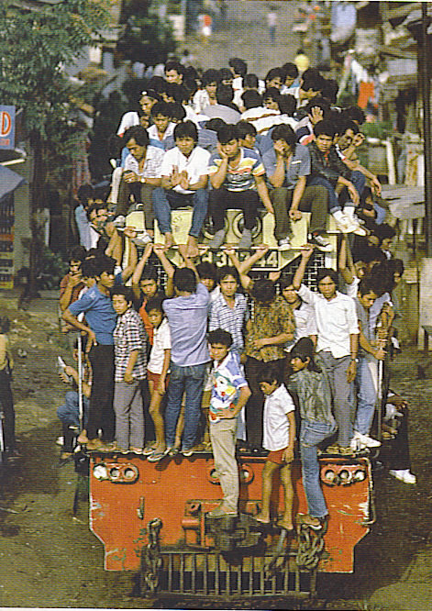
Population
Demographics is the study of human population distribution and migration.
Key Issues of Demographics are:
Food Supply
Health and life expectancy
Status of women
Migration
Notes:
Food Supply-in the 1960s the fear of rapid population growth outpacing food supply was a main concern.
The Green Revolution helped to ease the gap by introducing higher yield strains of rice, wheat and corn. Scientists continue to warn that an increase in population and the increased consumption of meat could lead to a global food crisis.
Health-infant mortality, child mortality and over all life expectancies are concerns of demographers.
Women-efforts to curb population growth have the greatest impact on women-some societies practice female infanticide or female children are malnourished or deprived of care. Where women are educated-birth rates decline.
Migration-the movement of millions of people across international boundaries and internal migration to evade poverty or war or environmental disasters are also concerns of demographers.
(train in Jakarta, Indonesia-one of the world’s most populous cities with 11 million people)

Slide 3
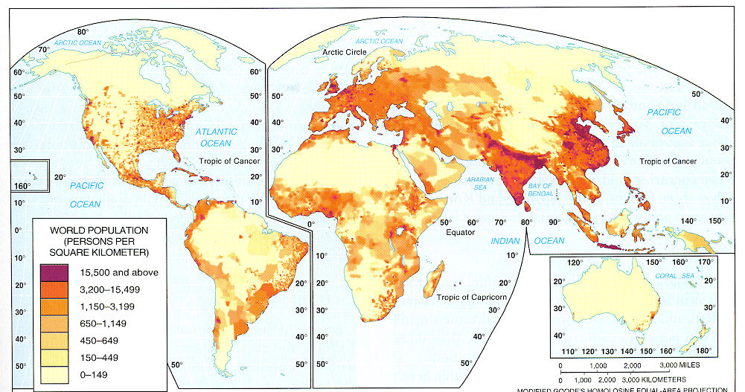
People are NOT distributed evenly across the Earth. Population is clustered in the mid latitude climates and relatively sparse in the dry and polar climates or the highlands.
Notes:
Earth: The Apple of Our Eye Activity
Slice an apple into quarters-remove ¾=oceans
Slice the quarter left (land) into 4 pieces set aside 3 = 2/3 are too rocky, wet, cold or covered by cities
1/32 left –peel the remaining piece=the topsoil surface that can grow food

Slide 4
Population Variations
Distribution
¾ of the world’s population lives on only 5% of the land.
Very uneven distribution intensified in 20th cent. as population soared.
2/3 of the pop. lives near an ocean or river.
Ecumene
Tech can/has increased ecumene and carrying capacity
Unlivable areas declining
Dry Lands (20% of planet) between 15-50 degrees lat.
Equatorial wet lands
Cold lands – permafrost, polar deserts
High lands (some exceptions in mts. of S. Am. & Africa)
Consider these points…
We have always been unevenly distributed, but the uneven distribution intensified in the 20th century.
Numbers are very important-every 10 years since 1790 the US govt. has done an official nation-wide census or count of the population to determine representation in Congress and the distribution of federal aid.
Mayors of big cities have been upset in recent years since inner cities are notoriously undercounted in the census. Why?
Notes:
Distribution-arable land is only a fraction of the Earth’s surface-
Often population maps are shown by using dots to represent populations.
We have always been unevenly distributed-but the uneven distribution intensified in the 20th century.
Numbers are very important-every 10 years since 1790 the US govt. has done an official nation-wide census or count of the population to determine representation in Congress and the distribution of federal aid. Mayors of big cities have been upset in recent years since inner cities are notoriously undercounted in the census. Why? The US Census Bureau also gathers world population data. United Nations officials also keeps statistics as does the World Bank and the Population Reference Bureau.
Growth rates, health and food availability are often estimates and are subject to error and inconsistency.

Slide 5
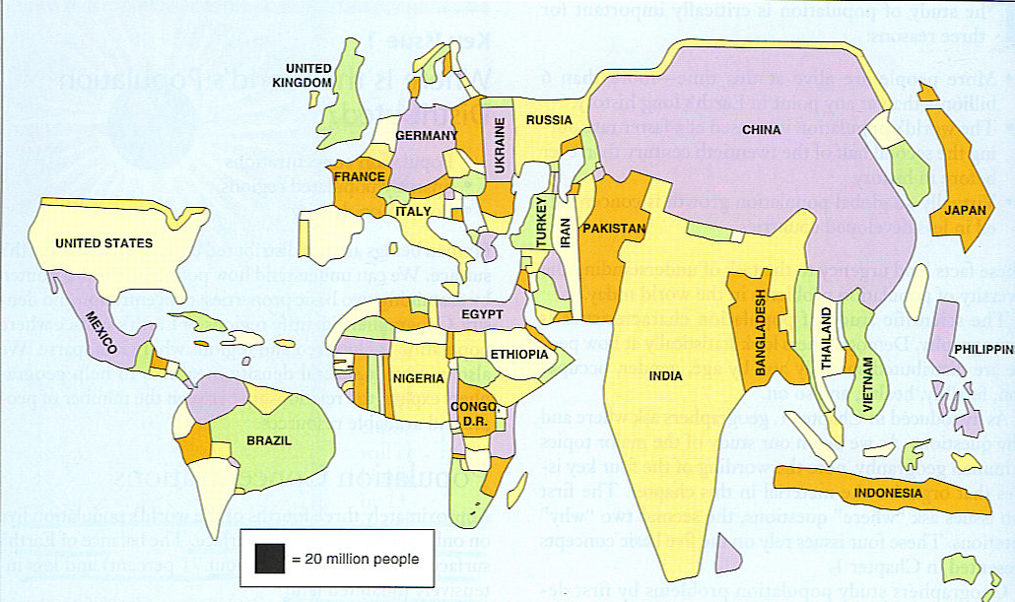
World Population Cartogram
Countries named have at least 50 million

Slide 6
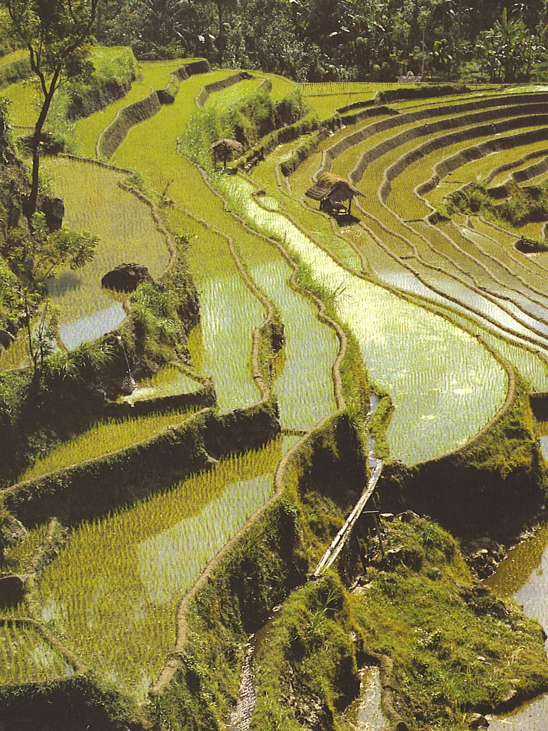
Major Population Concentrations
East Asia
1/4 of the world’s population is here
Concentration along coast and rivers in China
Most people are farmers, not city dwellers in China
Japan and Korea
3 major urban centers,
¾ urban pop

Slide 7
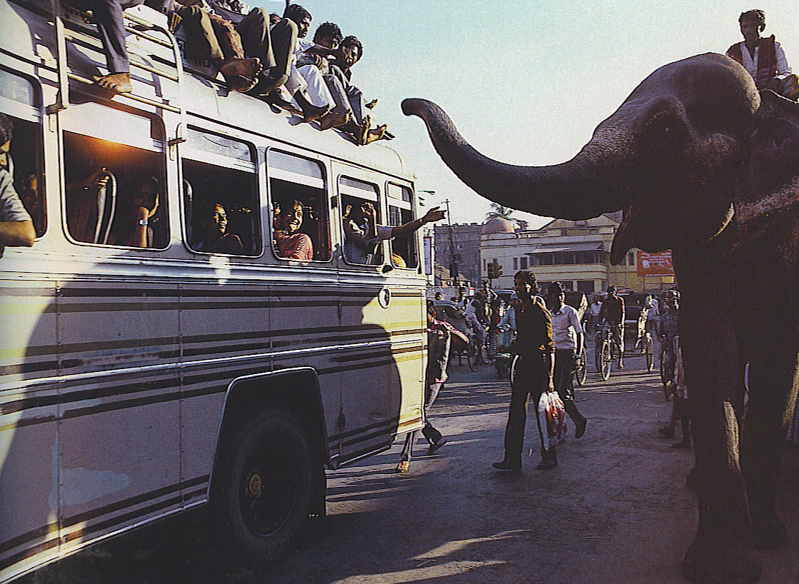
Major Population Concentrations
South Asia
2nd largest population cluster.
Dense pop. follows the Ganges and Indus rivers.
Bangladesh (size of Iowa) with 141 million (1/2 of total U.S. pop)
14 cities over 2 million
Still ¾ rural population

Slide 8
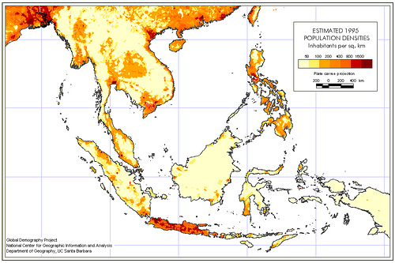
Major Population Concentrations
Southeast Asia
Vietnamese coast and inland rivers very dense
Islands of Java and Philippines
High % of farmers

Slide 9
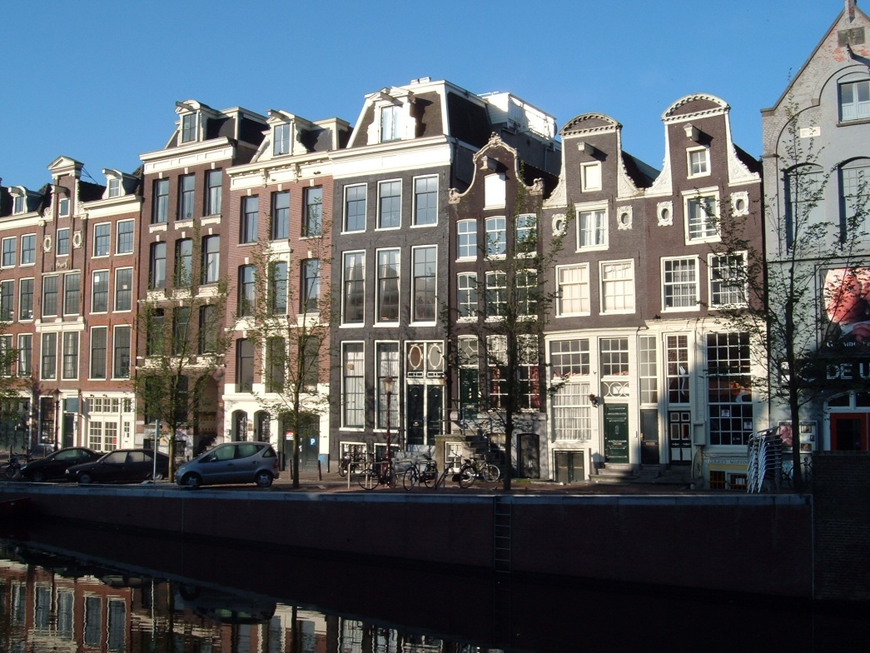
Major Population Concentrations
Europe (Western)
Over 700 million.
75% to 90% living in cities.
< 20% farmers
Dense road & rail networks
Import food & resources
Motivation for colonization
Closely spaced houses in
Amsterdam, Netherlands

Slide 10
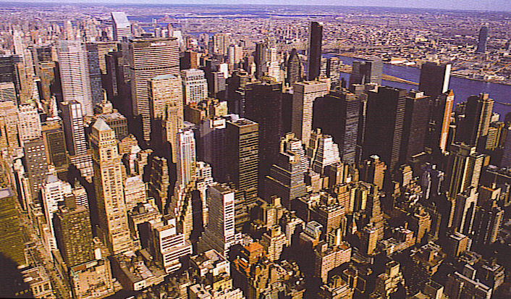
Major Population Concentrations
Eastern North America
Megalopolis Boston to Washington, D.C. which includes New York and Philadelphia.
West along Great Lakes to Chicago
Mostly urban
< 5% Farmers

Slide 11
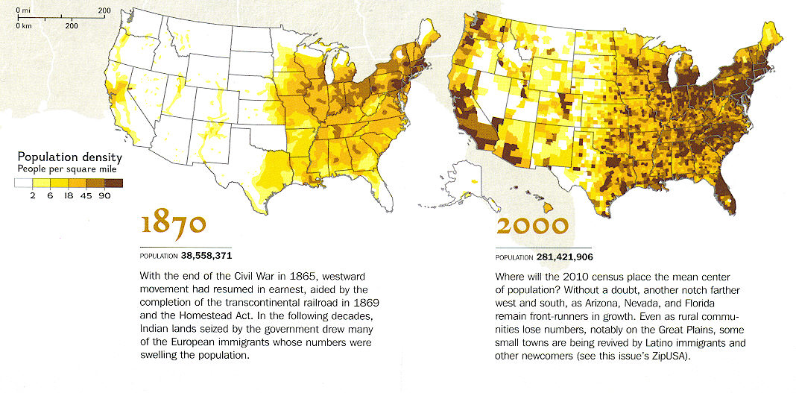

Slide 12
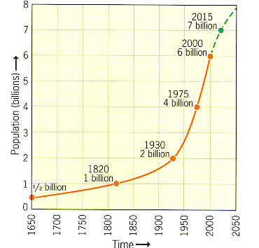
Population Growth
From Dawn of History to 1820 to reach 1 billion
1820-1930 to reach 2 billion
1970s only 12 years to add another billion.
Then a decade for another billion.
Notes:
1975 4 billion-world population increased from 3 to 4 billion in 14 years
1987 5 billion-from 4 to 5 billion in 13 years
1998 6 billion-from 5 to 6 billion in 12 years
A growth rate of 1 billion people per decade.
By 1997 growth rate was 1.5% - today 1.4%

Slide 13
Population Growth
Natural Increase Rate – NIR
Based on CBR and CDR only
Does NOT include migration
Tiny % NIR = Huge pop changes
2010 World NIR = 1.4% (1963=highest, 2.2%)
NIR almost entirely in LDC
Impacts doubling time
Total Fertility Rate – TFR
Average # children/woman
Averages < 2 in MDC and >6 in many LDC
Mortality
2 measures = infant mortality rate & life expectancy
IMR reflects health care
CDR does NOT vary directly with MDC vs. LDC
Ex. U.S. CDR higher than Mexico due to stages of demographic transition

Slide 14
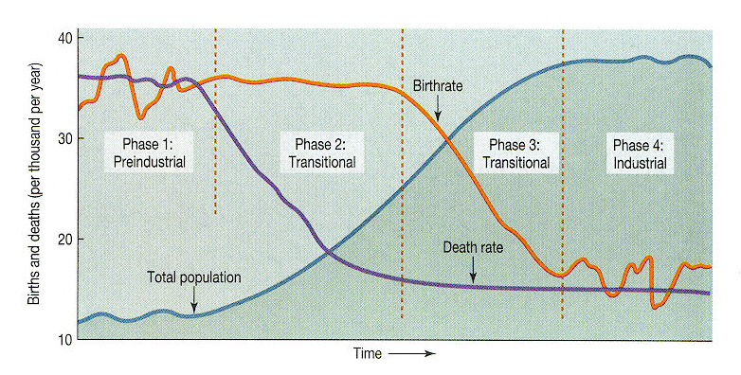
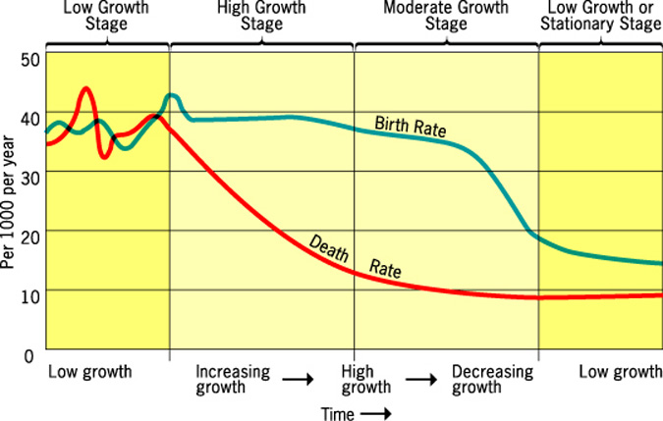
Demographic cycles of population growth
Stage 1 High Stationary Growth with high birth rates 40/1000 or higher and high death rates.
Stage 2 Early Expanding with high birth rates and declining death rates (birth 40s/death 20/1000) = rapid growth in pop.
Stage 3 Late Expanding with declining birth rates (30s) and low death rates (10s) = still significant growth
Stage 4 Low Stationary has low birth rates and low death rates (birth 15 and death 10 or lower) SPL Stationary Population Level
Notes:
Stage 1 has virtually no growth rate with very high birth and death rates. Most of human existence was in Stage 1 of the Demographic Transition model. Today no country is in this category.
Stage 2 has rapidly declining death rates and very high birth rates to produce population growth. In the late 18th and early 19th centuries several countries moved to stage 2 as the Industrial Revolution took place. Europe and North America entered Stage 2 about 1800, but Africa, Asia and South America did not reach stage 2 until around 1950. Africa, Asia and Latin America reached Stage 2 not because of an Industrial Revolution, but a medical revolution invented in Europe and North America and diffused to these places.
Stage 3 European and North American countries moved from Stage 2 to Stage 3 in the first half of the 20th cent. Most of Asia and Latin America moved to Stage 3 in the last half of the 20th cent. while Africa remained in Stage 2. Nations enter Stage 3 when people decide to have fewer kids since living in cities and working in factories or offices requires fewer people.
Stage 4 When the crude birth rate equals the crude death rate zero population growth is achieved or Stage 4.
Some argue that this model is useful only to study the demographic history of the core countries.

Slide 15
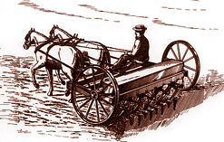
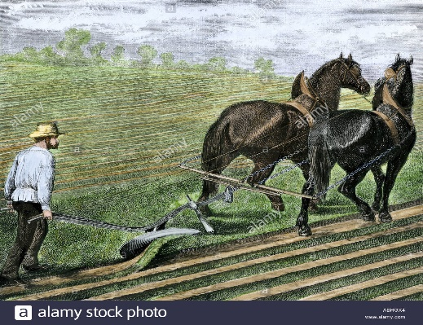
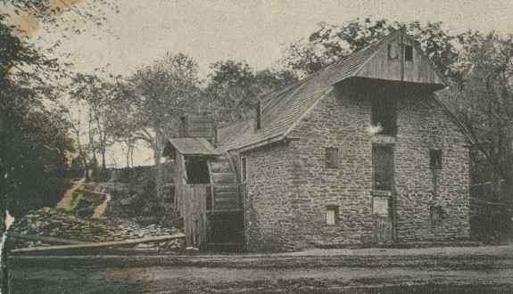
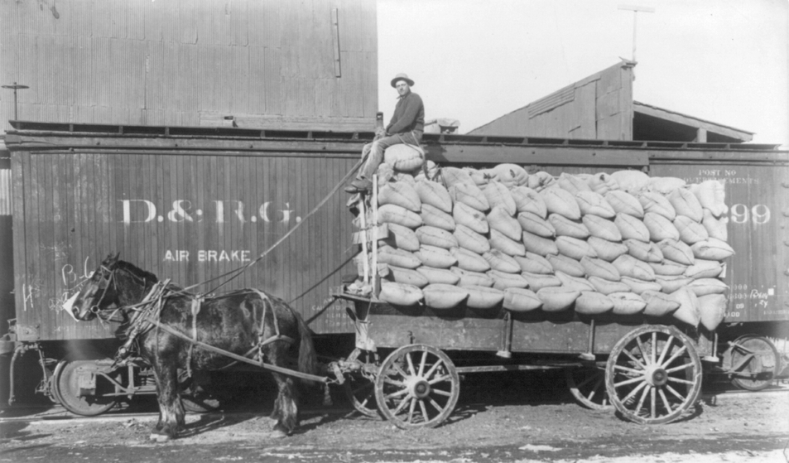
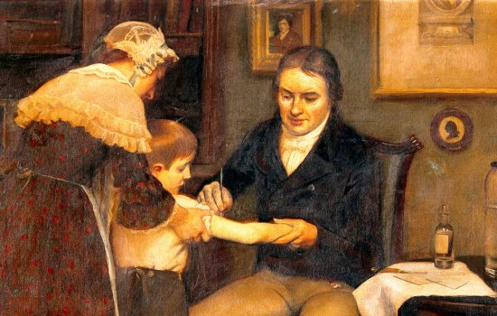
Second Agricultural Revolution and Industrial Revolution
18th century gains in agricultural production:
Crop yields improved with better farming methods
New crops such as potatoes, turnips and alfalfa
Storage and distribution improved which alleviated famines and shortages.
Industrial Revolution was also a factor:
Improved sanitation/public health
Improved medical care
Disease prevention such as smallpox vaccine
Notes:
Before 1750 Death rates were 35 and Birth rates were 39 per 1,000 a rate of increase of .4% or a doubling time of 150 years
By 1850 Death rates were 16 and Birth rates were 36 with a rate of increase of 2% and a doubling time of 35 years.

Slide 16
Demographic Transition Stages
No nations still in Stage 1
Industrial Revolution brought Stage 2 to Europe and North America early
Africa, Asia, Latin America etc. mid 20th century
Diffusion of medical technology vs. industry
Wealth & Urbanization typically bring Stage 3
Europe and North America Early 20th century
Asia and Latin Am. Recently
Africa still mostly Stage 2

Slide 17
Demographic Transition Stages
Europe mostly Stage 4 but diversity in U.S. keeps Total Fertility Rate higher
Social changes promote transition growth. Examples include female employment, access to birth control, and investment for arts and entertainment programs.
Eastern Europe in negative growth
Transitional growth stunted by suppressed societies. Examples included governments that promoted natalist policies, industrial value over environmental health, and poor healthcare systems.
Outside of Europe and North America, the Crude Death Rate dropped due to outside forces vs. inner changes
Colonization and Globalization pros / cons to Demographic Transition Stages.
Harder to complete change or stages since CBR only altered by social change and not tech

Slide 18
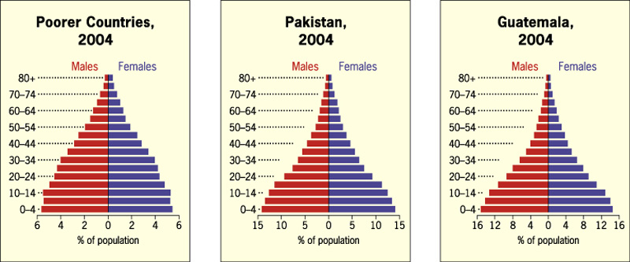
Population Pyramids –
Charts that show the percentages of each age group in the total population, divided by gender.
For poorer countries, the chart is shaped like a pyramid. Infant mortality rates are high, life expectancy is shorter.

Slide 19
Population Pyramids
For wealthier countries, the chart is shaped like a lopsided vase. Population is aging, TFRs are declining.

Slide 20
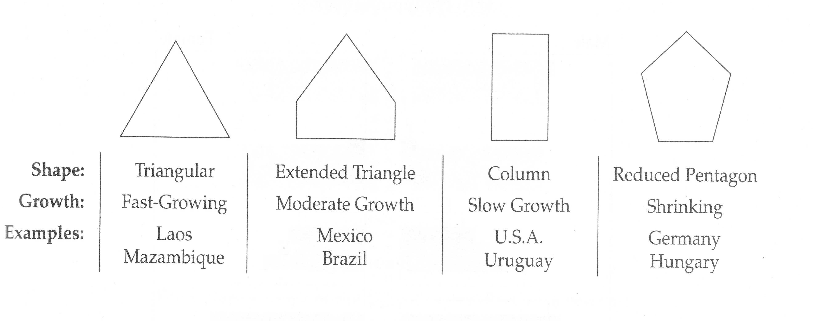
Four Patterns of Population Structure
Reflects different demographic transition stages
Dependency ratios easy to visualize
Notes:
Kenya will face many employment problems when the bottom cohort is old enough to work.
Austria’s negative growth means a future with fewer workers to support social services.
Russia’s 1992 pyramid shows the sharp decline in births during WW II as the “pinching” of 45-49 cohort. Also note the large deficits of men above 65 due to the heavy male mortality during the World Wars

Slide 21
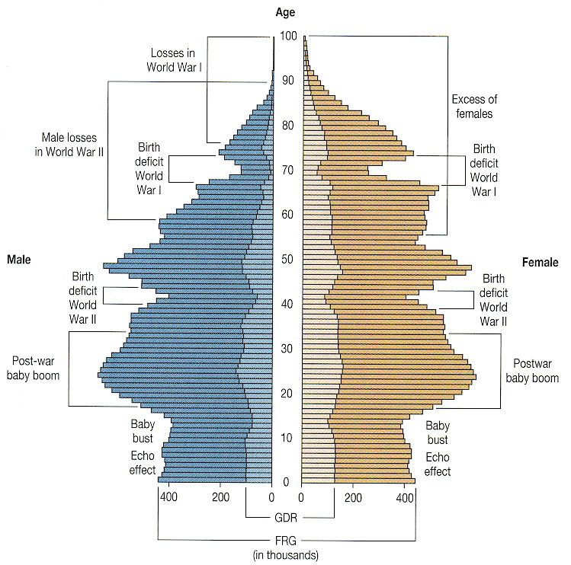
Population of
Germany, 1989
Notes:
Germany’s population profile is that of a wealthy core country that has passed through the post war baby boom and has a low birthrate. Note the impact of the losses of World War I and World War II.

Slide 22
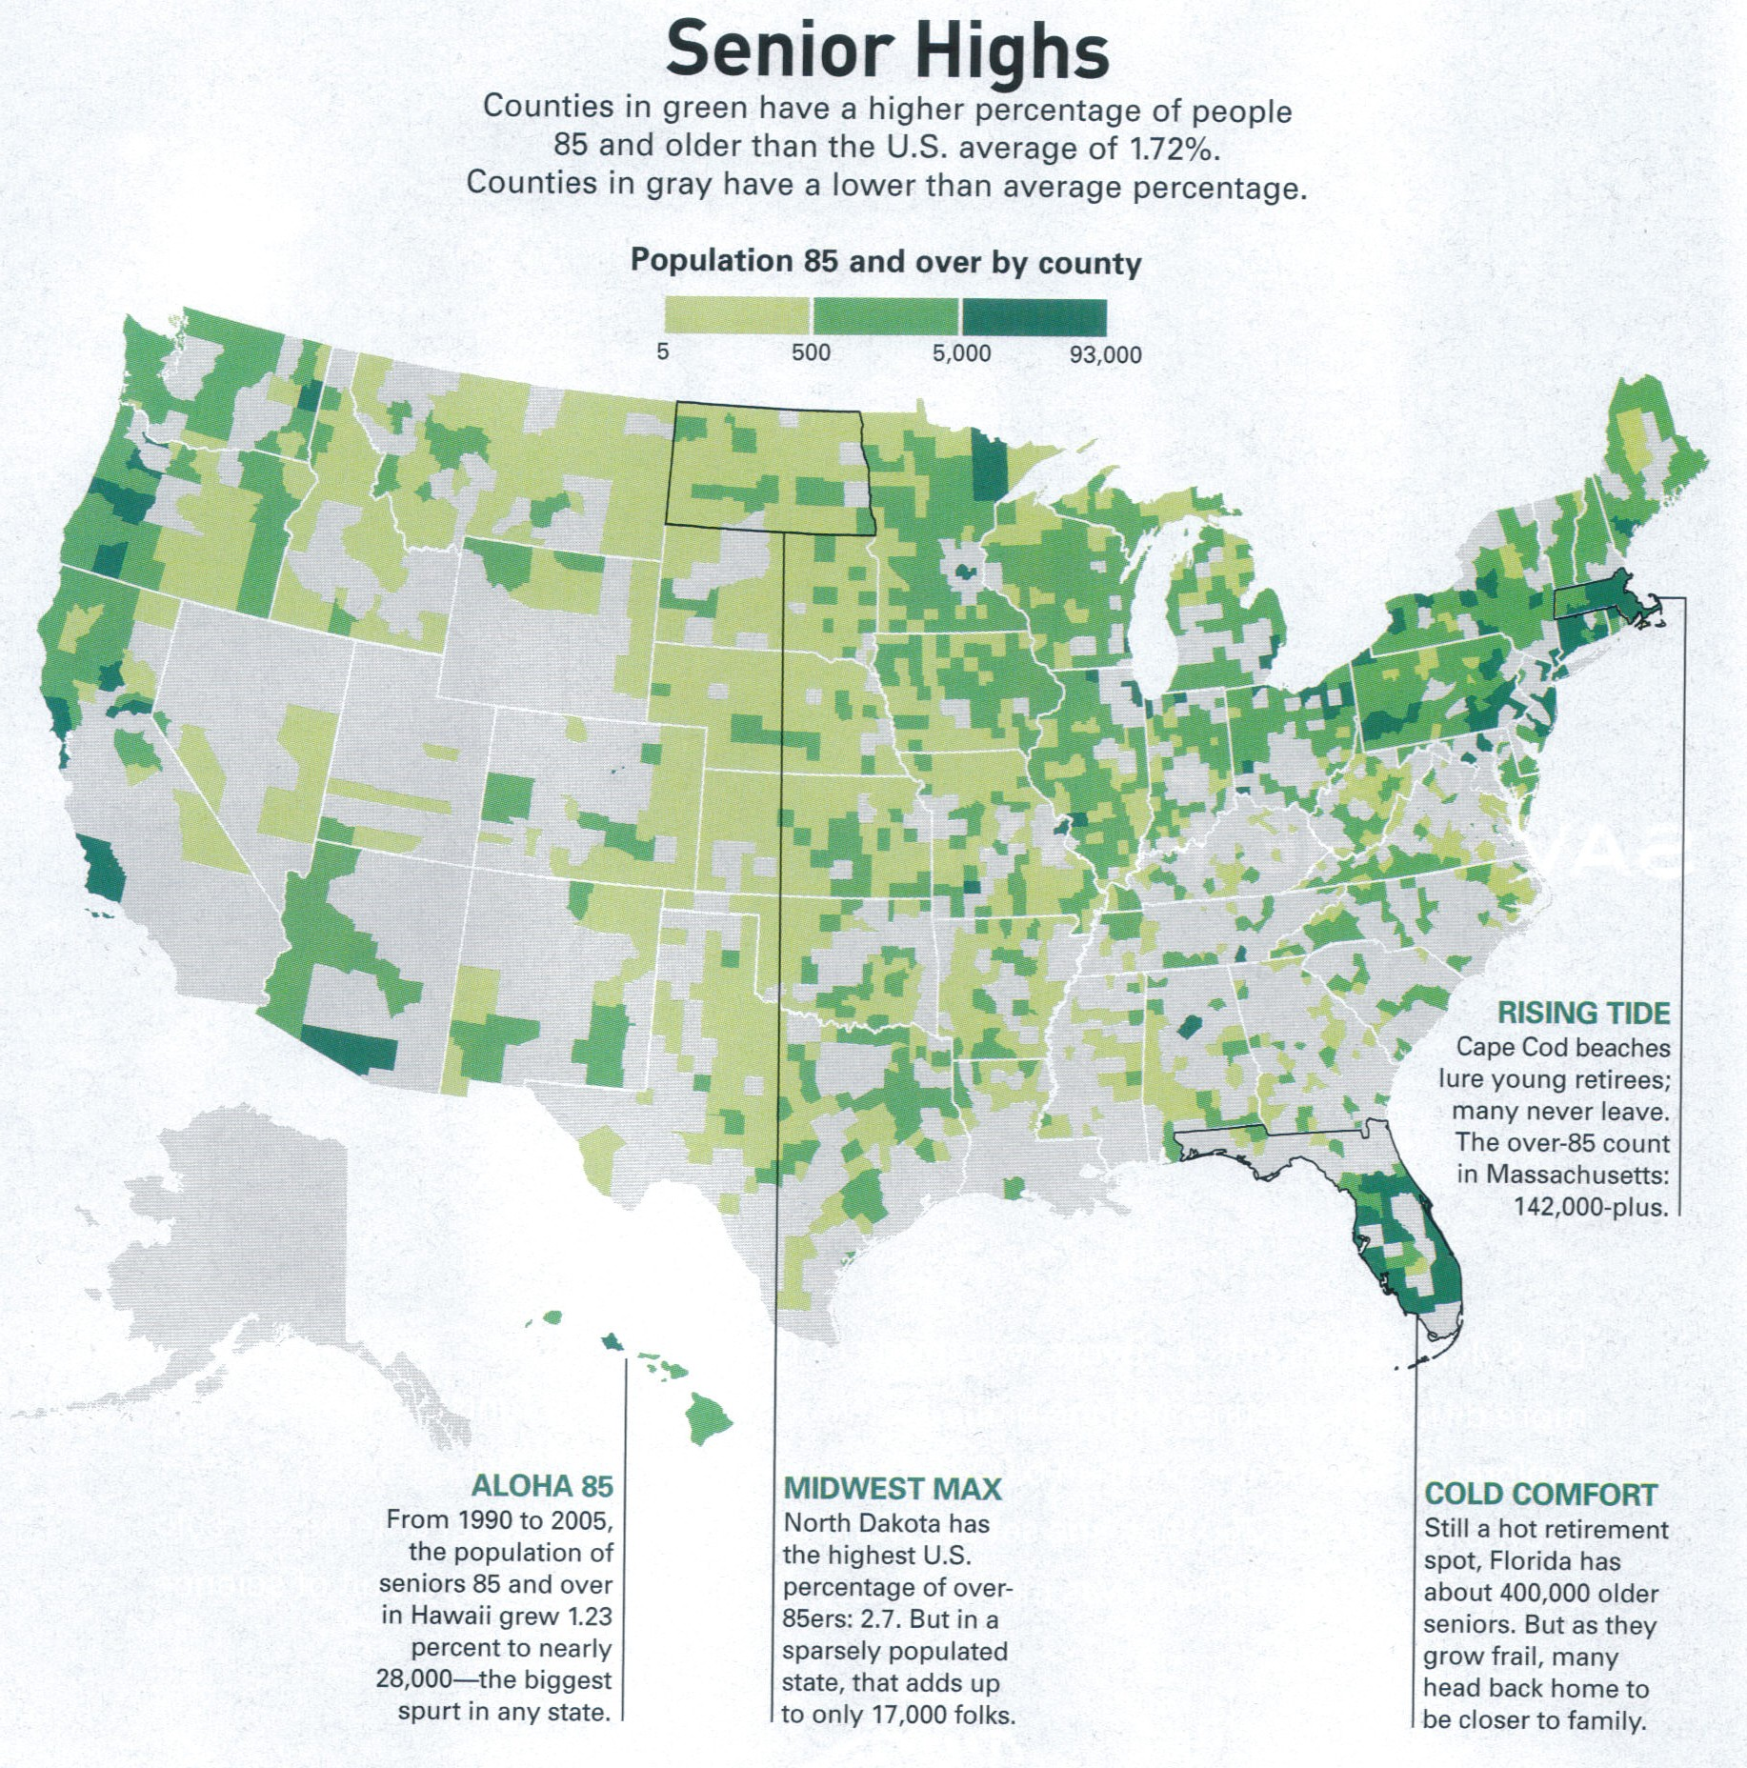
85 years and older is the fastest growing group in the US Population
2005 the “old old” topped 5 million.
By 2050 it is expected to be 20 million
Midwest has a high percentage since the young leave for jobs elsewhere.
Boston and San Francisco have gone grayer as seniors age in place.
Notes:
85 years and older is the fastest growing group in the US Population
2005 the “old old” topped 5 million
By 2050 it is expected to be 20 million
Midwest has a high percentage since the young leave for jobs elsewhere.
Boston and San Francisco have gone grayer as seniors age in place.

Slide 23
Low Growth in Denmark
Since the 1970s, with little population growth since then. Its population pyramid shows increasing numbers of elderly and few children.

Slide 24
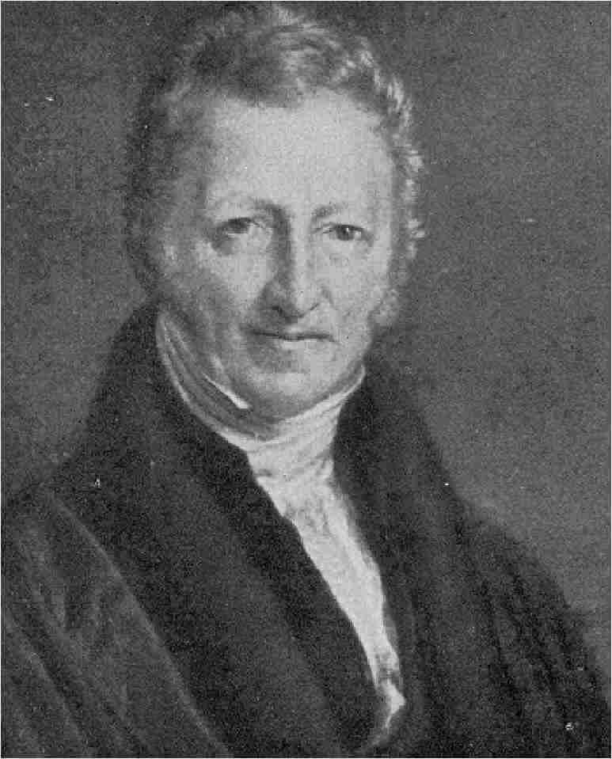
In 1798 he published An Essay on the Principle of Population
World’s population was expanding more rapidly than food production.
1st to recognize exponential population growth.
Predicted population pressure on resources would lead to disease, famine, war, &/or moral restraint
Today Neo-Malthusians revive theory but add pressures on fuel resources, clean air etc.
Rev. Thomas Malthus
1766-1834
Notes:
Thomas Malthus 1766-1834 a political economist and a clergyman he published a short book called Essay on Population in 1798 in which he argued that food production would always be outpaced by population growth.
Positive checks on population growth include war, famine and disease.
As a conservative clergyman he disapproved of birth control by artificial means.

Slide 25
Overpopulation Critics
Critical counterpoints to the overpopulation fears of Malthus:
World has enough but capitalism leads to unequal distribution
Stage 3 & 4 pop growth were not foreseen by Malthus
Technology, science, and medical advances can expand resources & carrying capacity
Ex. Since 1950 food production grew faster than NIR even though NIR was at highest rates
***CBR affected by Economy, Religion, Education, & Status of women

Slide 26
Why Migrate?
3 Common Objectives
Economic Opportunity
Cultural Freedom
Environmental Comfort
3 areas of study
Why move?
How far?
Who moves?

Slide 27
Circulation & Activity Space
Space of movement for daily activities
Circulation to jobs & schools
Expands with age
Expands with ability & opportunity to travel
Larger in suburb vs. city
Awareness space may be limited by poverty or physical isolation
Space-time prism sets limits for activities

Slide 28
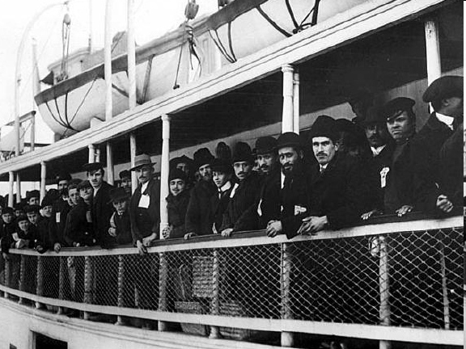
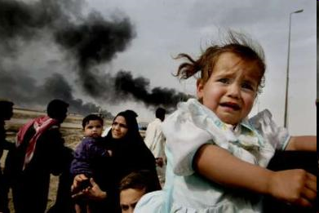
Why Migrate?
Push and Pull Factors
Jobs (lack or abundance)
Culture
Push – slavery, war, persecution etc.
Pull – freedom, individual choice etc.
Environmental
Pull – Mountains, coasts, warm climates etc.
Push – drought, flood etc.

Slide 29
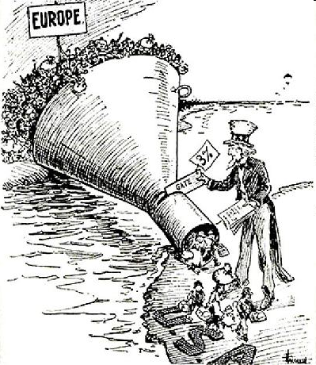
Why Migrate?
Obstacles Intervene
Types of obstacles vary with time
Physical Barriers
Transportation, extreme landscapes etc.
Legal Barriers
Passports, visas, quotas etc.
The image above represents both a physical and legal barrier to emigration. European immigrants had to overcome the journey across the Atlantic Ocean as well as the quotas established by the US Government.

Slide 30
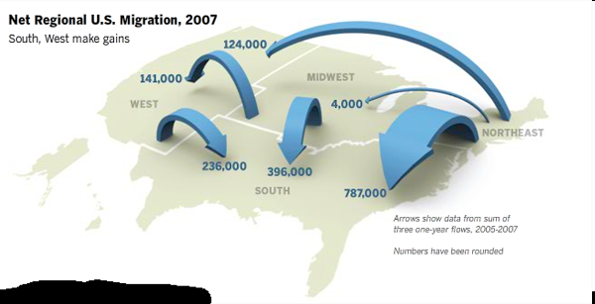
Migration Distance Patterns
Majority of migration patterns = internal, short
Interregional ex. Rural to urban
Intraregional ex. Older to newer urban area
Long-Distance typically head for economic centers
International can be voluntary or forced

Slide 31
Intraregional Migration
Metropolitan to Nonmetropolitan areas
Late 20th century in N.Am. & Europe
Counterurbanization
Motivation = lifestyle
Technology prevents true isolation
Retirement communities w/recreation opportunities
Global competition hurts economy in rural areas slowing counter-urbanization

Slide 32
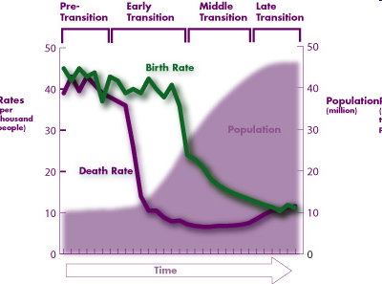
Migration distance patterns
Migration Transition
Linked with Demographic Transition Model
Stage 1 – Daily or seasonal movement
Stage 2 – Often International and Interregional movement
Stages 3 & 4
Internal migration more likely
Become destination for Stage 2 immigrants

Slide 33
Who are migrating?
Long-distance migrants
Mostly male, adult, single
Gender pattern reversed in U.S. in 1990s (evolving gender roles / family dynamics)
Age pattern altering (youth movement)
Example
Recent U.S. immigrants from Mexico
Less educated than average American
More educated than average Mexican
Farm work = some seasonal migration

Slide 34
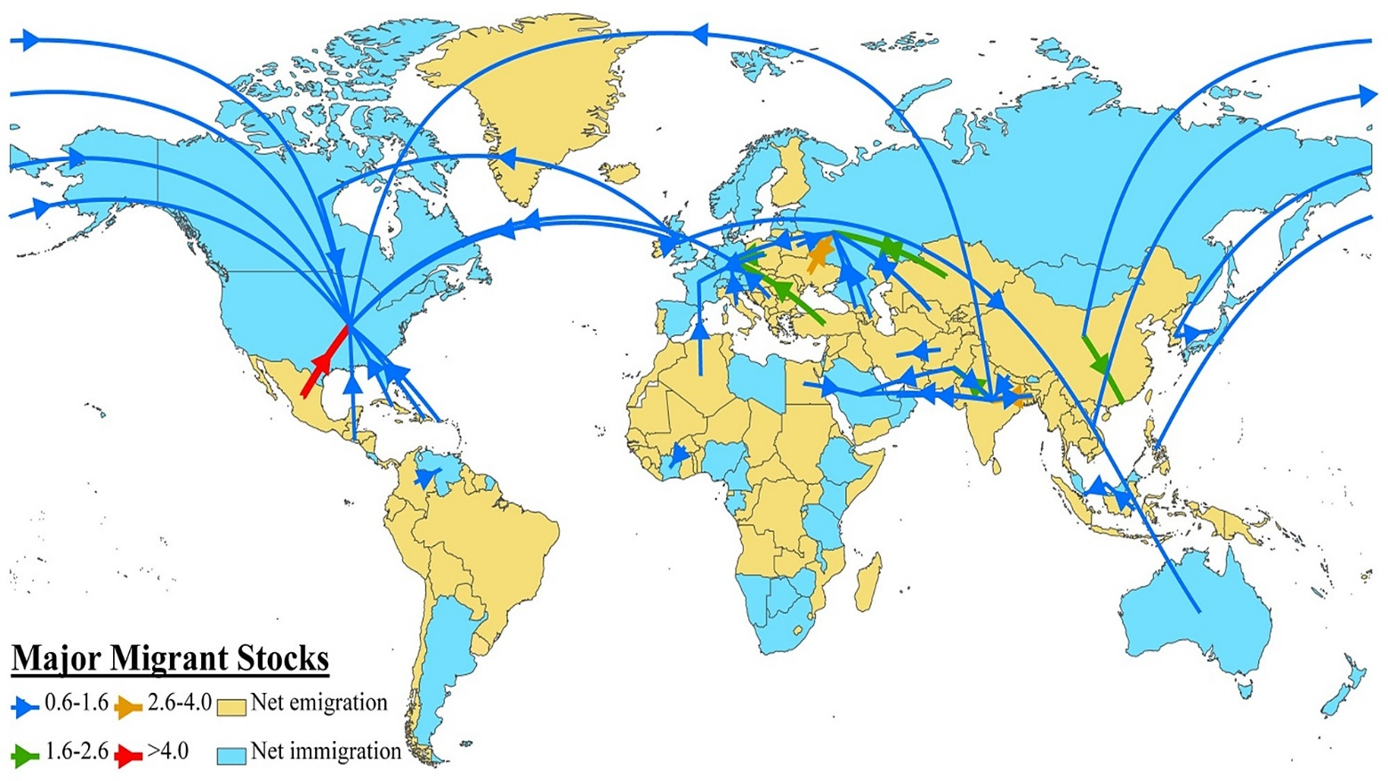
Global Migration Patterns
Global Net Emmigration
Asia, Latin America, Africa
Net Immigration
North America, Europe, Oceania
3 largest flows (Mainly LDC to MDC)
Asia to Europe
Asia to North America
Latin America to North America

Slide 35
Immigration to the U.S.
Major sources
Germany
Italy
U.K.
Ireland
Russia/USSR
Many Poles counted as German or Russia
The US is the world’s 3rd most populous nation
Almost entirely immigrant descended
1st Peak= Colonial (Mainly British, surge in 1800s)
90% Northern and Western Europe
2nd Peak= Late 1800s German and Irish
3rd Peak= Early 1900s Italian and Slavic regions of Europe
Mid 1800s-Early 1900s = 90% European
1970s–present = 75% Latin Am. & Asia

Slide 36
Current U.S. Destination patterns for migrants
3 Factors
Proximity, Chain migration, Established communities
¼ California
Mexican, Chinese, Indian, other Asians
¼ NYC and New Jersey
Caribbean, Chinese, Indian, E. Europe
¼ Florida, Texas, Illinois
Caribbean in FL, Mexican in TX, Mexican & E. Europe in IL
¼ in other 44 states

Slide 37
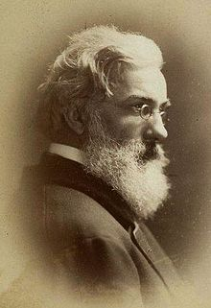
Ravenstein's Laws of Migration:
Most migrants move only a short distance.
Migration occurs in steps.
Most migrants tend to move to cities, and those cities grow more through migration than natural increase rate.
Each migration flow produces a counter-flow (not necessarily the same number).
Rural dwellers migrate more than urban dwellers.
Females are more migratory than males within regions and states, but males are more migratory over longer distances.
Most migrants are adults.
Economic factors are the main cause of migration, and economic development fuels movement.
Ernst Ravenstein 1834-1919

Slide 38
Main Concepts of migration:
Understand the difference between circulation and migration
Recognize the difference between emigration and immigration
Pay attention to global migration patterns.
Study Ravenstein’s Laws of Migration
Analyze Push factors and pull factors—How do they differ? What are some examples of each from history?
Recognize the push/pull factors. Reflect on how they differ, and be able to identify various examples throughout history.
Identify the intervening obstacles migrants face (physically / legally), and apply those forces to migration at different scales (local / global)

