Slide 1
The Constitution and Federalism
An evolving process

Slide 2
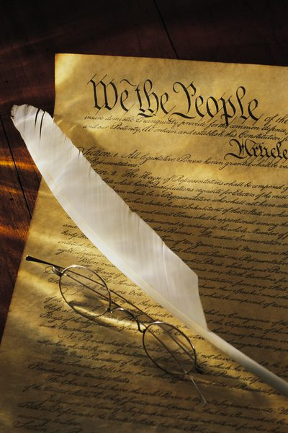
Outline of The U.S. Constitution
Preamble- Introduction
Article I – Legislative Branch Powers
Article II - Executive Branch Powers
Article III – Supreme Court Powers
Article IV - Full Faith And Credit
Article V - Amending the Constitution
Article VI - Supremacy Clause
Article VII - How to Ratify
Bill of Rights- Amendments 1-10
Evolving Laws- Amendments 11-27

Slide 3
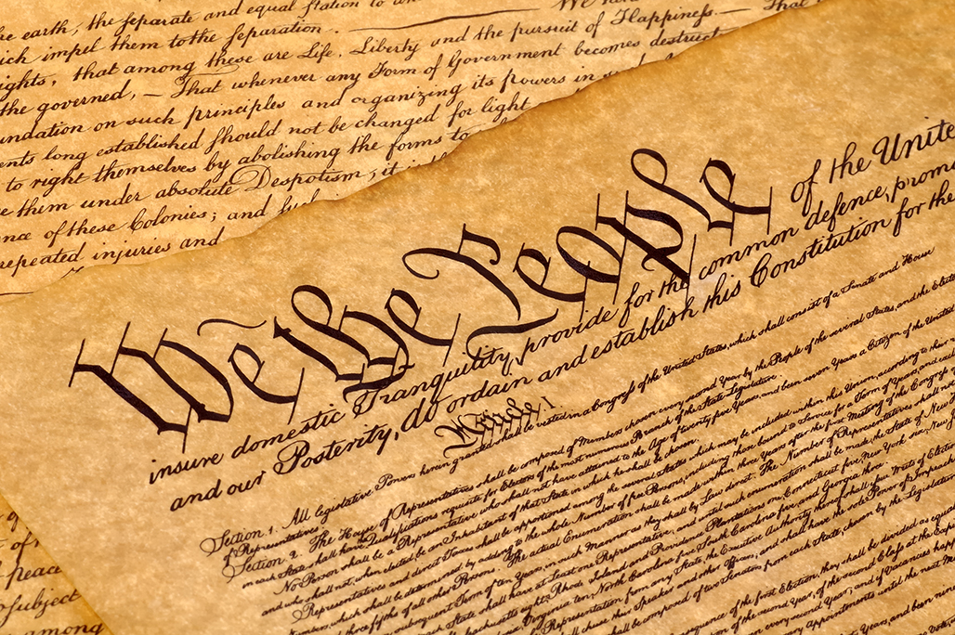
Basics of the Constitution
Popular Sovereignty
Rule of Law
Separation of Powers
Checks And Balances
Judicial Review
Federalism

Slide 5
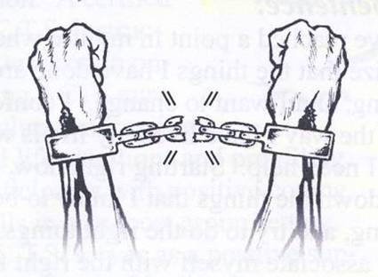
Rule of Law
This means that the law is applied equally to every citizen in the US.
Founding Fathers obviously dropped the ball on this one.
Civil War Era (13th, 14th, 15th) and Progressive Era Amendment (19th) addressed Rule of Law deficiencies.

Slide 6
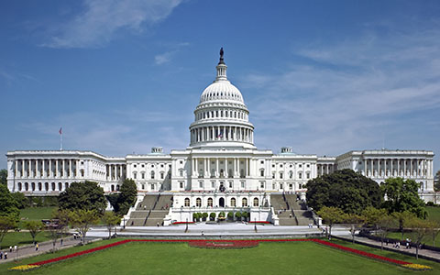
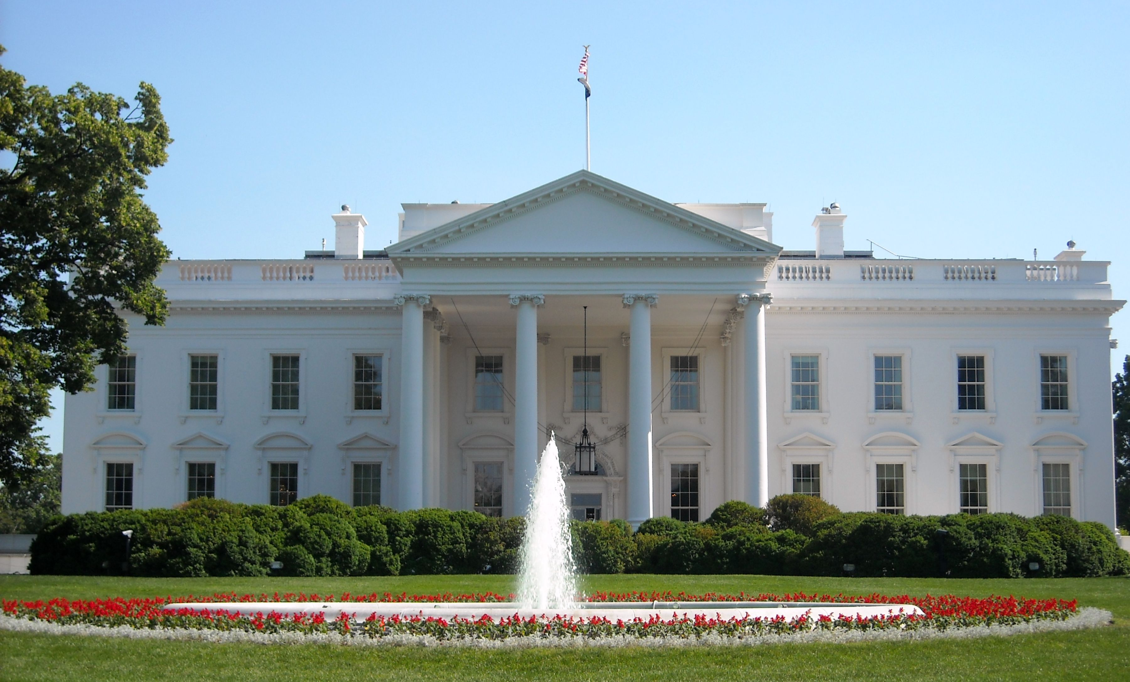
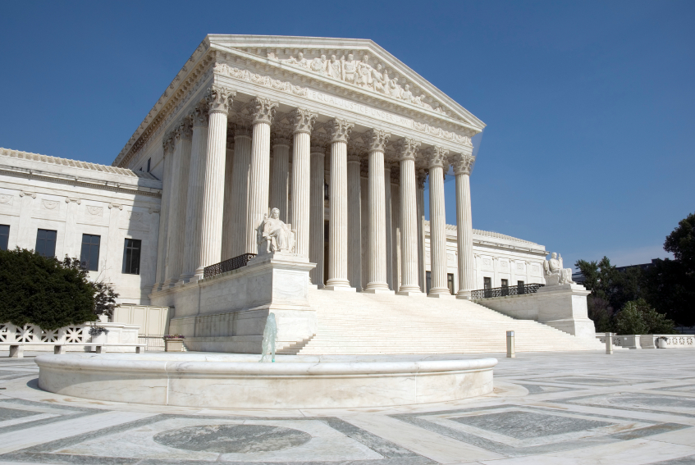
Separation of Powers
Legislative Branch- headed by the Congress (House of Representives, Senate). They make all of the laws. The Legislative branch gets its powers from Article I of the Constitution.
Executive Branch- Article II in the Constitution gives the President the power to enforce the laws of The Constitution.
Judicial Branch- headed by the Supreme Court. They interpret the law. They get their power from Article III of the Constitution.

Slide 7
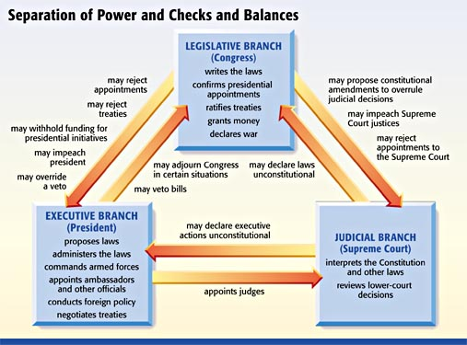

Slide 8
Judicial Review

Slide 10
Federalism
Ruling power is divided between the national government and the state governments.
Each of these levels of government have powers and responsibilities that are outlined in the US Constitution.

Slide 11
Federalism: Government Powers
Enumerated Powers are given to the federal government in the Constitution (coin money, regulate trade, declare war, maintain a postal service, and maintain an army / navy).
Implied Powers allows Congress to make laws that are necessary and proper for them to carry out expressed powers. This is also known as “The Elastic Clause”. (Air Force, National Bank, Military Draft)

