Slide 1
American Government: Origin and Purpose

Slide 2
Power–the ability of one person to get another person to act in accordance with the first person’s intentions Authority–the right to use power Legitimacy–political authority conferred by law or by a state or national constitution
What Is Political Power?

Slide 3
Key Terms / People
Sovereign (pg 7)
Nation (pg 5-6)
State (pg 6-8)
Autocracy (pg 18)
Monarchy (pg 19)
Oligarchy (pg 19)
Democracy (pg 19-20)
Unicameral ( pg 48)
Bicameral (pg 123)
Capitalism (pg 26)
Social Contract (pg 8)
Laissez-Faire (pg 27)
Socialism (pg 28)
Communism (pg 29)
Proletariat (pg 29)
Bourgeoisie (pg 29)
Command Economy (pg 29-30)
Market Economy (pg 717)
Free Market (pg 27)
Magna Carta (pg 36-36)
Articles of Confederation (pg 65)
Federalists and Anti-Federalists (pg 56-57)
New Jersey Plan (pg 54)
Virginia Plan (pg 54)
Connecticut Compromise (pg 54-55)
3/5 Compromise (pg 55)
U.S. Constitution (pg 3,13)
Preamble (pg 13)
Articles (pg 64)
Bill of Rights (pg 56-58)
Amendments (pg 65)
Adam Smith (pg 27)
Thomas Hobbes (pg 8)
Baron de Montesquieu (pg 63)
Jean-Jacques Rousseau (---)
John Locke (pg 8)
George Washington (pg 71)
John Adams (pg 71)
Thomas Jefferson (pg 55)
James Madison ( pg 52)

Slide 4
Major Types of Governments:
Autocratic- Power and authority to rule are in the hands of a single individual.
Totalitarian dictatorship- Ideas of single leader are glorified
Government seeks to control all aspects of social and economic life
Oligarchy- Any system of government in which a small group holds the power
Do not have to be connected by bloodlines in order to inherit power
Usually assembled by leaders of the economy, military, politics, education, or religion
Monarchy- A “royal” family rules from generation to generation.
Absolute Monarchy- Royal family is in total power
Constitutional Monarchy- Royal family are mostly celebrated figures
Democracy- A form of government in which power lies within the people.
Direct Democracy- All citizens may participate on each decision
Representative Democracy- Citizens vote for representatives to propose, create, and execute laws for the state

Slide 5
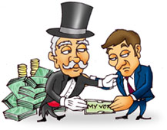
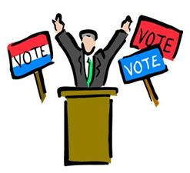
Motivators for political change to government policies include:
Economic interests
Powerful elites
Entrenched bureaucrats
Competing pressure groups
Morally impassioned individuals

Slide 6
A Social Contract
A social contract begins with individuals in a state of nature. Society is created by establishing a contract whereby people agree to live together in harmony for their mutual benefit. This contract involves the retaining of certain natural rights, an acceptance of restrictions of certain liberties, the assumption of certain duties, and the pooling of certain powers to be exercised collectively.
The social contract is very simple. It has only two basic terms: (1) mutual defense of rights; and (2) mutual decision by deliberative assembly.
Hobbes, Locke, and Rousseau all wrote extensively on the social contract that exists between a government and its citizens.

Slide 7
Key Political Change Documents
Magna Carta- a contract King John was forced to sign with English nobles in 1215 ensuring basic rights and principles.
Mayflower Compact- An agreement by the Pilgrims in 1620 just before landing at Plymouth Rock binding all participants to live in a civil society according to their own laws.
Declaration of Independence- A formal statement written by Thomas Jefferson and endorsed by the 2nd Continental Congress in 1776 establishing the colonial separation from Great Britain.
Articles of Confederation- A document signed by the 13 states in 1781 relegating most power to the individual state.
U.S. Constitution-the fundamental law of the U.S., framed in 1787 by the Constitutional Convention. It went into effect March 4, 1789.

Slide 8
Why did the American Colonists break away from the British Empire? (Cause & Effect)
Taxation by British without representation to pay for wars
Angered the wealthy leaders of the colonies
Intolerable Acts= Infuriated all classes with infringement of rights
Quartering Act, Boston Port Act, Stamp Act
Boston Massacre= Unruly mob get into it with British officers
Trial ended in soldier acquittals
Declaration of Rights= King ignored the petition
Continental Congress becomes more desperate to resolve crisis
Olive Branch Petition as a last ditch effort to mollify King George
King threatened colonists with hanging
Declaration of Independence
Colonists finally united in breaking away from the British Empire

Slide 9
Keys to successfully sustaining a democracy:
1) Need a healthy, large middle class
2) Need a stable, growing economy
3) Free enterprise- a citizen’s ability to make economic decisions
4) Support of higher education
a) It is the duty of government to provide education for citizens
5) People need to buy into the system and be involved
a) Organizations that exist separately from the government
b) Citizens must express views and make opinions heard
c) Acceptance of democratic values
1a- individual liberty,
1b-equality for all
1c-limits of government power

Slide 10
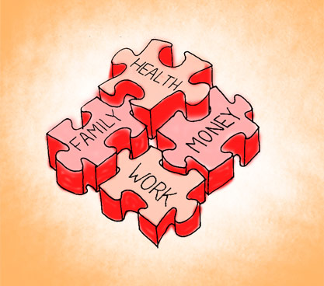
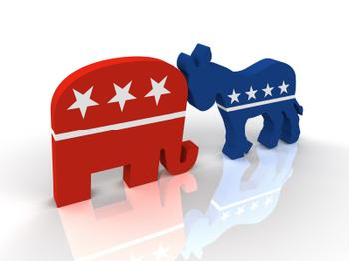
WHO GOVERNS? 1. How is political power actually distributed in America? 2. What explains major political change? TO WHAT ENDS? 1. What value or values matter most in American democracy? 2. Are trade-offs among political purposes inevitable?

Slide 11
The First Failure of Government
1781-Articles of Confederation
No central leadership
The “president” merely presided over meetings
All powers rested within each separate state
Legislative inefficiencies (system often gridlocked)
All states had to agree to approve an amendment
Congress could not regulate trade or impose taxes on states
There was no foreign affairs head to provide a unified diplomatic vision
No Independent Judiciary
States relied on their individual laws to manage cases
Interstate rivalries developed as a result of conflicting statutes
Government unable to protect citizens from domestic / foreign threats
State militias were the only form of protection from hostile forces
Funding for a standing army was not approved or supported by Congress.

Slide 12
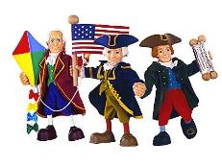
Essential Question-
Why did the Founding Fathers struggle to agree on the Constitution?
Federalists- Proponents of a strong central government, supported a Constitution that would be the supreme authority of the land, and desired 3 branches of government with an executive leader elected by the people.
Notable Leaders included George Washington, Alexander Hamilton, John Adams, and John Jay
Anti-Federalists- Proponents of state government, supported only amending the Articles of Confederation (not creating a Constitution), and believed the executive branch was provided too much power
Notable Leaders included Thomas Jefferson, Patrick Henry, Sam Adams, and Richard Henry Lee

Slide 13
The immediate problems facing the Constitutional Convention
12 of 13 colonies attend. Rhode Island refuses to go.
The goal of the Constitutional Convention was to revise the Articles of Confederation. This was soon discarded and work began on developing a new governing document.
Plan 1= Virginia Plan (supported populated states…failed)
Plan 2= New Jersey Plan (supported small states…failed)
Plan 3= Connecticut Compromise (bicameral legislation…success)

Slide 14
Support is finally obtained for the Constitution after the slavery issue is delayed for future debate.
3/5 Compromise= 5 slaves counted as 3 citizens for apportionment purposes in the House of Representatives
Congress would not tax exports from any state
The slave trade would be left alone for at least 20 years

Slide 15
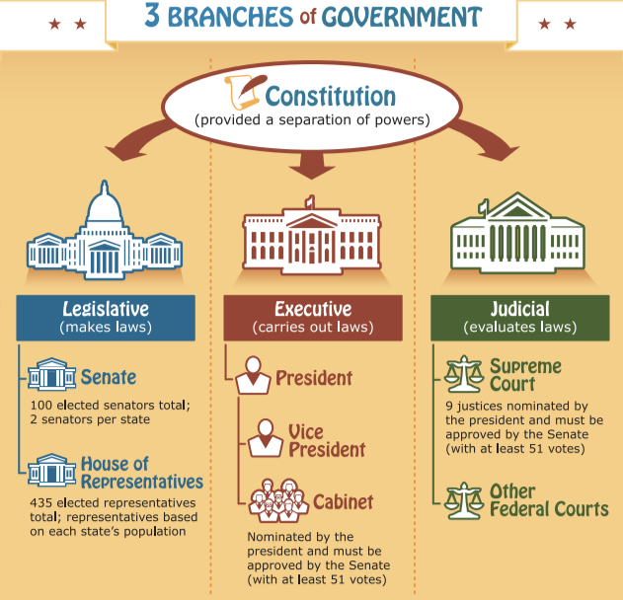

Slide 16
Characteristics of U.S. Democracy
Individual Liberty
People are free to pursue success
All citizen have a right to participate
Majority Rule with Minority Rights
Citizens accept majority vote as rule
Individual rights protected under U.S. Constitution
Free Elections
a) Each citizen has a vote
b) Competitive political parties
c) Secret ballots
d) Candidates express views freely

Slide 17
Reflection Activity
Imagine you are assigned to write an editorial article on the new constitution describing the benefits and weaknesses of the document.
Why will this document improve your state’s status?
How does this document address equality?
Will this document improve the lives of your citizens?
What changes would you like to see made to this document?
What challenge will face the changes you propose?

