Slide 1
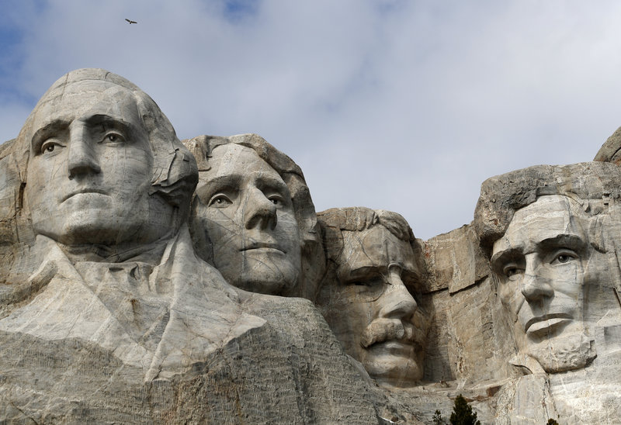
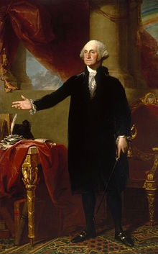
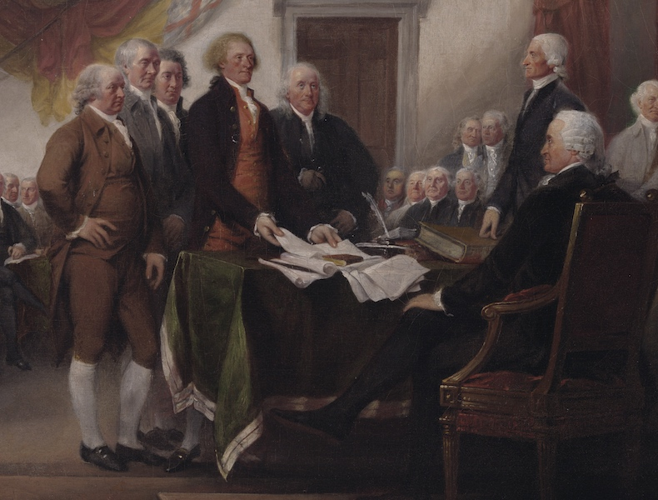
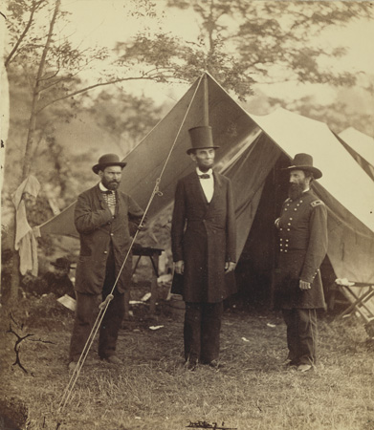
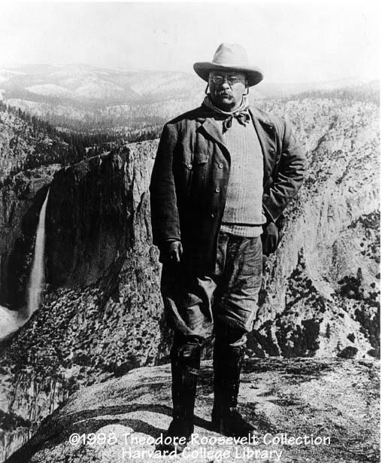
Article II: The Executive branch
A review of the functions and purpose of the presidency, guidelines to serve, and important leadership concepts to consider when assessing the content.

Slide 2
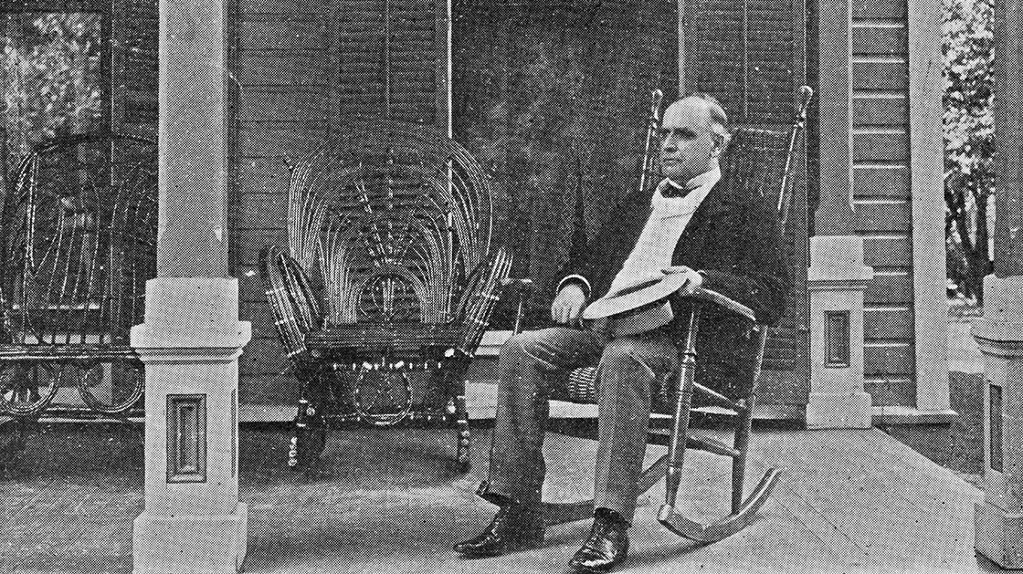
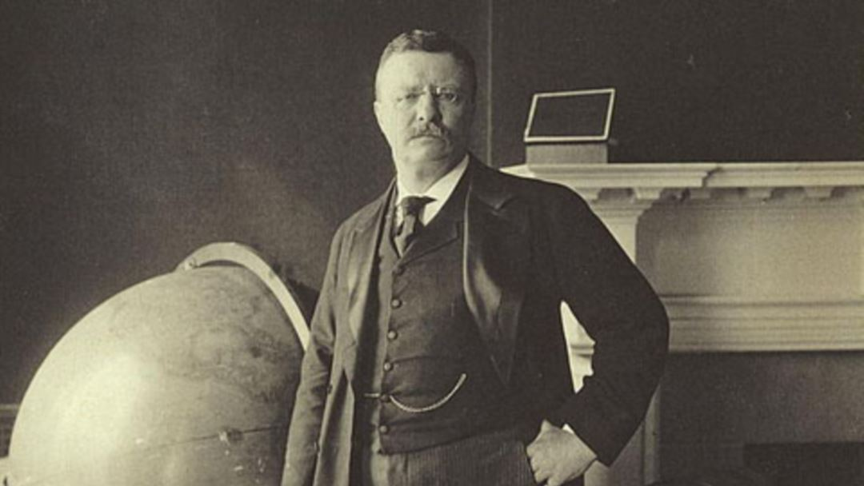
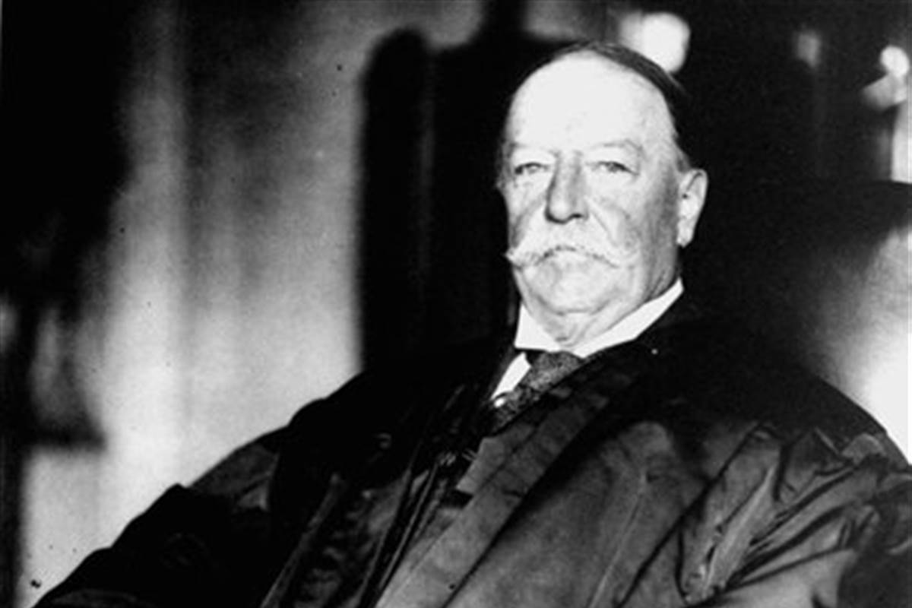
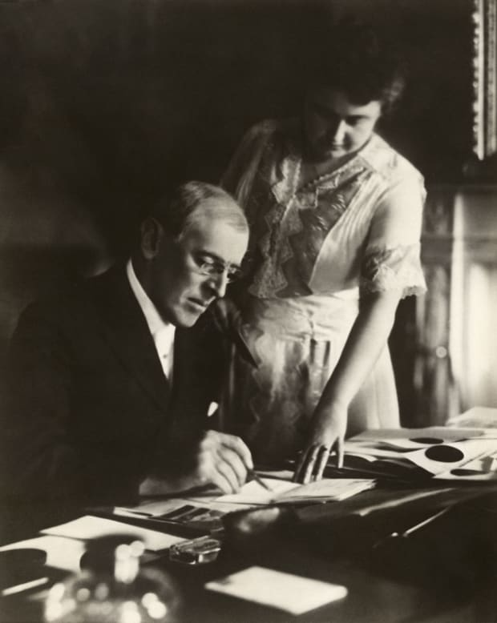
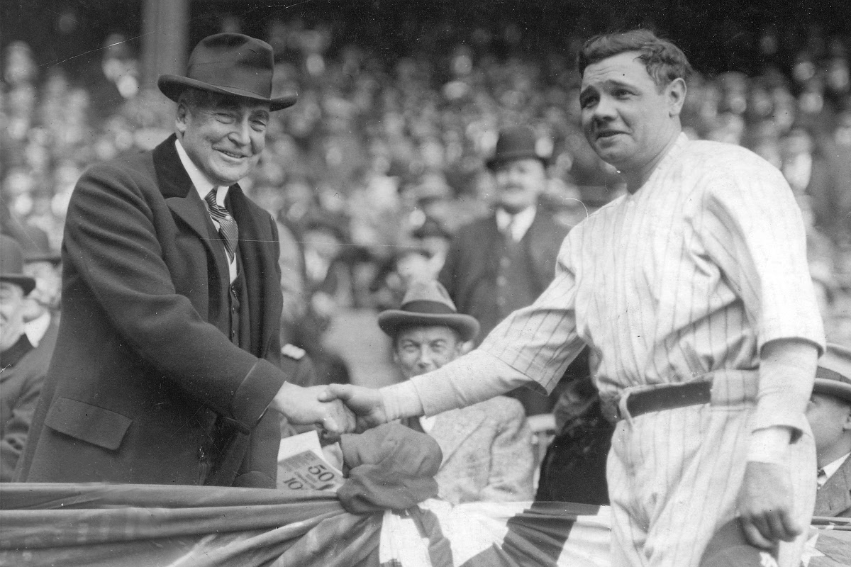
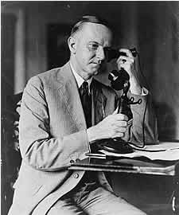
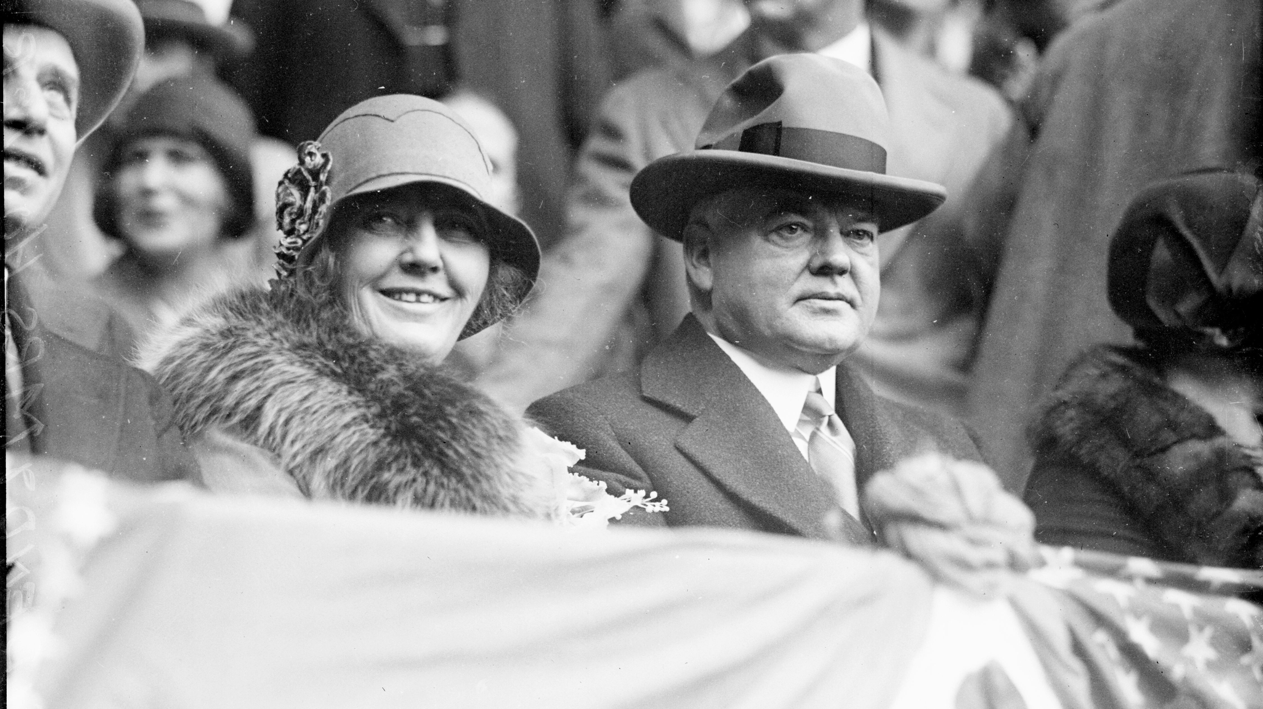
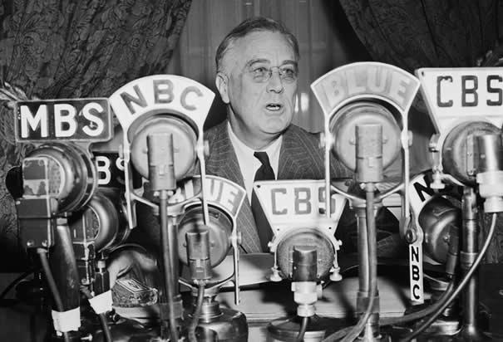
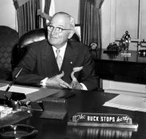
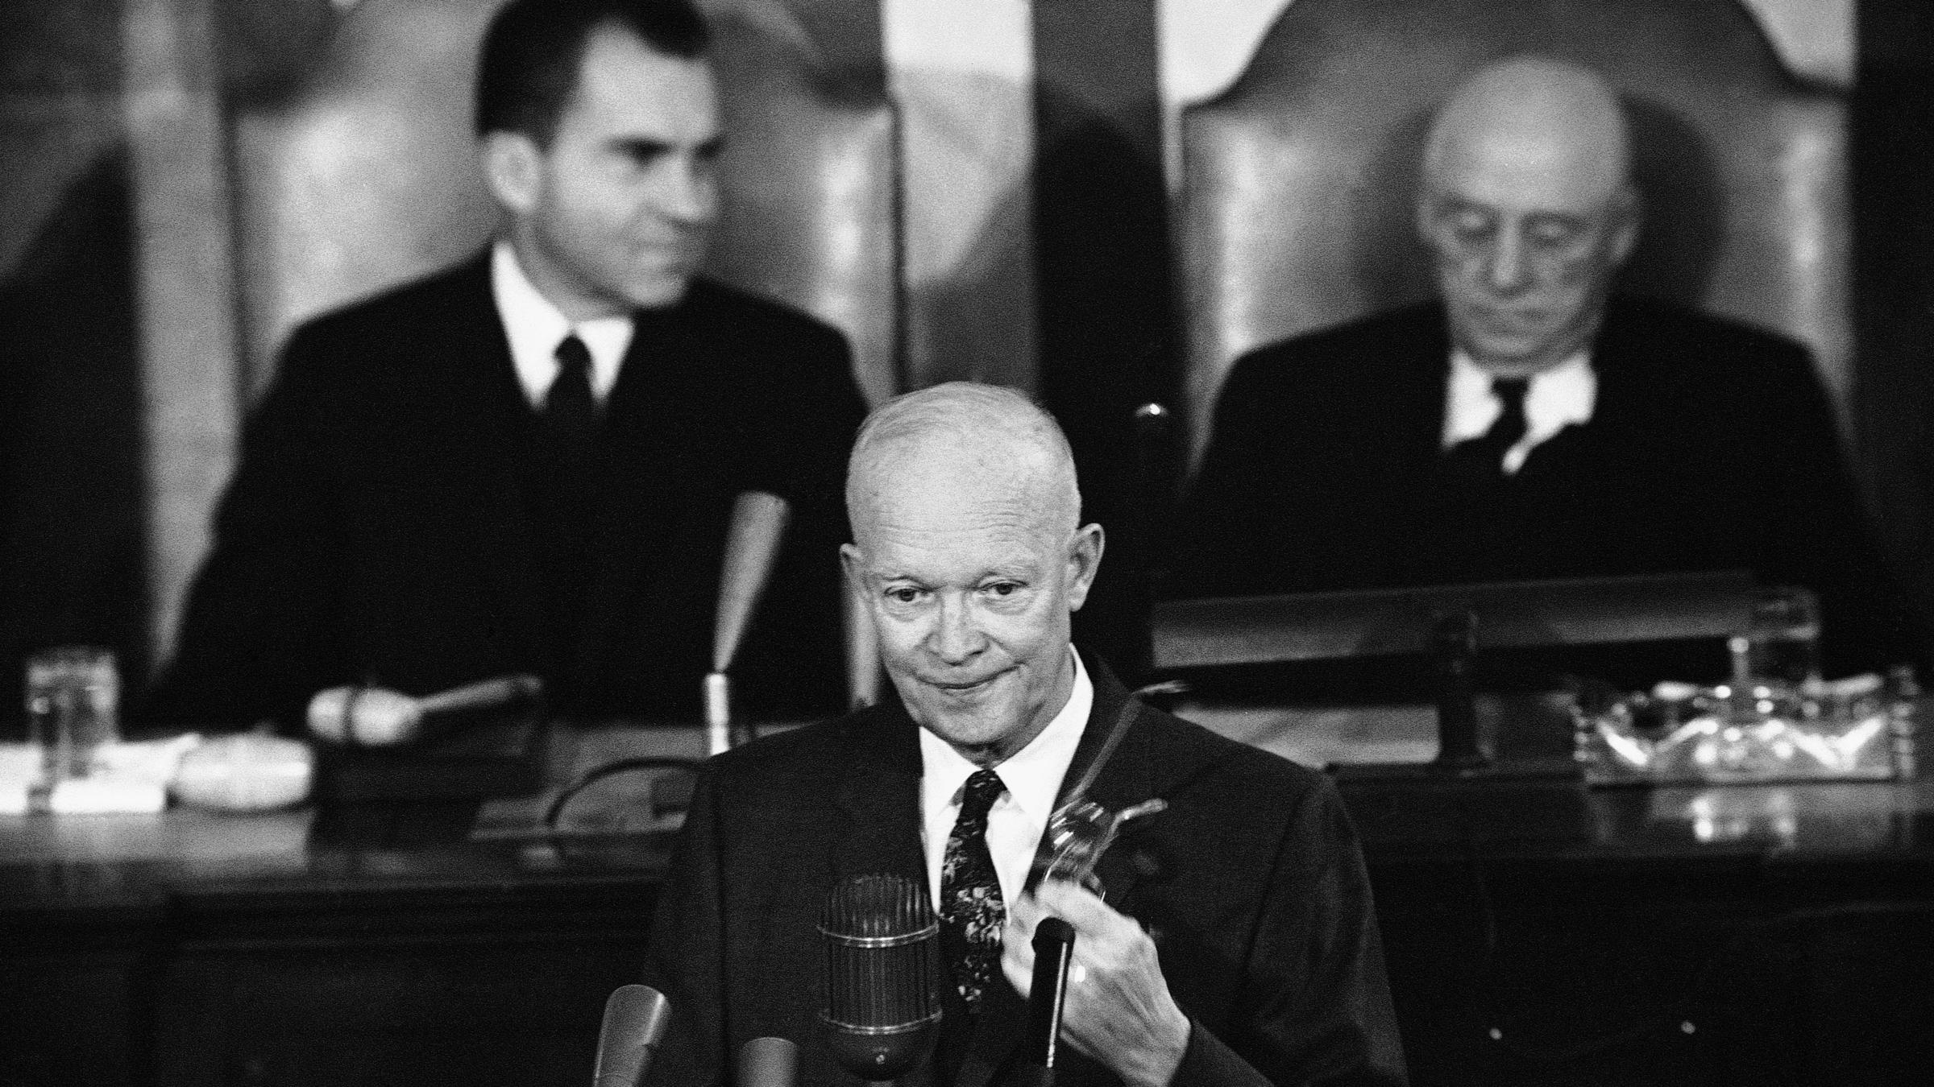
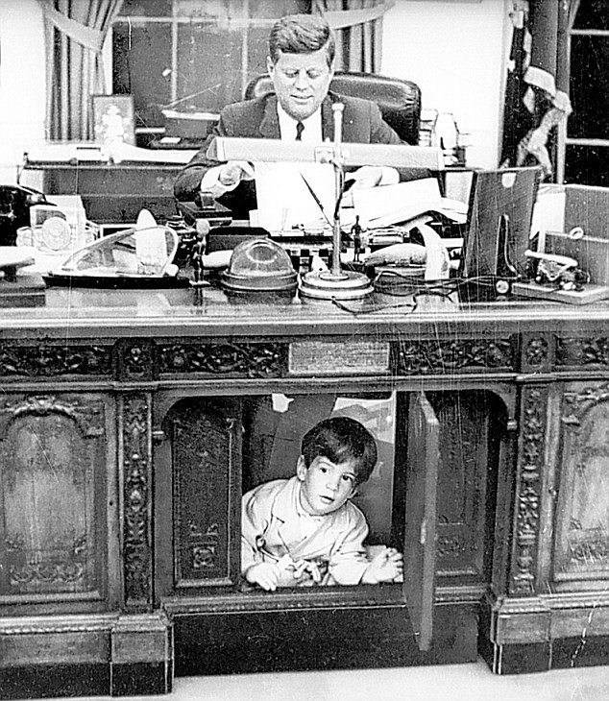
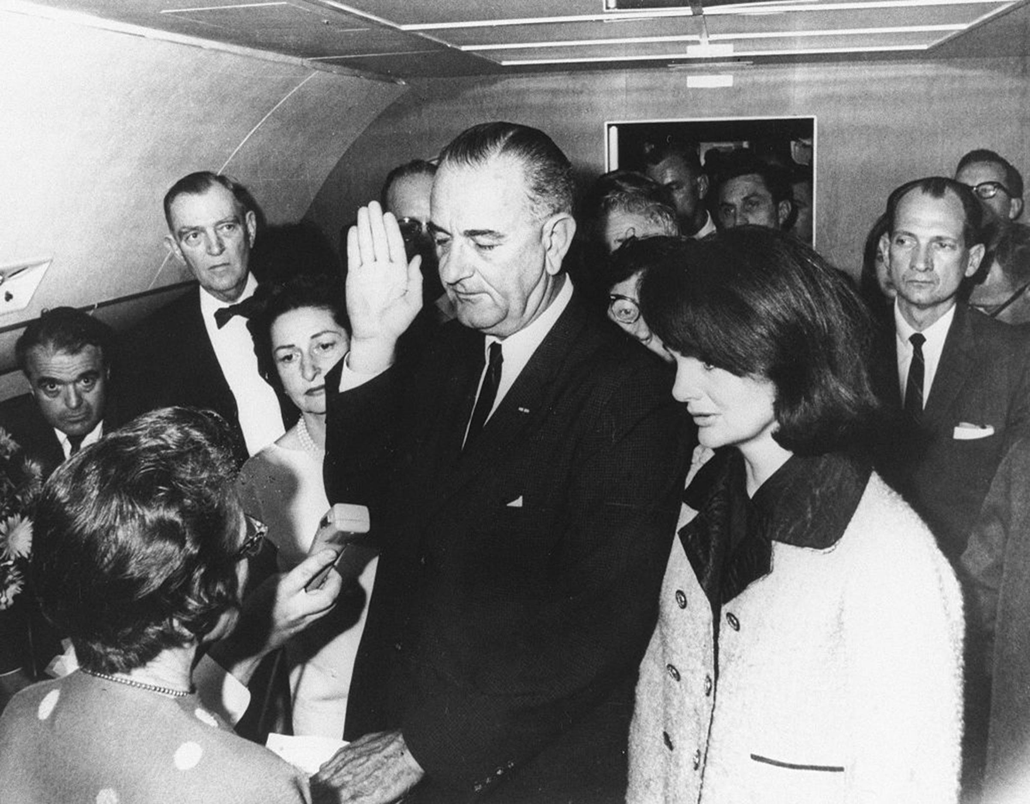
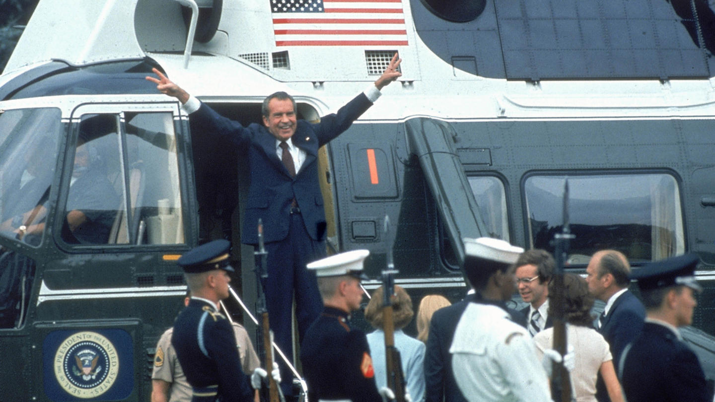
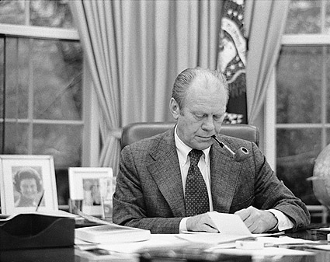
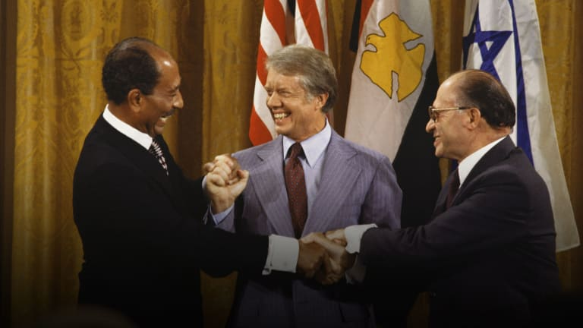
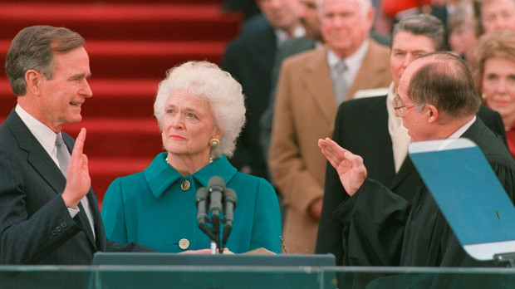
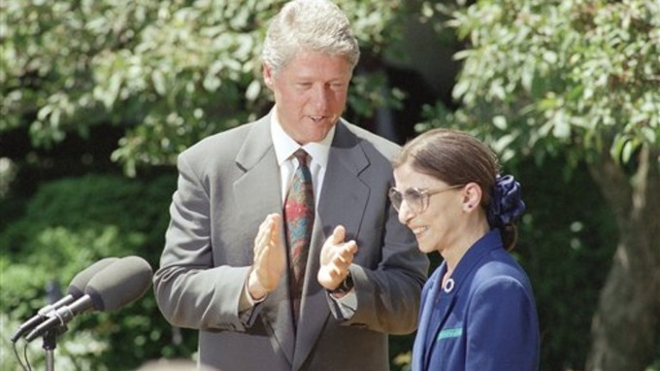
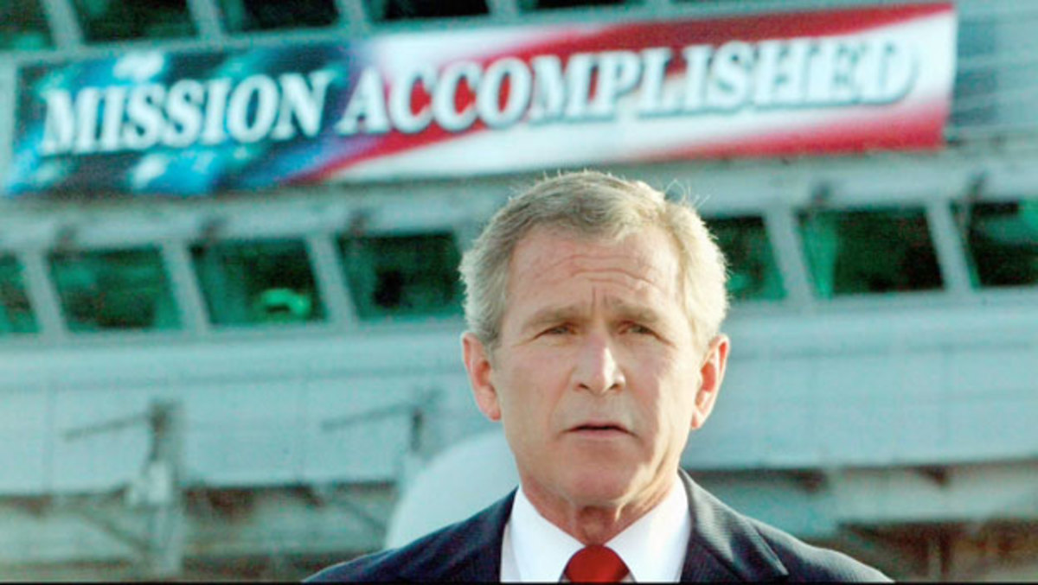
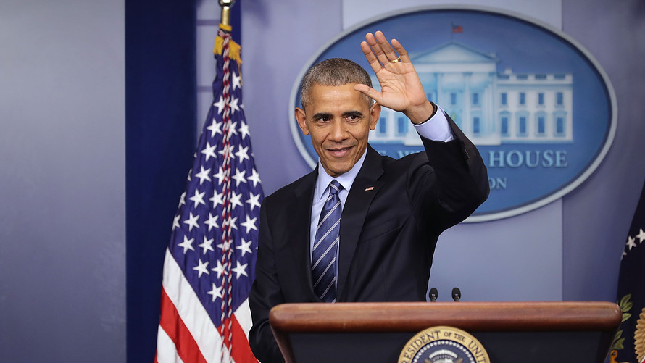
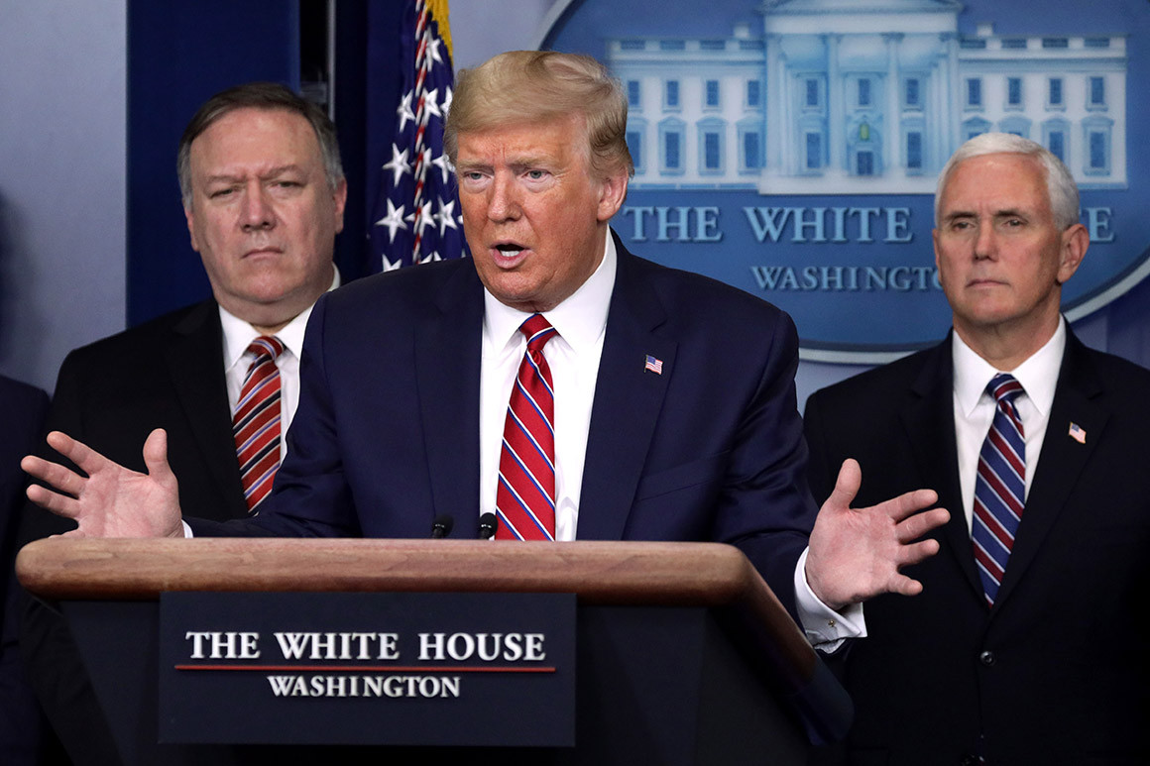
The Presidents of the 20th and 21st Centuries are Recognized here.
How many can you identify? What did they contribute to our nation?

Slide 3
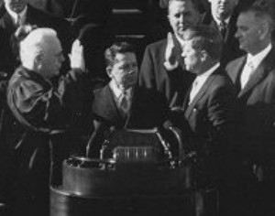
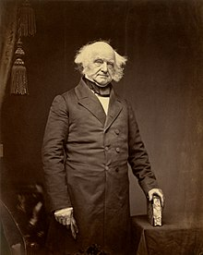
Constitutional Qualifications to become President of the United States
Must be at least 35 years old
Must have lived in the United States for 14 years
Must be a natural born citizen
President John F. Kennedy was the youngest president elected to office. He was 43 years old when he became president.
Martin van Buren was the 8th president, and first born as a U.S. citizen.

Slide 4
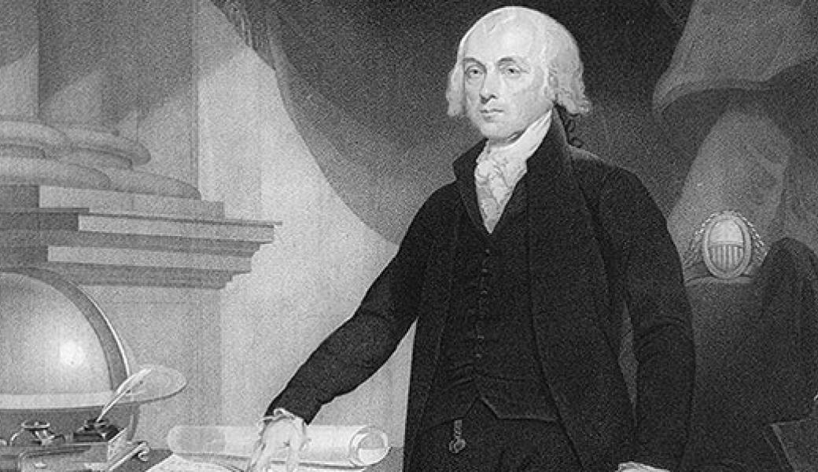
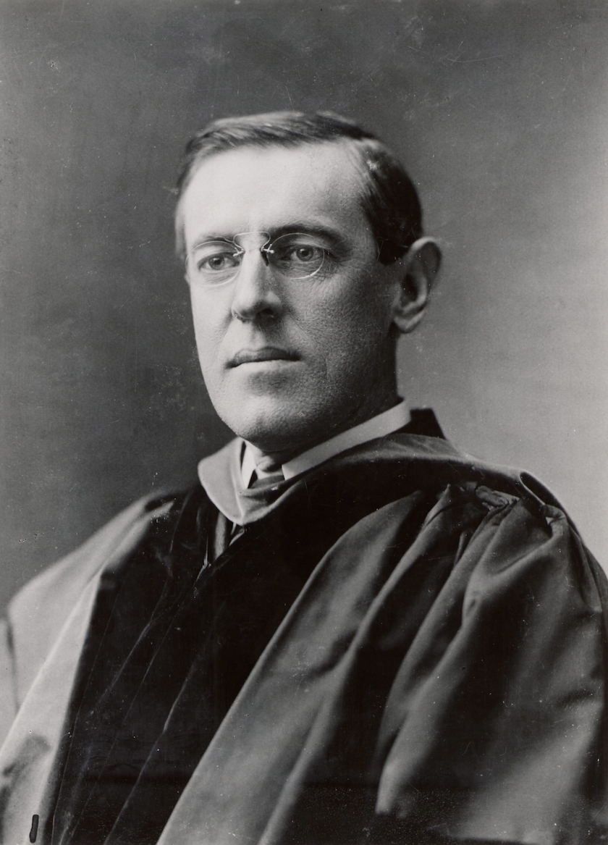
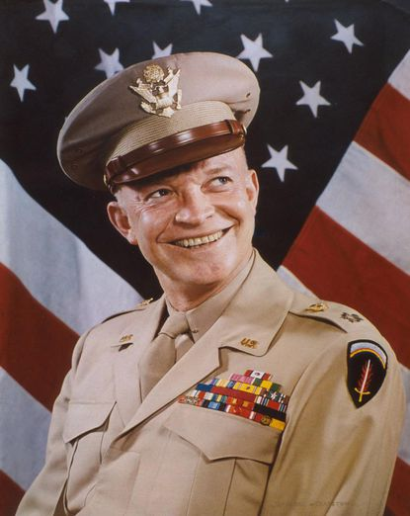
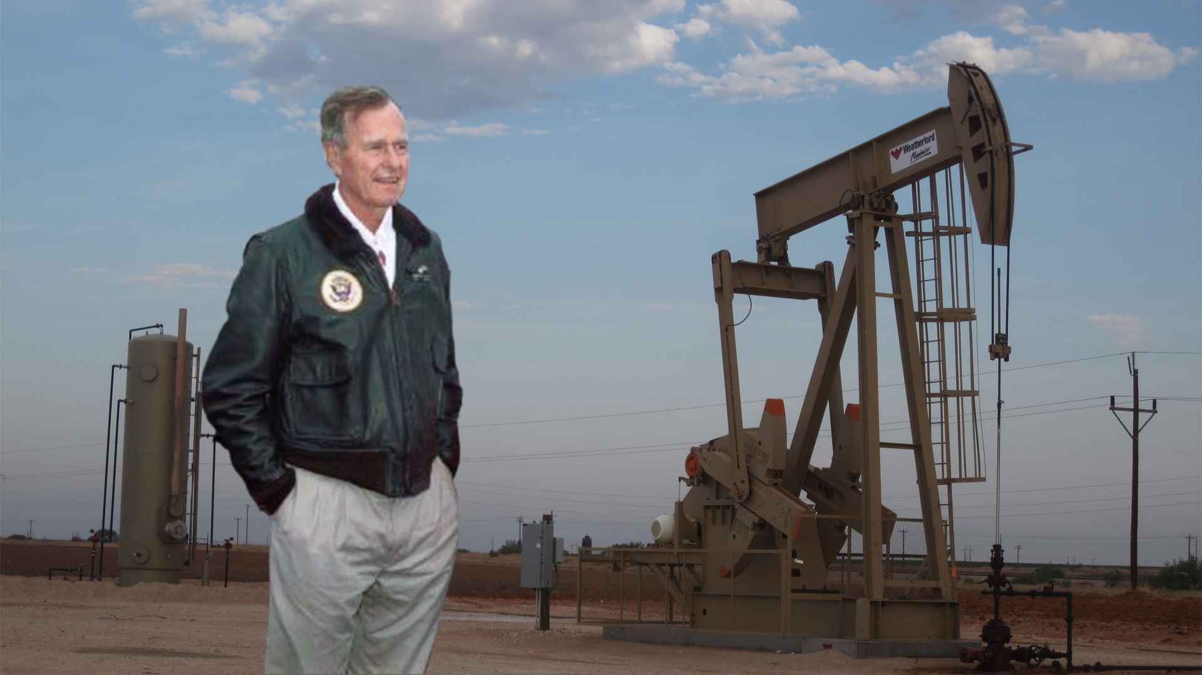
What people want in a president…most of the time!
Wealth / Financial Success (Self-reliant and focused on public good)
Moderate Political Views (Avoiding extremes)
Experience in a field (politics, military, law, business, or education)
All four of these presidents (Madison, Wilson, Eisenhower, and George HW Bush) were instrumental to our nation and led our nation through the war. They were quiet, focused, and driven to serve our country during difficult times.

Slide 5
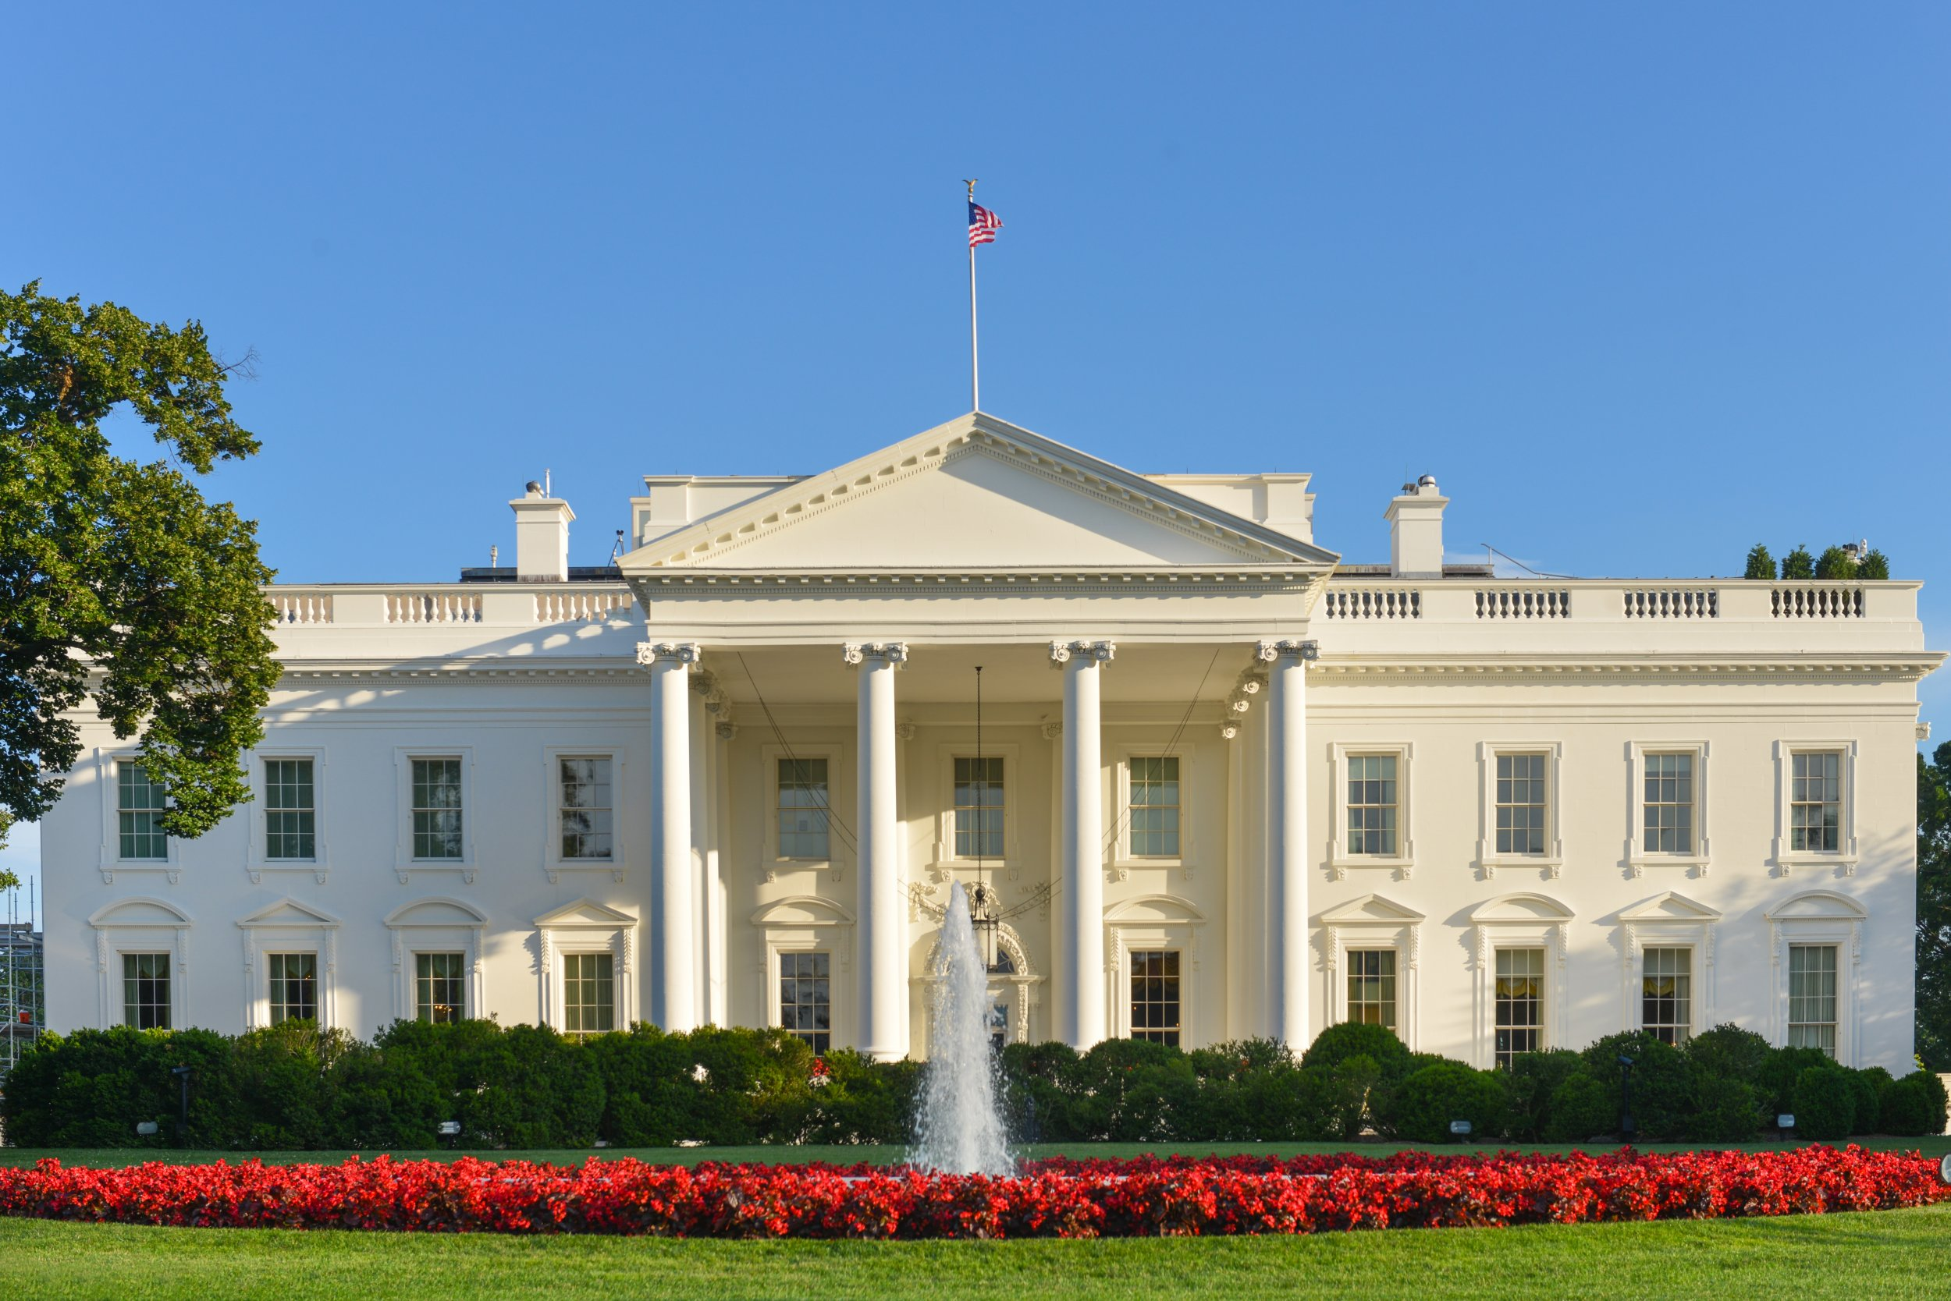
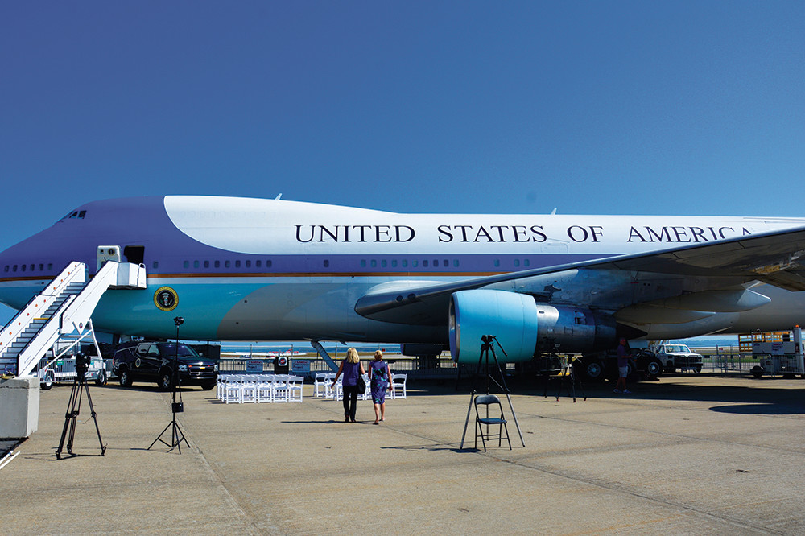
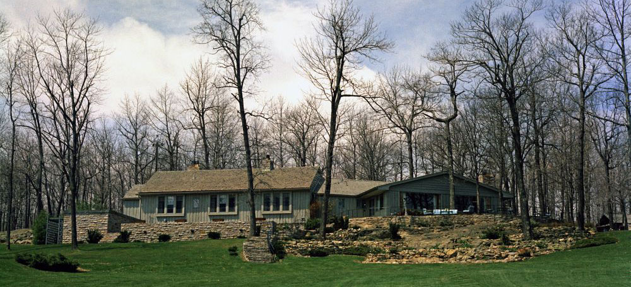
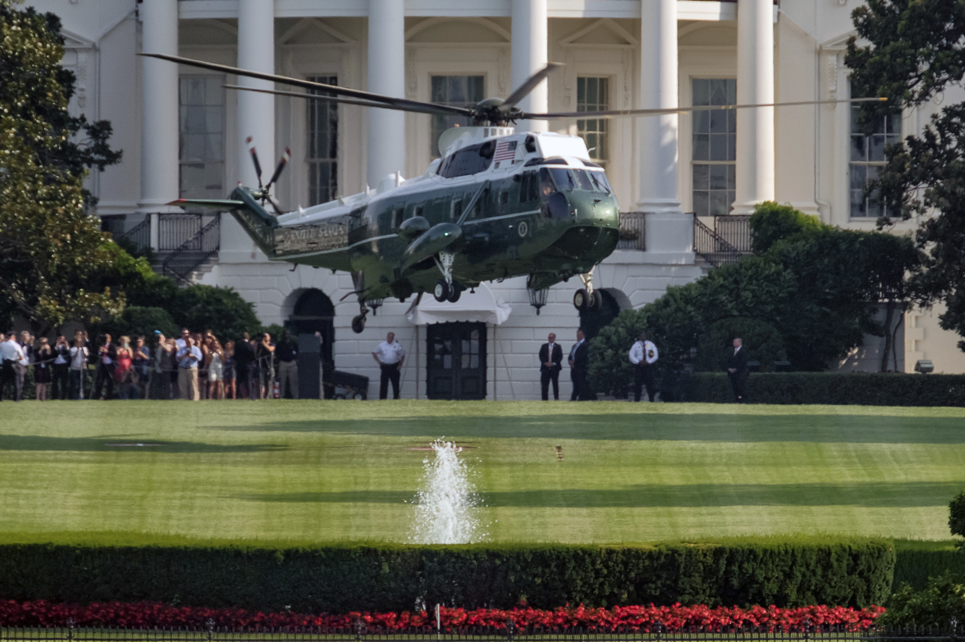
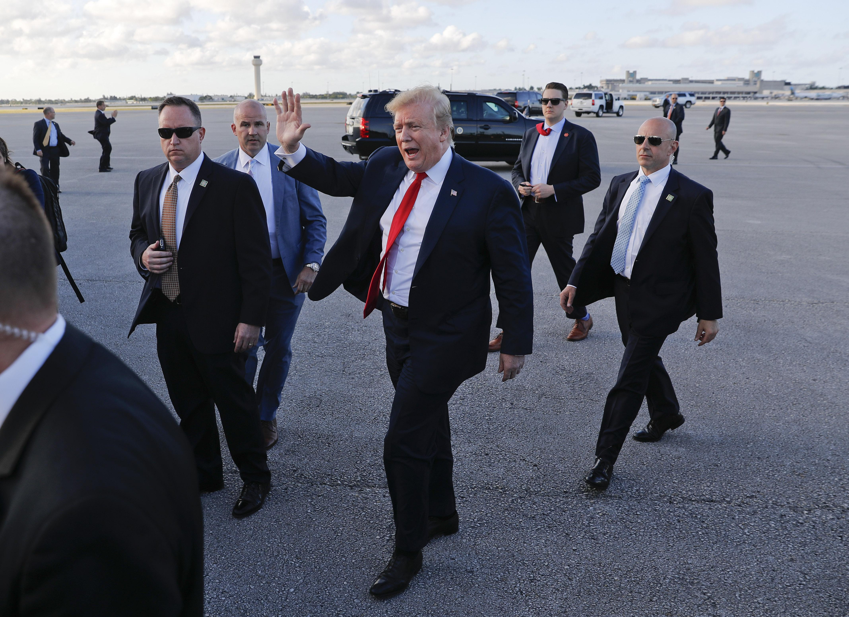
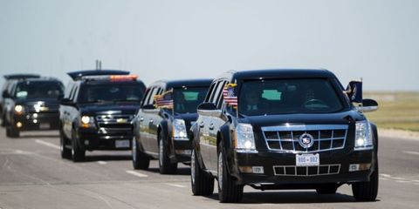
Presidential Benefits
$400,000 tax-free salary
$50,000/year expense account
$100,000/year travel expenses
$19,000/year entertainment
$200,000/year pension
Paid Healthcare
Residence in The White House
Secret Service protection
Camp David country estate
Air Force One personal airplane
Immediate Staff of 400-500

Slide 6
Functions of the Executive Branch
Article II of the Constitution sets out the structure and functions of the Executive Branch.
The Executive Branch contains POTUS, VP, and all those officials and offices they command.
Basic duty of the Executive Branch is to enforce the laws, treaties, and court decisions of the United States.
The President may use the armed forces to protect citizens, soldiers, or sovereign territory. Extended use of military action must be approved by Congress.
POTUS may also issue additional emergency powers in the event of a crisis to protect the country and maintain order.
The President cannot vote in Congress, but he does have the power to influence legislation. (State of the Union Address & Annual Executive Branch Budget Request)
Calling Congress into Special Session, which puts pressure on them to act.
Signing or vetoing bills. Historically, only about 5% of vetoed bills are successfully over-ridden by Congress.
Appoints ambassadors and diplomats, but they must be confirmed by the Senate (majority vote).
May act as a representative of the nation at international conferences.

Slide 7
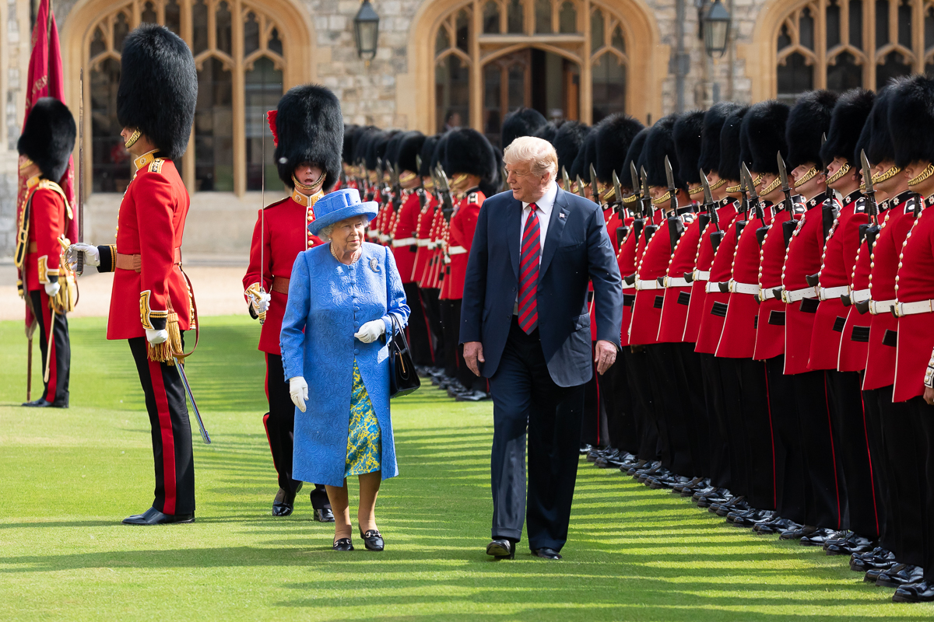
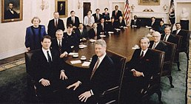
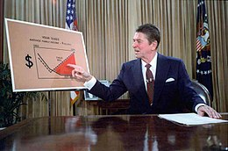
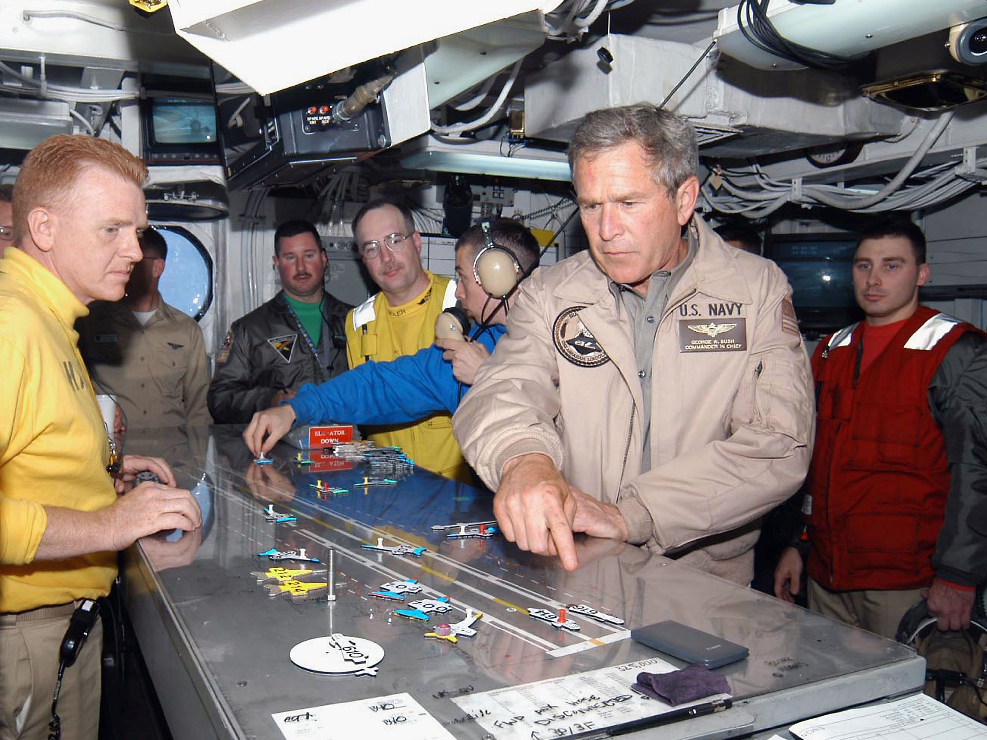
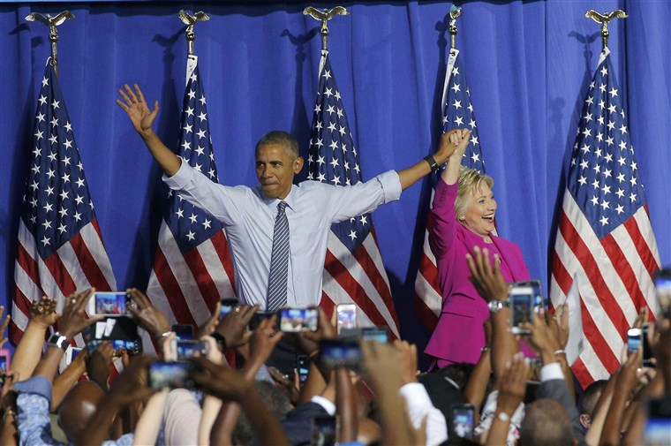

Slide 8
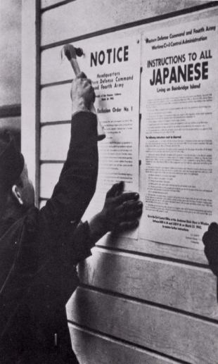
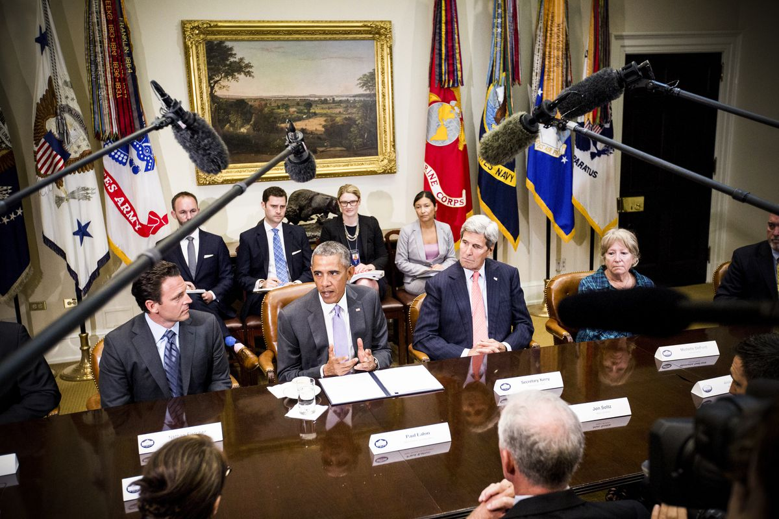
Informal Executive Powers
Those powers not explicitly written in the Constitution
Similar to “necessary and proper” powers of Congress
In the modern era (since 1933), the President’s informal powers may be significantly more powerful than his formal powers
Executive Orders
Executive Agreements
Orders issued by the President that carry the force of law. These directives are enforced by the Justice Department. An example of this would be Franklin Roosevelt’s executive order for Japanese Internment Camps.
International agreements, usually related to trade, made by a president that has the force of a treaty. It does NOT need Senate approval because it is not a treaty, but it only lasts through the president’s term in office. An example of this would be Obama’s Iran Nuclear Deal.

Slide 9
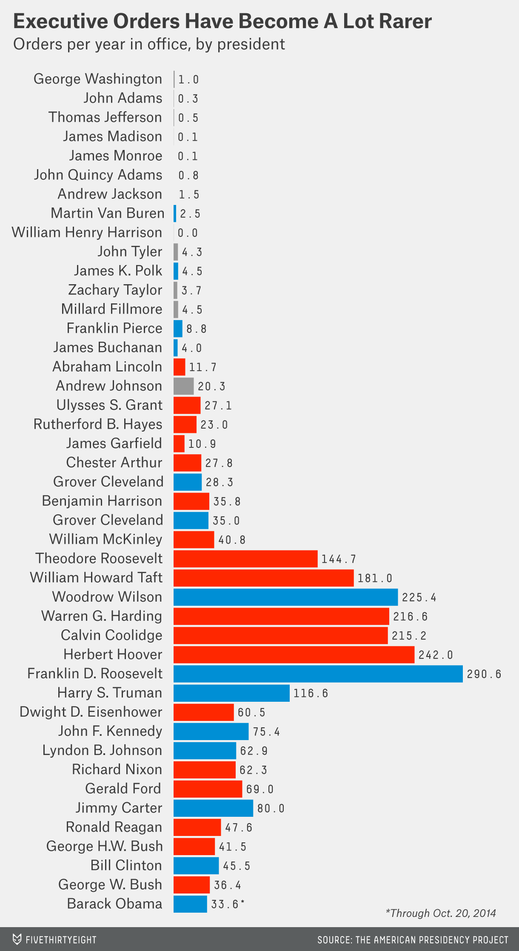
Executive Privilege
INFORMAL EXECUTIVE POWERS
Executive Orders and Executive Agreements are used more commonly during a crisis, or when the legislative and executive branches are at odds.
When things really get bad between the branches of government, a president can try to restrict transparency using the “executive privilege” order.
A statement insisting the president that he has the right to decide that the national interest will be better served if certain information is withheld from the public, including the Courts and Congress
United States v. Nixon (1973) – presidents do NOT have unqualified executive privilege (Nixon Watergate tapes).

Slide 10
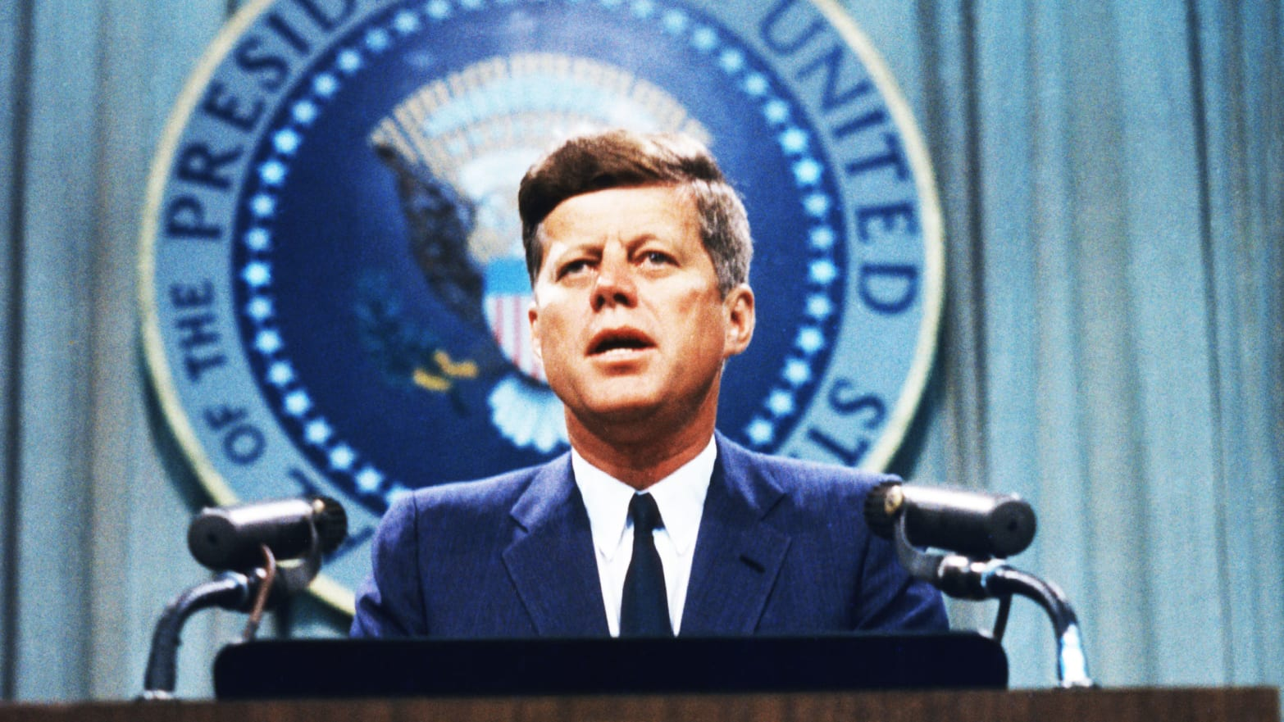
The Awesome Responsibility
"When I ran for Presidency of the United States, I knew that this country faced serious challenges, but I could not realize - nor could any man realize who does not bear the burdens of this office - how heavy and constant would be those burdens" --"Radio and Television Report to the American People on the Berlin Crisis (302),"
July 25, 1961, Public Papers of the Presidents: John F. Kennedy, 1961.

Slide 11
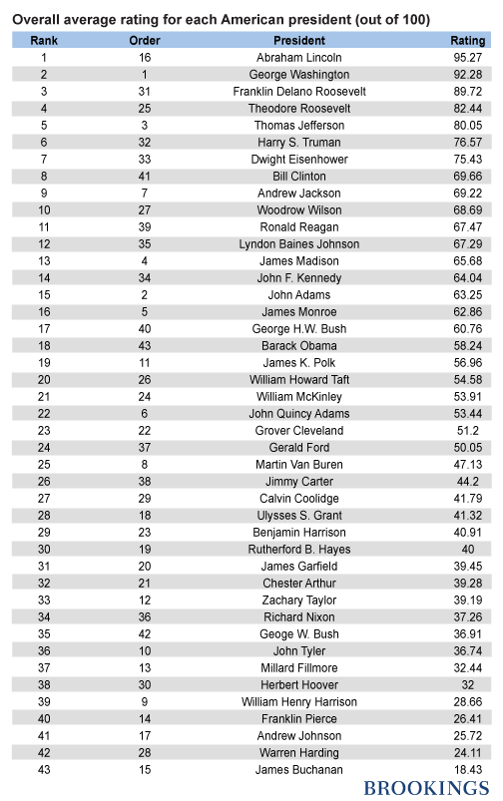
How would you rank the presidents? Pick five of the best and five of the worst. Compare with your classmates and provide reasons for your rankings.

Slide 12
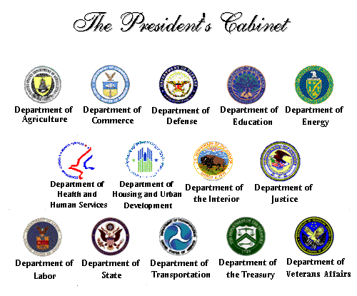
Who are they?
How are they selected?
What do they do?

Slide 13
The Role of the Cabinet
President selects cabinet
Cabinet – Presidential Advisors & Administration teams
Senate must approve all nominations – Check and Balance
Factors in choosing cabinet
Experience in Policy
Experience in their area/department
Administrative experience
Manage and supervise many people and programs
Support president’s plans
Loyalty to party and president
Support from various groups
Support from interest groups
Demographic Diversity
Represent different demographics (race/gender/location)

Slide 14
Public Policy
Public Policy – plan of action adopted by government decision makers
Solve a problem or reach a goal
Different agencies help conduct public policy
Bureaucracy – implement laws created by public policy
Liaison officers
Officers within cabinets
Officer who helps to make sure bills are being passed through congress
Supply information to information to law makers

Slide 15
Steps in the Process of Appointing Members of the Cabinet
Presidential nomination
White House review
Paperwork financial disclosure
FBI investigation
Senate confirmation hearings
Senate vote (majority needed)
Notes:
Image credit: Cabinet Seal [Web Graphic]. Retrieved from http://en.wikipedia.org/wiki/United_States_Cabinet

Slide 16
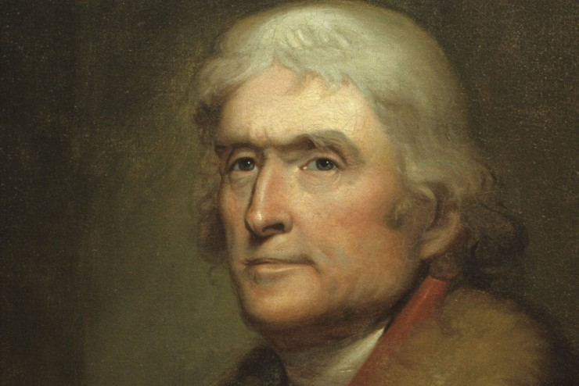
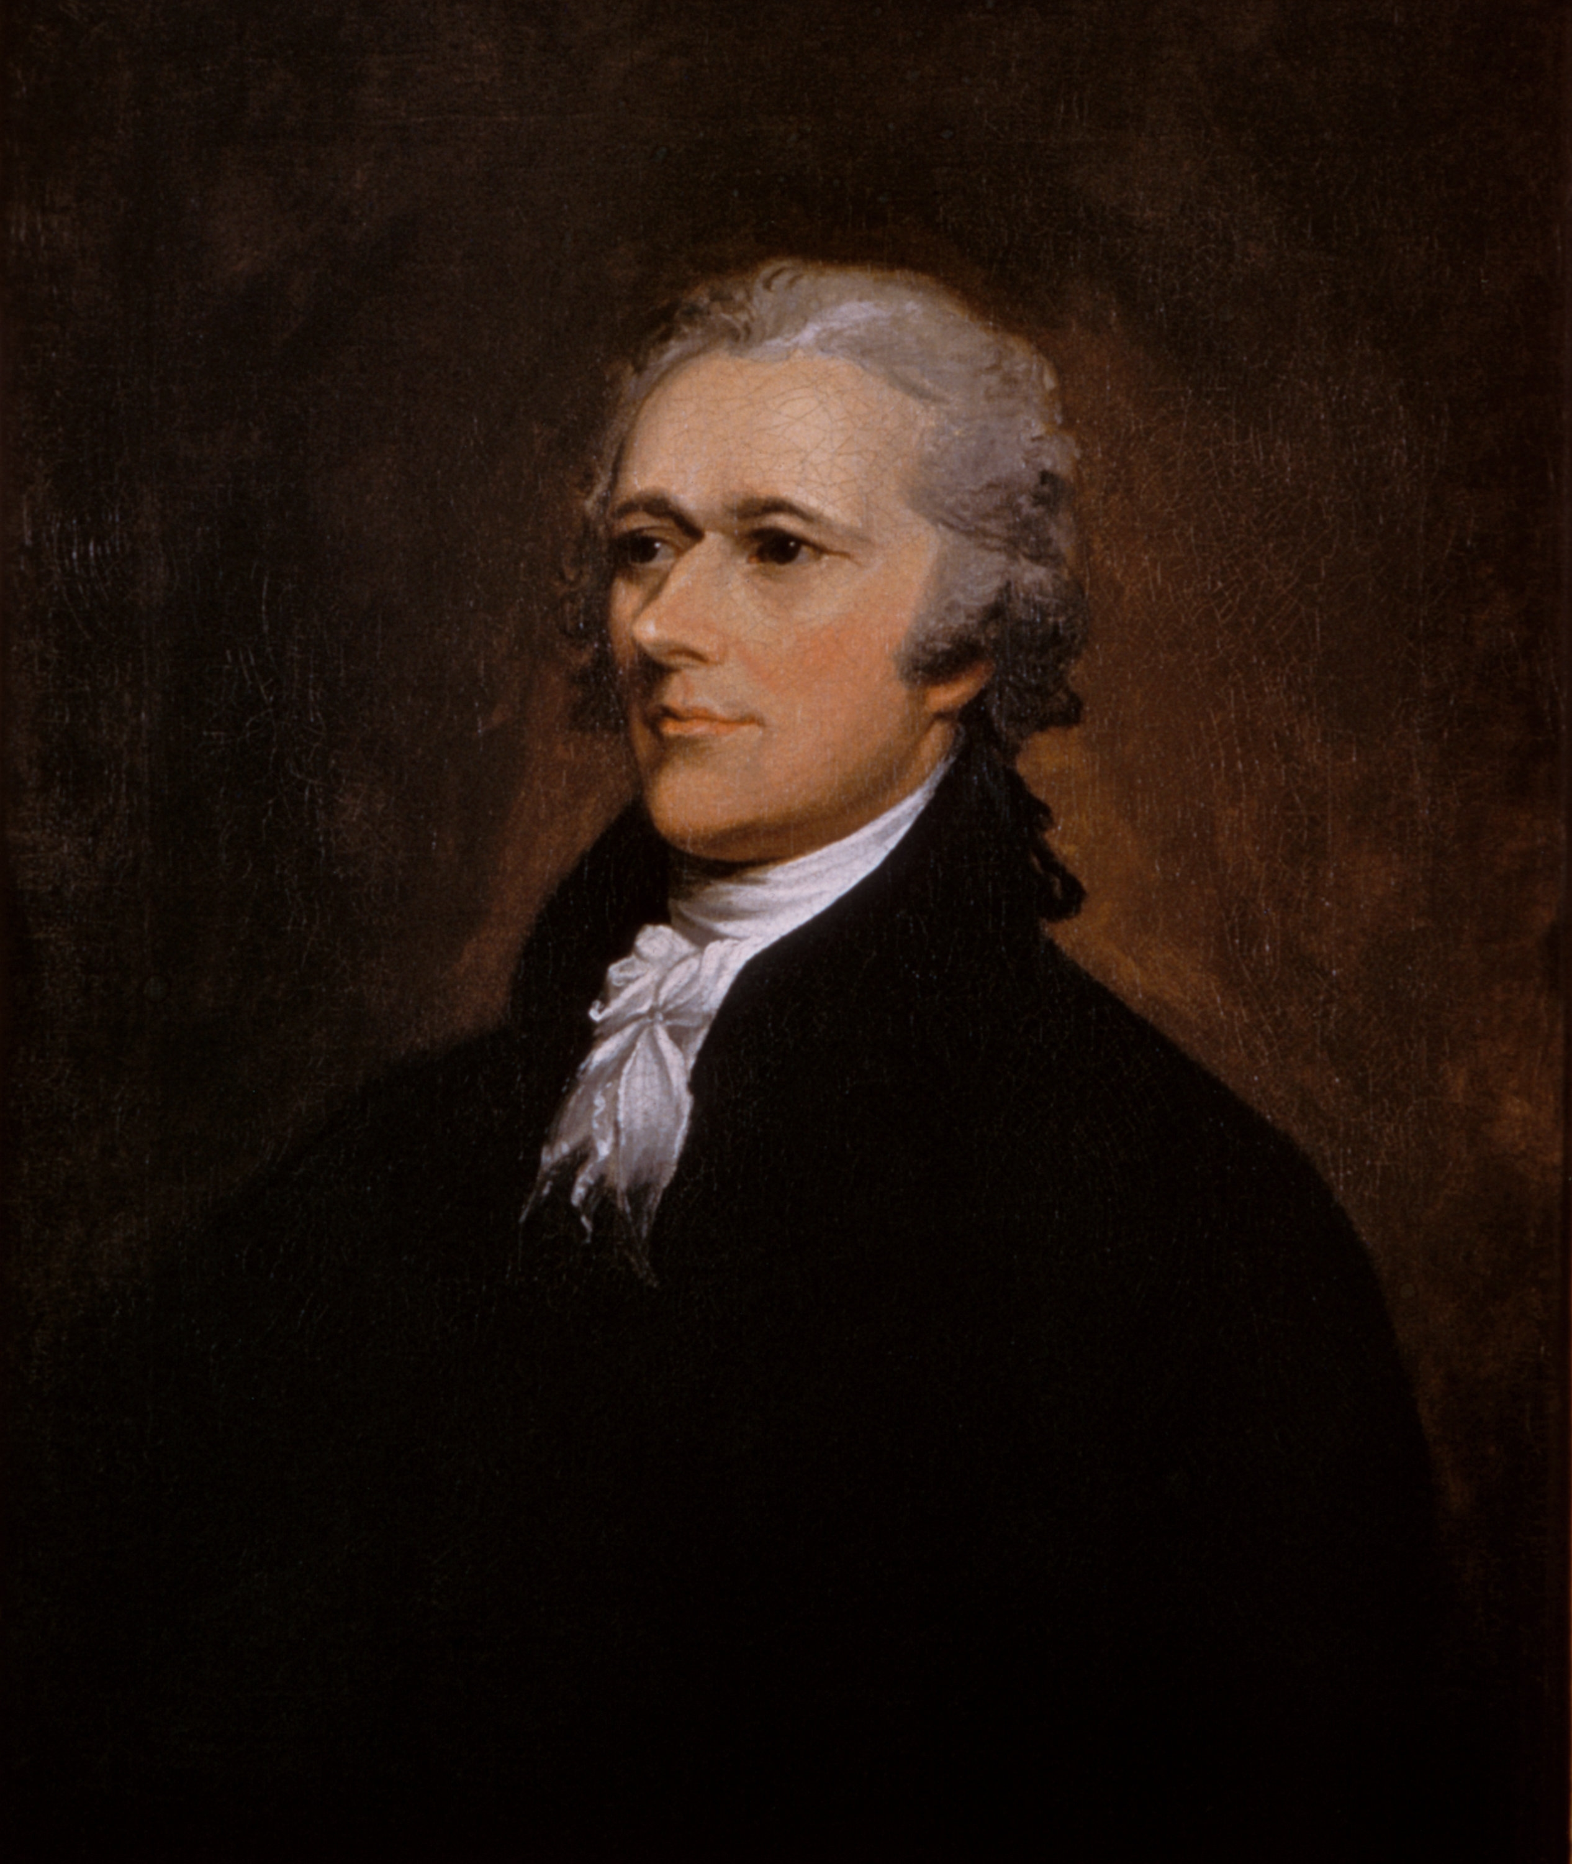
The First Executive Departments: George Washington’s Presidency
Department of State - Secretary of State Thomas Jefferson
Department of the Treasury - Secretary of the Treasury Alexander Hamilton
Department of War - Secretary of Defense Henry Knox
Office of the Attorney General - Edmund Randolph -became the Department of Justice in 1870

Slide 17
Office of the White House
Group of advisers “Inner Circle”
Political strategy, communicate on behalf of the president, run day-to-day operations
People are chosen without Senate approval
Close associates and/or experts in policy
Chief of Staff – most trusted consultant
Oversees operations of the White House
Political strategy, affect of policy decisions
Press Secretary – handle relations with the press
In charge of releasing information to the Press
Responding to press inquiries relating to White House policy
President Trump discussing policy with his son-in-law Jared Kushner and former Chief of Staff John Kelly looking on.

Slide 18
Department of State, Treasury, & Homeland Security
Handles the foreign policy of the nation
Staffs embassies
Analyzes data about American interests in other nations
Speaks for the United States at the United Nations
Charged with protecting the security of America’s borders, shores, land and the safety of its people
Newest department created in 2002 after September 11, 2001

Slide 19
Department of Justice & Defense
Oversees the nation’s legal affairs
Supervises the agencies that serve as the nation’s police and prison system
Enforces antitrust laws
Notes:
Image credit: Cabinet Seal [Web Graphic]. Retrieved from http://en.wikipedia.org/wiki/United_States_Cabinet

Slide 20
Department of Interior & Agriculture
Protects the public lands and natural resources throughout the United States
Oversees relationships with American Indian nations
Helps farmers improve incomes and production for home and abroad
Develops conservation programs
Safeguards the nation’s food supply

Slide 21
Department of Commerce & Labor
Promotes and protects the industrial and commercial parts of the economy
Carries out the census

Slide 22
Department of Health and Human Services & Housing and Urban Development
Oversees programs concerned with health and social services of the American people
Manages federal Medicare and Medicaid

Slide 23
Department of Transportation and Energy
Regulates America’s transportation needs, policies and planning
Works to ensure safe, efficient, and convenient land, sea, rail, and air transportation including monitoring inland waterways and highways
Notes:
Image credit: Cabinet Seal [Web Graphic]. Retrieved from http://en.wikipedia.org/wiki/United_States_Cabinet

Slide 24
Department of Education & Veteran Affairs
Establishes policy for, administers and coordinates most federal assistance to education, collects data on US schools, and enforces federal educational laws regarding privacy and civil rights
Its mission is: to promote student achievement and preparation for global competitiveness by fostering educational excellence and ensuring equal access

Slide 25
Other Agencies working within the Executive Branch include the following:
NASA – National Aeronautics and Space Administration
Government Corporations – businesses the Federal government operates
FDIC – Federal Deposit Insurance Corporation
USPS – United States Postal Service
Commissions –
independent agencies that have government’s authority to issue licenses and issue fines and charges
FCC – Federal communication commission
EPA – Environmental Protection Agency
FTC – Federal Trade Commission
FEC – Federal Election Commission

